Slide 1
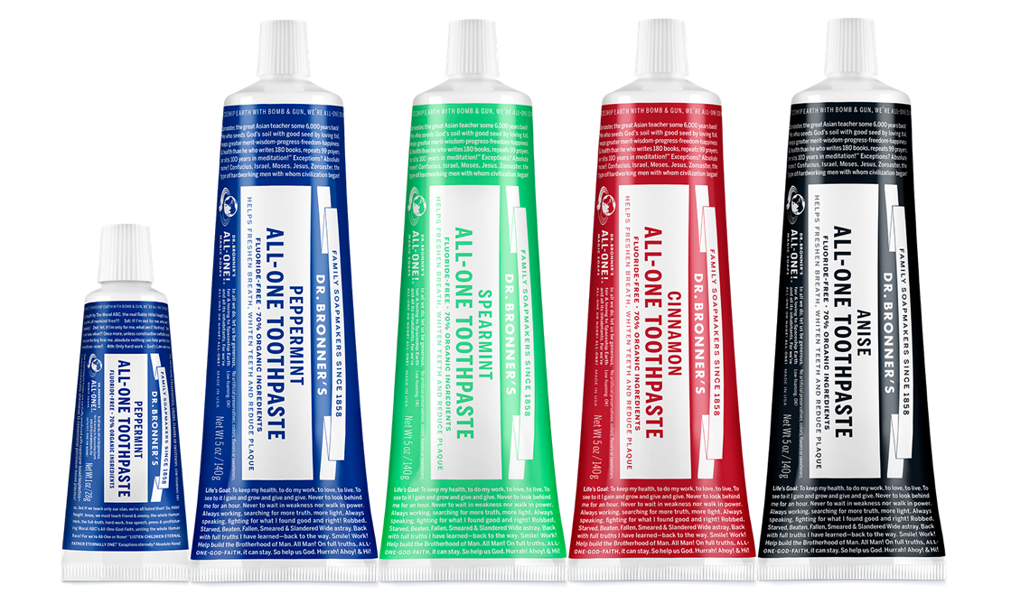
All-one toothpaste
No detergents or foaming agents—brush with trust!
FLAVORS: Peppermint, Spearmint, Cinnamon & Anise SIZES: 1 oz. (Peppermint only) & 5 oz.

Slide 2
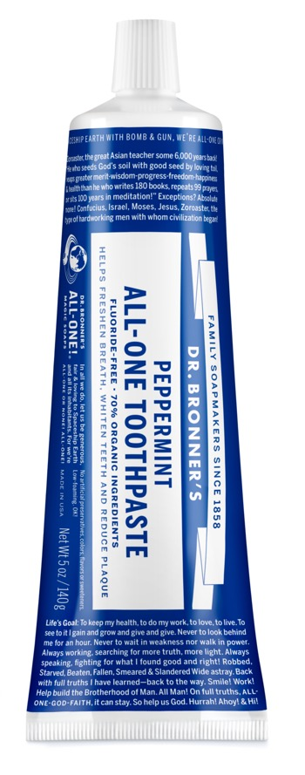
ALL-ONE TOOTHPASTE
70% organic ingredients
Fluoride-free and SLS-free!
Organic menthol crystals freshen breath naturally
Flavored with pure organic essential oils
Made with fair trade & organic coconut oil
Made with organic coconut flour
Organic aloe helps soothe gums
Certified vegan and cruelty-free!
No artificial preservatives or colors
No artificial flavors or sweeteners
No synthetic detergents or foaming agents
Box made from 100% recycled paper, with a minimum of 35% post-consumer fiber
Among the first companies to use 100% HDPE plastic made partially from sugarcane for 5 oz tubes as well as TSA-compliant 1 oz. tubes
50% of tube comes from sugarcane—a more sustainable alternative to conventional petroleum-based plastics
Ingredients: Organic Glycerin,*** Organic Aloe Barbadensis Leaf Juice, Hydrated Silica, Calcium Carbonate, Xanthan
Gum, Sodium Bicarbonate (Baking Soda), Potassium Cocoate (made with Organic Coconut Oil*), Organic Essential
Oils,** Organic Menthol Crystals, Organic Coconut Flour, Organic Coconut Oil,* Tocopherol, Citric Acid, Organic Stevia
Rebaudiana Leaf Extract
*CERTIFIED FAIR TRADE INGREDIENTS
**Essential oils vary by scent. / ***Sourced from Organic Soy

Slide 3
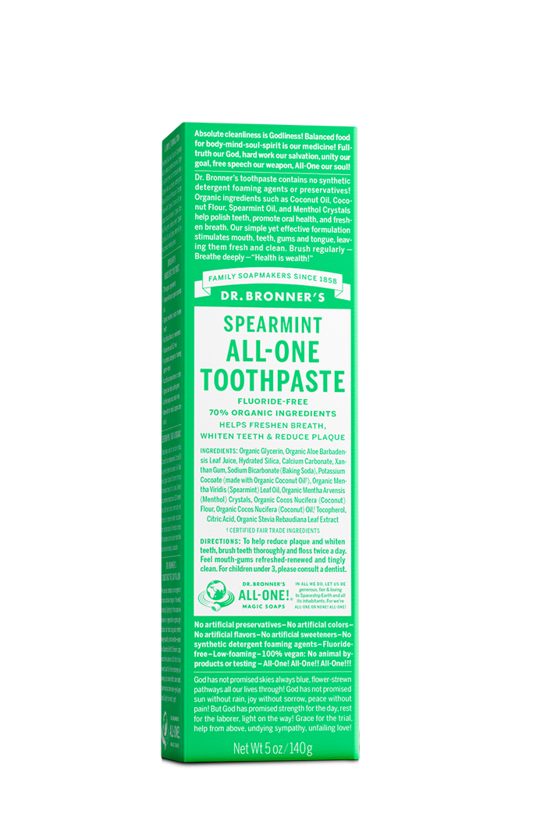
EVERY INGREDIENT HAS AN IMPORTANT FUNCTION
A SIMPLE FORMULATION: Hydrated Silica and Calcium Carbonate act as natural, gentle abrasives that help to remove plaque, while Organic Aloe Juice helps to soothe irritated gums. Baking Soda and Potassium Cocoate (made with our own Organic & Fair Trade Virgin Coconut Oil) are superb natural cleansers. Organic Essential Oils provide refreshing flavor.
BENEFIT | DR. BRONNER’S ALL-ONE TOOTHPASTE
Whitens Teeth | Baking Soda (Sodium Bicarbonate), Hydrated Silica
Anti-plaque | Calcium Carbonate, Hydrated Silica
Cleaning | Potassium Cocoate, Baking Soda (Sodium Bicarbonate), Organic Coconut Oil
Freshens Breath | Organic Menthol Crystals
Polishing | Organic Coconut Flour, Organic Fair Trade Coconut Oil, Hydrated Silica
Soothes Gums | Organic Aloe Leaf Juice

Slide 4
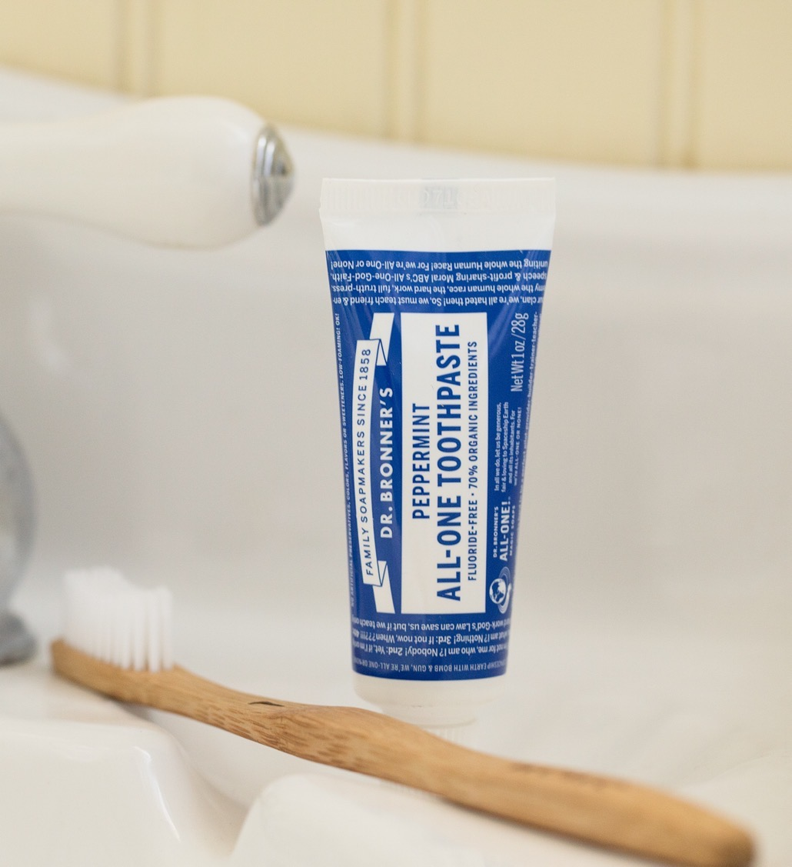
ONLY THE BEST INGREDIENTS, WHICH MEANS YOU WON’T FIND:
Carrageenan
Artificial colors
Artificial flavor
Synthetic detergent foaming agents
Synthetic preservatives
Artificial sweeteners
Gluten
Fluoride
Animal products
Notes:
Structure is from coconut flour and glycerin
No colors or bleaching agents
Flavors are only from essential oils
(we'll get into foaming in more detail in a later topic)
- most of us get more than sufficient flouride through our water and dental visits
completely vegan
All this adds up to a highly effective, simple, straightforward toothpaste. Nothing unnecessary

Slide 5
As seen in:
These Are Allure Editors’ Favorite New Beauty Products for 2020
Dr. Bronner’s Unveils New Toothpaste
7 Cruelty-Free Toothpaste Brands
The Best Natural Toothpaste, According to Dentists
Dr. Bronner's Travel-Size Toothpaste
Notes:
MSN Lifestyle
https://www.msn.com/en-us/lifestyle/beauty/the-best-natural-toothpaste-according-to-dentists/ss-BB1fRIwS#image=8
Gear Junkie
https://gearjunkie.com/emerging-gear/emerging-gear-08-26-2021/Dr.+Bronner%27s+Travel-Size+Toothpaste

Slide 6
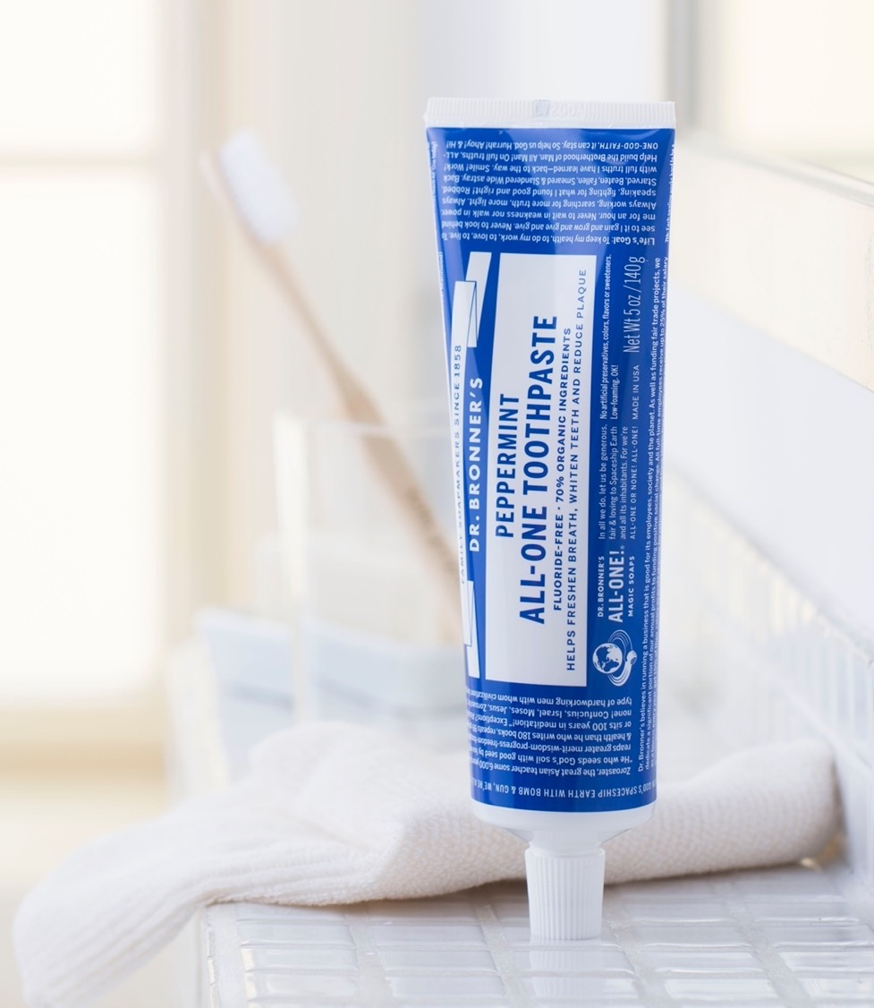
As seen in:
Dr. Bronner’s Spearmint Toothpaste Looks to Freshen Smiles
New Products
In the Aisle… What to Stock

Slide 7
Toothpaste faqs
What does Spearmint taste like?
Dr. Bronner’s All-One Spearmint Toothpaste, made with organic spearmint oil and organic menthol crystals, leaves your mouth with a long-lasting mellow-minty-fresh-clean feeling.
What does Peppermint taste like?
Dr. Bronner’s All-One Peppermint Toothpaste, with a bold peppermint flavor from organic peppermint oil and organic menthol crystals, stimulates mouth and gums with a cool, crisp sensation.
What does Cinnamon taste like?
Dr. Bronner’s All-One Cinnamon Toothpaste creates a warm, spicy feeling from the organic cinnamon oil, combined with a freshness from the organic menthol crystals.
What does Anise taste like?
Dr. Bronner’s All-One Anise Toothpaste has slightly sweet, slightly herbal flavor from the organic anise oil, combined with a freshness from the organic menthol crystals.
Why was there no silver seal on the toothpaste?
We have recently discontinued the use of the silver seal, as customers have shared that it can be excessively difficult to remove. Because the toothpaste is already packaged in a protective sealed box, the silver seal is wholly unnecessary and allows us to reduce waste.
Why is there glycerin in the toothpaste? Glycerin gives the toothpaste its smooth texture as well as it’s structure. Although reports abound online about glycerin damaging tooth enamel, there are not scientific studies to support this.
What is the glycerin in the toothpaste derived from? The glycerin used in our All-One Toothpaste has been sourced from non-GMO and organic soy since 2018.
Is the toothpaste tube and cap recyclable? Our toothpaste tubes have been third party tested to meet Association of Plastic Recyclers’ critical guidance requirements and meet APR’s critical guidance for recyclability. While this speaks to the compatibility of our toothpaste tubes with HDPE bottle recycling, it does not speak to collection of used tubes or include other tubes in the market that may conflict with the HDPE bottle recycling process, thus we encourage you to check locally. The industry is having ongoing conversations around tube recyclability so this may change in the future. In the meantime, we are maximizing the amount of material from renewable resources to reduce the amount of plastic in our tubes. Overall, the tubes (including cap) are 33% biobased with the remainder of the material being HDPE and PE.
Notes:
Over 75% of the US population receives fluoridated water through their local water supply. This is a universal dose given to large and small people equally. Using a fluoride free toothpaste gives people the ability to control/reduce their fluoride intake.
Fluoride should not be swallowed so this makes the toothpaste safe for those who are learning to brush and spit.
Carrageenan can be used as a binder in toothpaste but because of the sensitivities of some consuemers, we decided to use xanthan gum instead.

