Slide 1
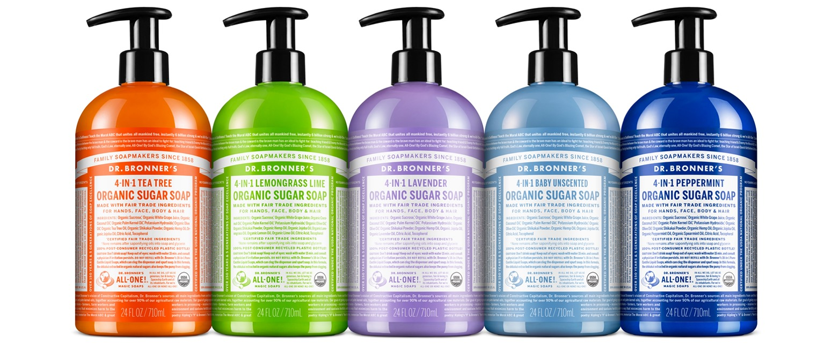
Organic Sugar Soap
Rich lather in no-clog pump—keep skin-hair hydrated & smooth!
12 OZ. & 24 OZ. SUGAR SOAPS AVAILABLE IN:
Tea Tree, Lemongrass Lime, Lavender, Baby Unscented & Peppermint

Slide 2
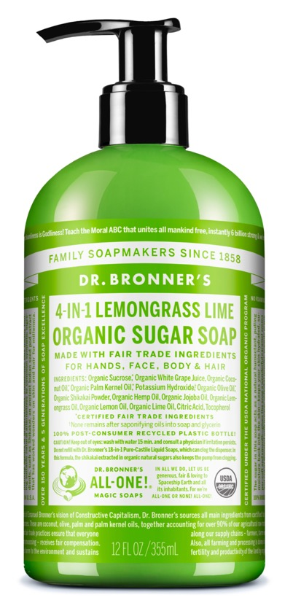
Organic Sugar Soap
Fair trade & USDA certified organic
Organic white grape juice keeps hands-face-body-hair clean-nourished-hydrated-smooth!
Organic sugar creates a rich caramel color and sweet scent, functions as a natural humectant and exfoliant
Organic coconut-olive-hemp seed-jojoba oil makes a creamy castile lather
Organic shikakai powder with a low pH is traditionally used for hair care in India—mild on scalp and hair
Now made with U.S.-grown hemp seed oil!
Follow with our Citrus Organic Hair Rinse for silky smooth hair!
Ingredients: Organic Sucrose,* Organic White Grape Juice, Organic Coconut Oil,* Organic Palm Kernel Oil,* Potassium Hydroxide,† Organic Olive Oil,* Organic Shikakai Powder, Organic Hemp Seed Oil, Organic Jojoba Oil, Organic Essential Oils,** Citric Acid, Tocopherol
*CERTIFIED FAIR TRADE INGREDIENTS
†None remains after saponifying oils into soap & glycerin. / **Essential oils vary by scent.
Made with U.S.-grown hemp seed oil! Sugar Soaps are packaged in 100% post-consumer recycled plastic bottles.

Slide 3
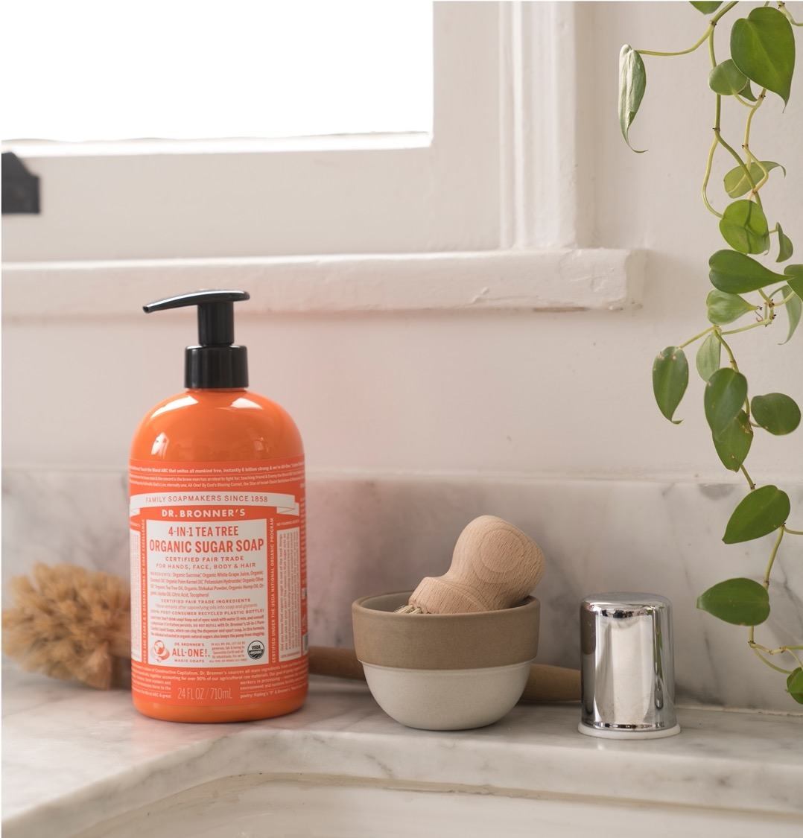
SUGAR SOAP PACKAGING
Ready-to-use pumps and 100% Post Consumer Recycled plastic bottle
Easy dispensing
Locks for transport
Great for by the sink or in the shower
No need to dilute

Slide 4
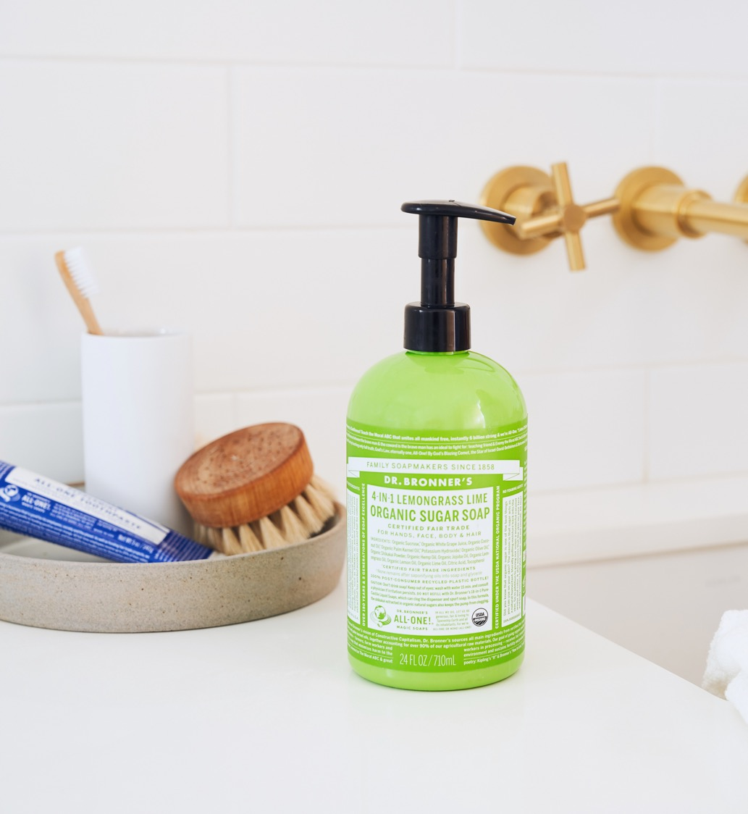
As seen in:
The Best Hand Soap for Washing Your Hands Non-Stop
Watch Liza Koshy Share her Nightly Skin Care Routine
HEALTH & WELLNESS: 12 Hand Soaps That Are Effective at Killing Germs and Hydrating Your Hands

Slide 5
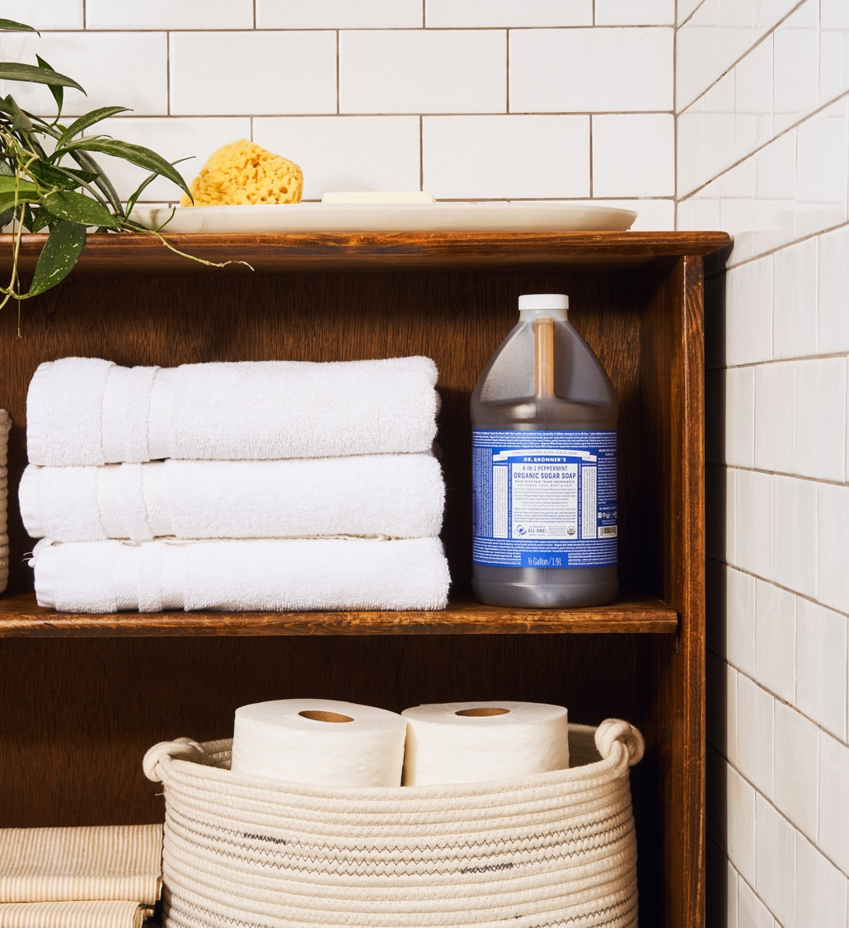
As seen in:
Why you should really consider natural cleaning products
The 20 Best Body Washes for Skin-Nourishing Results
Liza Koshy Swears By This Double-Sided Pencil for ‘Incredible’ Brows
The Best Organic Body Wash of 2021
Notes:
CNN - https://www.cnn.com/2021/08/26/cnn-underscored/all-natural-cleaning-products/index.html
Women’s Wear Daily - https://wwd.com/shop/shop-beauty/best-body-washes-1234710145/
Glamour - https://www.glamour.com/story/liza-koshy-one-of-one-by-cest-moi-brow-pencil
TreeHugger - https://www.treehugger.com/best-organic-body-wash-5182302

