Slide 1
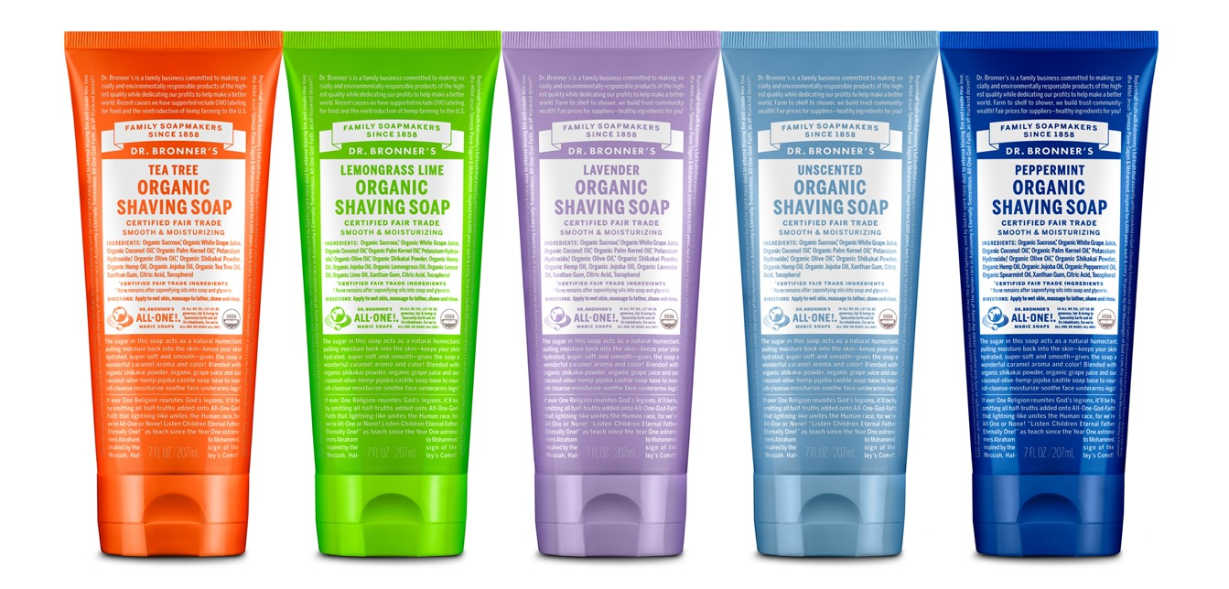
ORGANIC SHAVING SOAP
Give your skin a treat! Moisturize while you shave!
7 OZ. SHAVING SOAPS AVAILABLE IN: Tea Tree, Lemongrass Lime, Lavender, Unscented & Peppermint

Slide 2
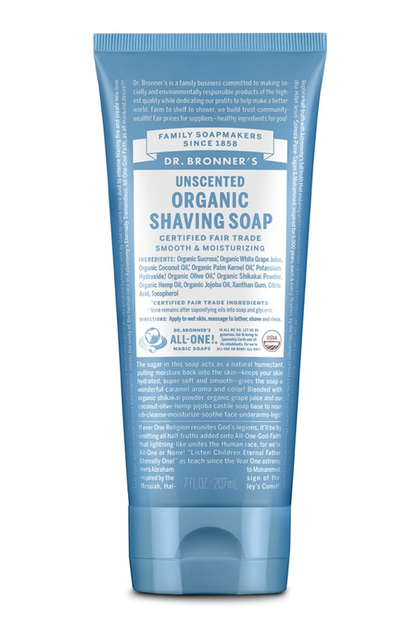
ORGANIC SHAVING SOAP
Fair trade & USDA certified organic
Organic shikakai powder, organic grape juice, fair trade & organic sugar blended with coconut-olive-hemp seed-jojoba castile soap base—our soapmaking tradition!
Sugar from Brazil creates delightful caramel color and aroma
Nourish-cleanse-moisturize-soothe face-underarms-legs
Now made with U.S.-grown hemp seed oil!
For men and women!
No synthetic ingredients
Ingredients: Organic Sucrose,* Organic White Grape Juice, Organic Coconut Oil,* Organic Palm Kernel Oil,* Potassium Hydroxide,† Organic Olive Oil,* Organic Shikakai Powder, Organic Hemp Seed Oil, Organic Jojoba Oil, Organic Essential Oils,** Xanthan Gum, Citric Acid, Tocopherol
*CERTIFIED FAIR TRADE INGREDIENTS
†None remains after saponifying oils into soap & glycerin.
**Essential oils vary by scent.
Made with U.S.-grown hemp seed oil! Soaps are packaged in 50% post-consumer recycled plastic tubes.

Slide 3
Features & Benefits
Face-underarms-legs—men & women
Produces a thick, creamy lather
Cleanses as it shaves in one easy step
Leaves skin smooth, nourished, clean, moisturized

Slide 4
As seen in:
Gifts For Dad And Grads That Give Back
A Look Inside Variety’s Power of Women Gift Bag

