Slide 1
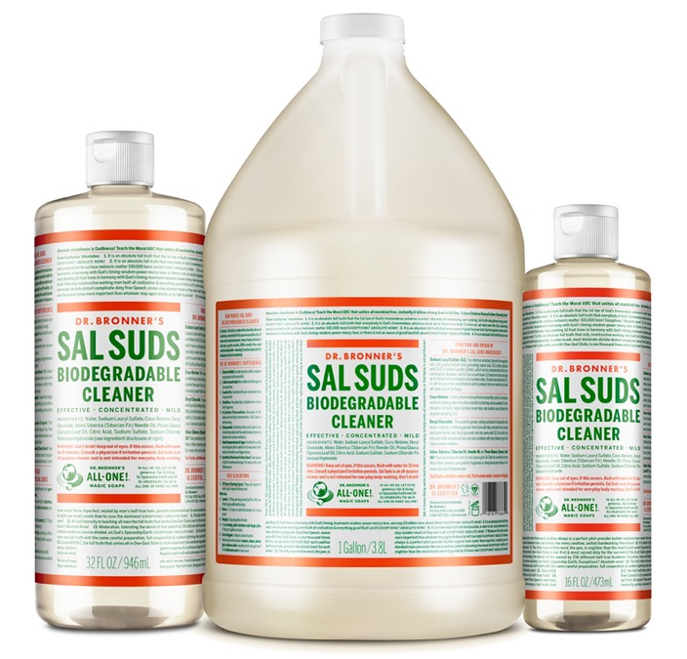
Sal Suds Biodegradable Cleaner
Effective, super-concentrated, biodegradable, all-purpose—All-One!
SAL SUDS AVAILABLE IN: 16 oz., 32 oz. & 1 gal.

Slide 2
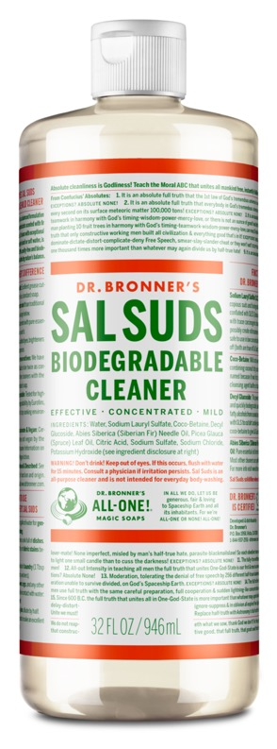
Sal Suds Biodegradable Cleaner
2x more concentrated than many leading all-purpose cleaners. Saves more, wastes less!
Readily biodegradable!
Exceptionally clean-rinsing. No residue left behind on fabrics & surfaces.
Rinses freely in hard or soft water
Scented with pure essential oils. No harsh fumes, no artificial fragrance
Animal compassionate & vegan
Packaged in 100% post-consumer recycled plastic bottles (excluding 1 gallon)
Ingredients: Water, Sodium Lauryl Sulfate, Coco-Betaine, Decyl Glucoside, Abies Siberica (Siberian Fir) Needle Oil, Picea Glauca (Spruce) Leaf Oil, Citric Acid, Sodium Sulfate, Sodium Chloride, Potassium Hydroxide

Slide 3
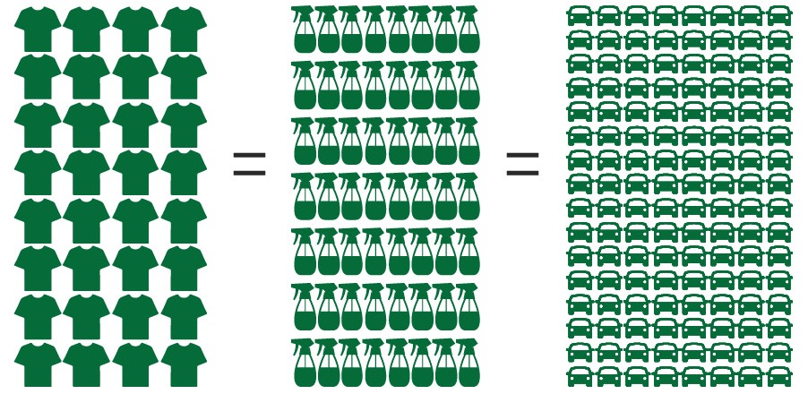
Supreme Cost efficiency & Versatility
32
Loads of Laundry
64
All-Purpose Spray Bottles
128
Car Washes

Slide 4
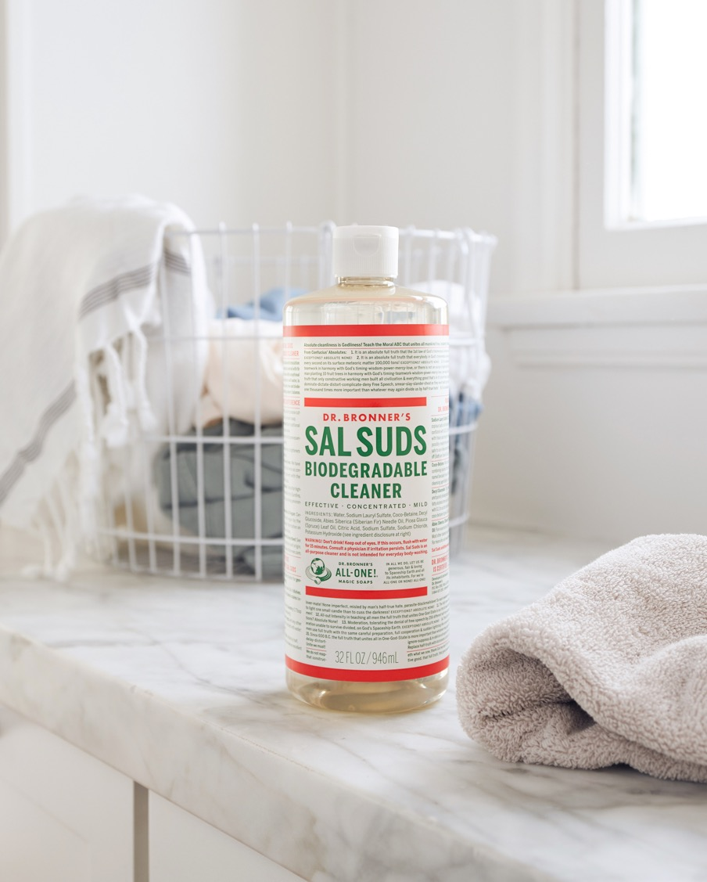
Unmatched versatility
If it can be washed, Sal Suds can wash it!
All-Purpose Spray - Use to clean stone countertops & tile, sinks, toilets, stainless steel, plastics, painted & sealed wood surfaces (not waxed)—anything that can be washed!
Laundry, handwashing delicates & pre-treating stains
Dishes (by hand)
Flooring: Tile, hardwood, linoleum & stone
Fruits and veggies
Treated Leather, Microsuede, Synthetic Surfaces, Metal
Pressure washer & carpet cleaner
Exterior windows
Car washing, patio furniture & other large jobs
Paint brushes
Camping Gear
Combines with baking soda for a great soft scrub

Slide 5
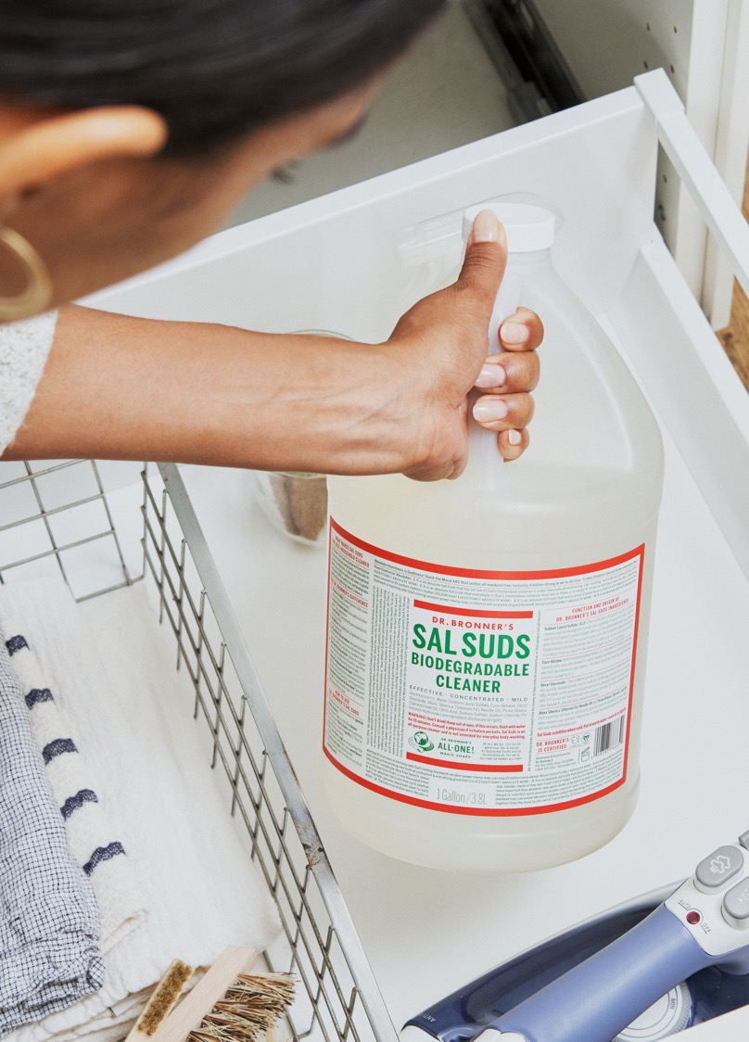
As seen in:
These 15 Cleaning Products Are Safe & Sustainable— And They Actually Work
Celebrate Earth Day All Year Long With These Cleaning Products
10 Natural Cleaning Products You Need for Spring Cleaning
15+ Natural Cleaning Products You Need for Spring Cleaning
The Clean Living Show: Clean Green

Slide 6
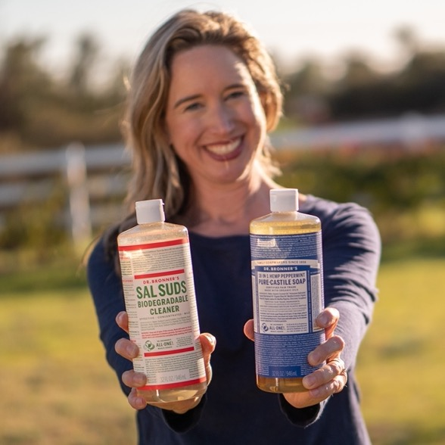
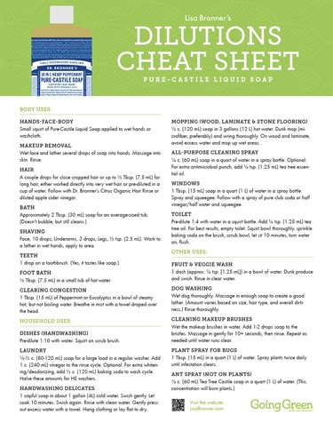
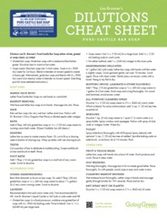
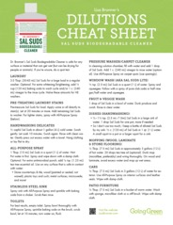
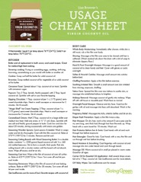
Going Green Resources
Usage & Dilutions Cheat Sheets
Printable PDF:
Castile Liquid Soap Cheat Sheet
Sal Suds Dilutions Cheat Sheet
Castile Bar Soap Cheat Sheet
Coconut Oil Cheat Sheet for Kitchen & Body Care
Lisa bronner
Consumer Engagement & Education
LisaBronner.com
Facebook.com/GreenWithLisaBronner
YouTube.com/BronnerMom

Slide 7
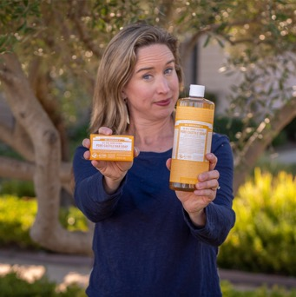
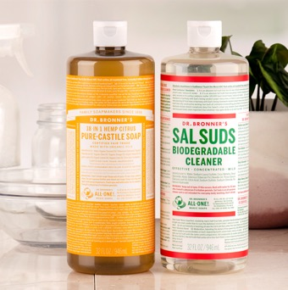
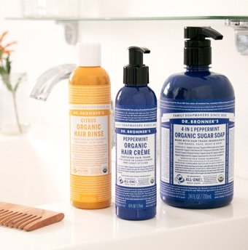
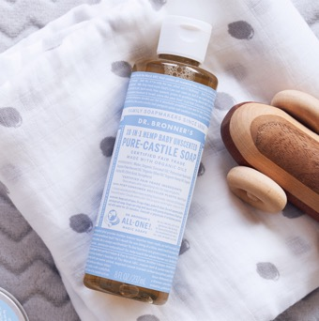
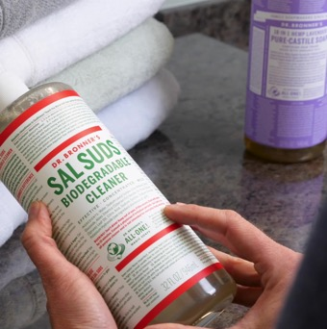
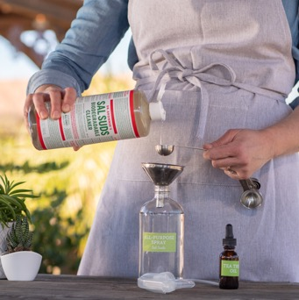
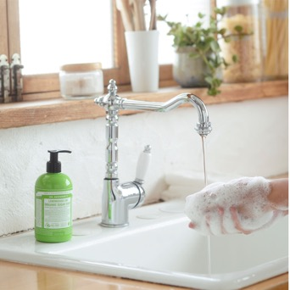
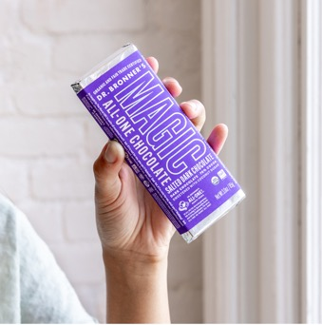
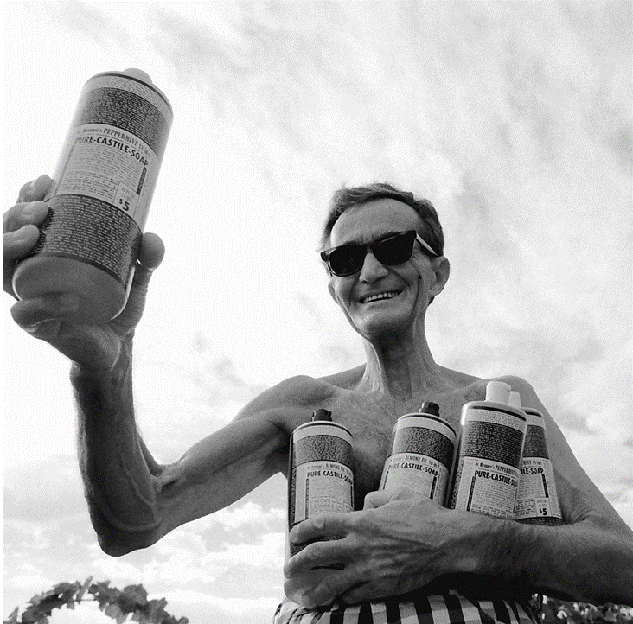
Going green with lisa Bronner
Lisa Bronner, Consumer Engagement & Education
Liquid vs. Bar in Dr. Bronner’s Pure-Castile Soap | Sal Suds or Castile – Which To Use? | From Soap to Shampoo – My Story | Using Castile Baby Mild Soap on Babies | Green Laundry Care with Dr. Bronner’s
GIY All-Purpose Cleaning Spray | How Soap Works | Chocolate So Good It’s Magic | How the Label Was Born

