Slide 1
Marketing, demos, and brand education

Slide 2
2022 Promo Calendar
January | February | march | April | May | June
All 16 oz Liquid Soaps All 5 oz Toothpastes & Travel Toothpaste | All Chocolate All Lip Balms (Display Included), Both Magic Balms, All 12 oz & 24 oz Sugar Soaps, All Shave Soaps & Both Hand Sanitizers All Coconut Oils: 14 oz & 30 oz | Baby Unscented: 2 oz, 4 oz, 8 oz, 16 oz, 32 oz Liquid Soaps & Bar Soap Unscented Magic Balm Sal Suds 16 oz & 32 oz | All 8 oz & 32 oz Liquid Soaps | All Chocolate All 5 oz Toothpastes & Travel Toothpaste All Coconut Oils: 14 oz & 30 oz | All Bar Soap All 12 oz & 24 oz Sugar Soaps & All Shave Soaps
July | august | September | October | November | December
All 2 oz Liquid Soaps Both Hand Sanitizer’s, All Lip Balm (Display Included) & Both Magic Balms Travel Toothpaste | All 16 oz Liquid Soaps All Lotions All 5 oz Toothpastes | All 12 oz & 24 oz Sugar Soaps, All Shave Soaps & Both Hand Sanitizers | All Chocolate All 8 oz & 32 oz Liquid Soaps | Sal Suds 16 oz & 32 oz All Lotions All 5 oz Toothpastes & Travel Toothpaste All Coconut Oils: 14 oz & 30 oz | All 2 oz Liquid Soaps & All Bar Soaps All Lip Balms (Display Included) & Both Hand Sanitizers Travel Toothpaste All Coconut Oils: 14 oz & 30 oz

Slide 3
2022 Trade Marketing Assets Overview
  Evergreen & product-focused signage
  Evergreen product signage means flexibility—select the signage to support your store promotion!
  Signage aligns with product lines, instead of seasonal themes.
Themed signage
  Place to feature multiple product lines under a common theme
  All-One! Brand Signage and Baby Unscented Body Care Line
Look & Feel
  Product photography: Bright & sunny photography grabs the eye & brings our products to life.
  Layout: Billboard style layout to easily be seen
  & understood from far away.
  Voice: True to brand. Reflects our soap labels’ bold declaration and vision.
  Captures our company’s Soap & Soul—
  Product + Purpose; People + Earth; All-One!
Types & sizes
  NEW! 8.5” x 3.5” Tri-fold (select products)
  18” x 36” Endcap Header (select products)
  3” x 3” Shelf Talkers

Slide 4
Accessing Signage & Recognition Opportunities
Accessing Dr. Bronner’s Trade Marketing signage:
  Order printed signage from your Sales Account Rep
  Downloaded & print in-store from the Retailer Download Center:
    drbronner.com/retailers
    Password: drbpromos
In-Store Signage Recognition Program:
  Send us photos of Dr. Bronner’s-branded signage displayed in your store and receive
  Dr. Bronner’s product and/or swag!
  Submit photo(s) by the 15th of each month to: pictures@drbronner.com or text to 760-212-2032. Be sure to include your name, and store name & location.
  Each store that submits photos received product and/or swag (one per store).
  All photo entries will be entered into a twice-yearly drawing for a virtual meet-and-greet with members of the Bronner family!

Slide 5
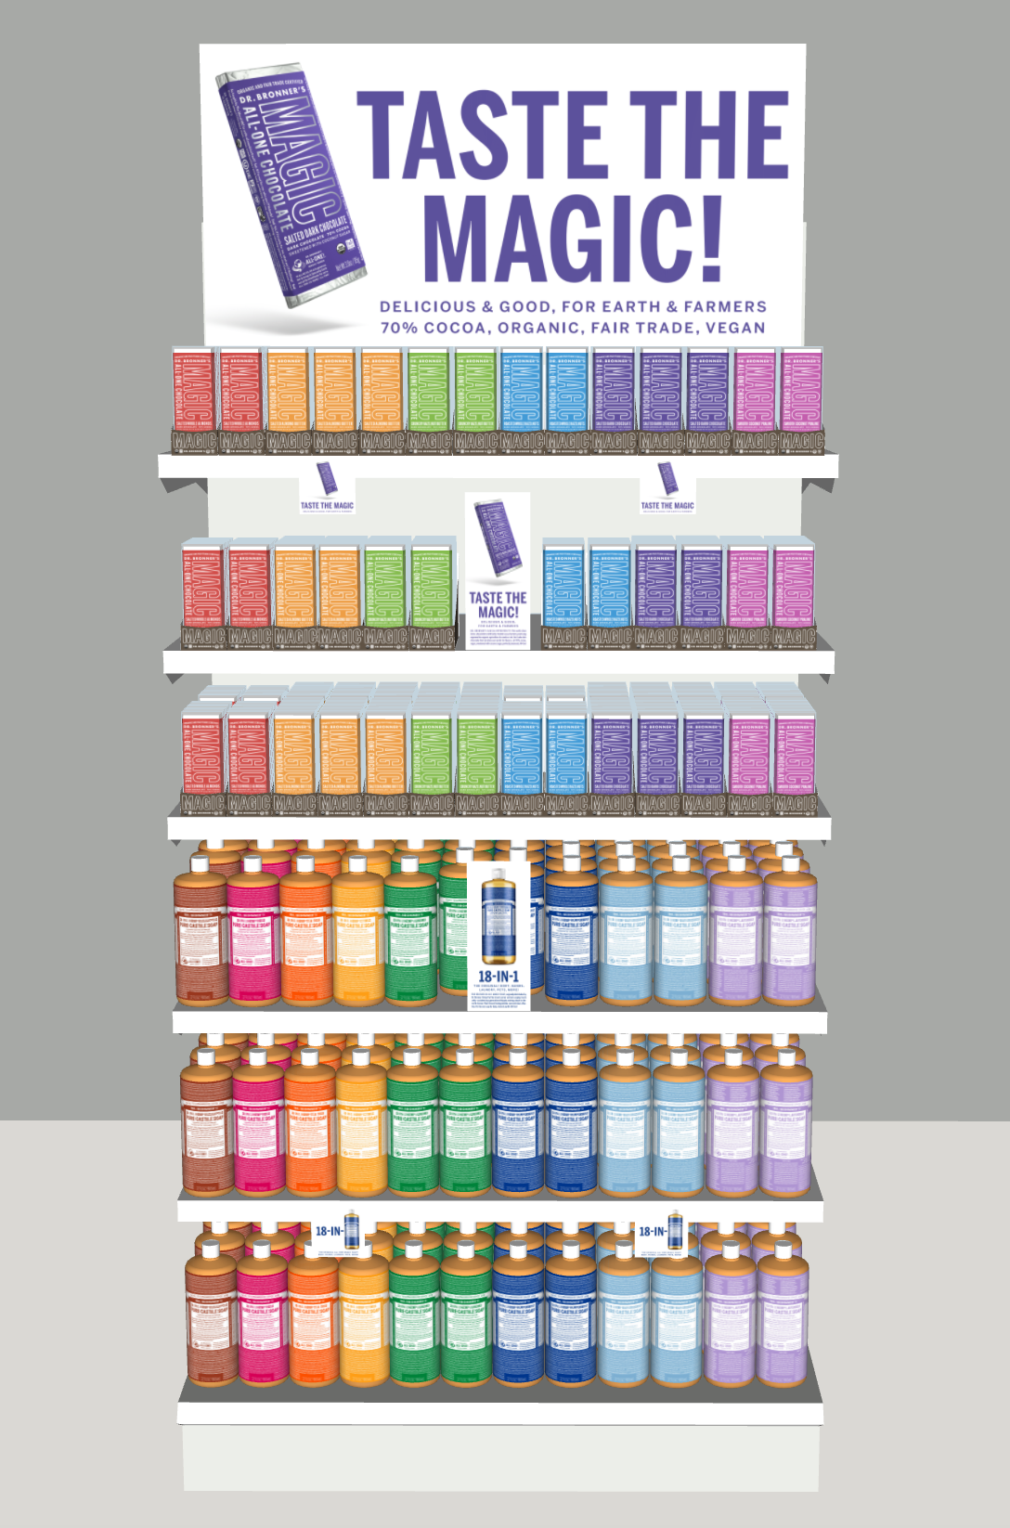



Slide 6

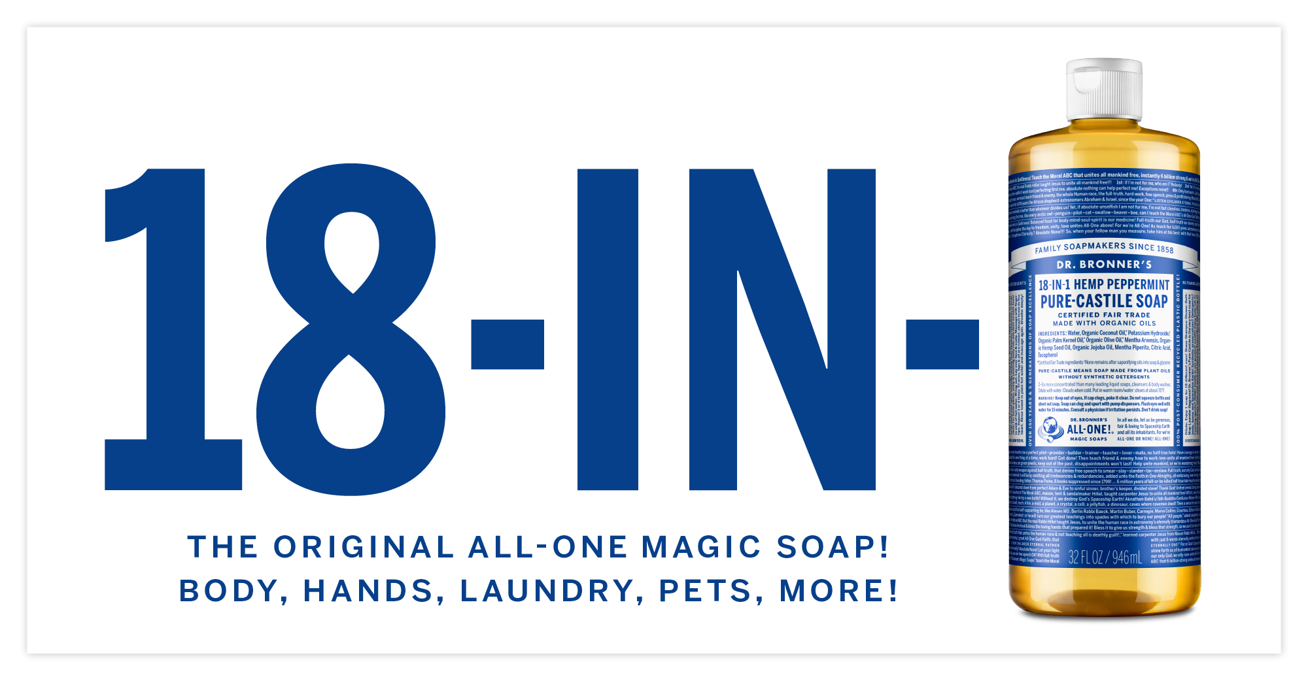

EndCap Header: 18” x 36”

Slide 7
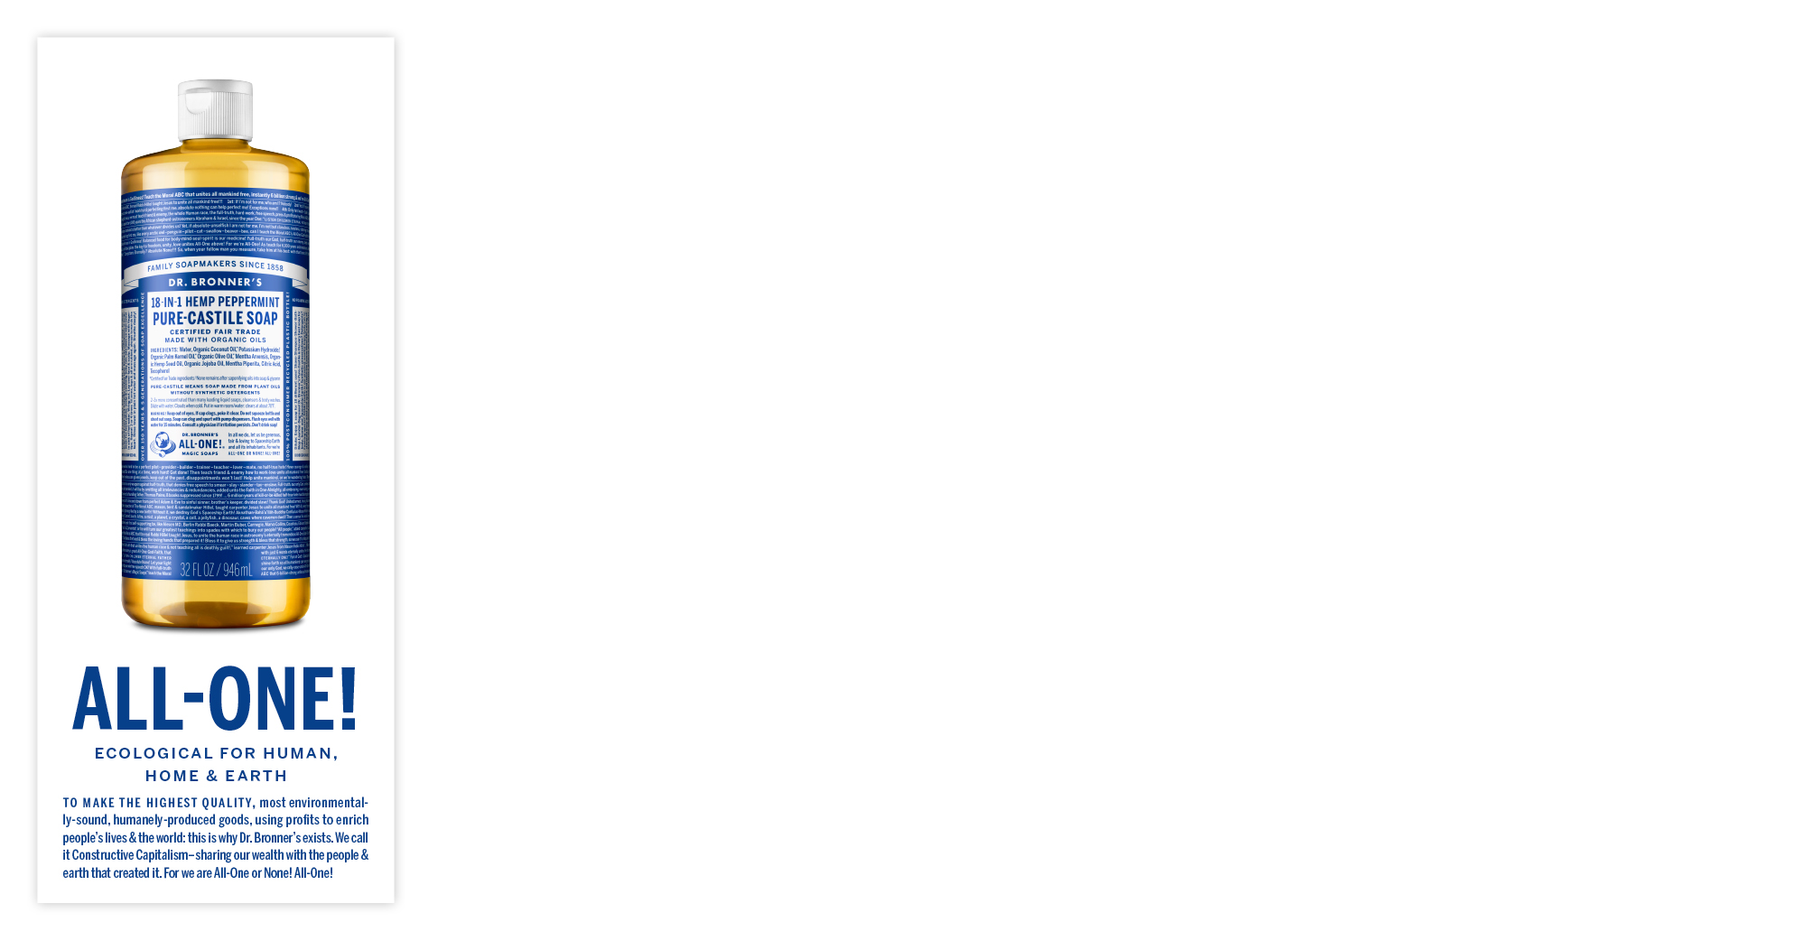
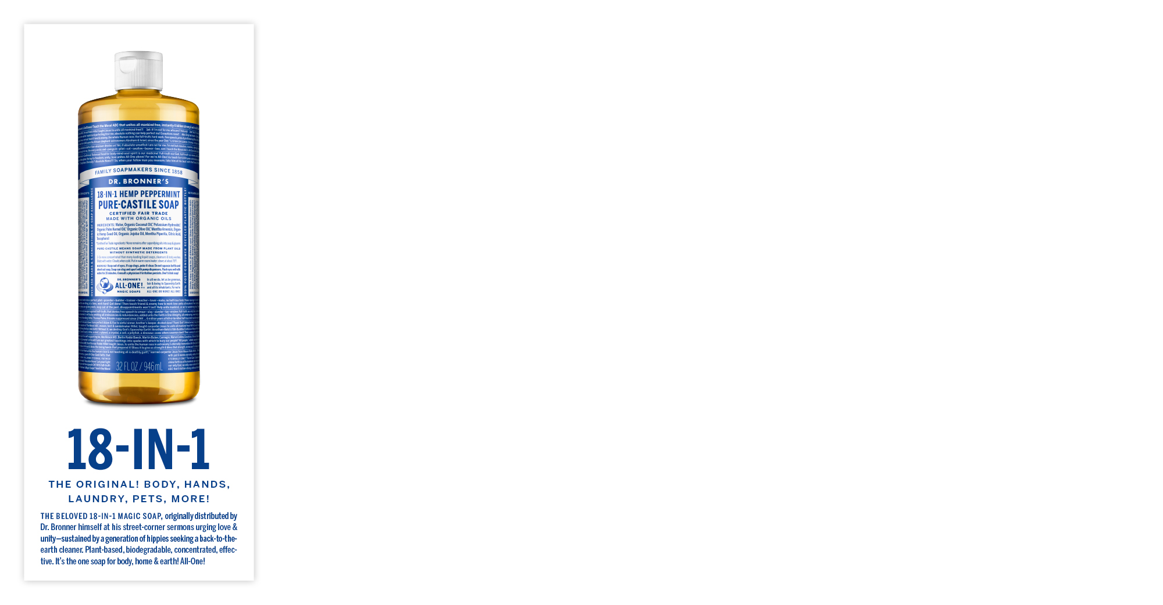



Shelf Sign: 3.5 x 8.5”

Slide 8

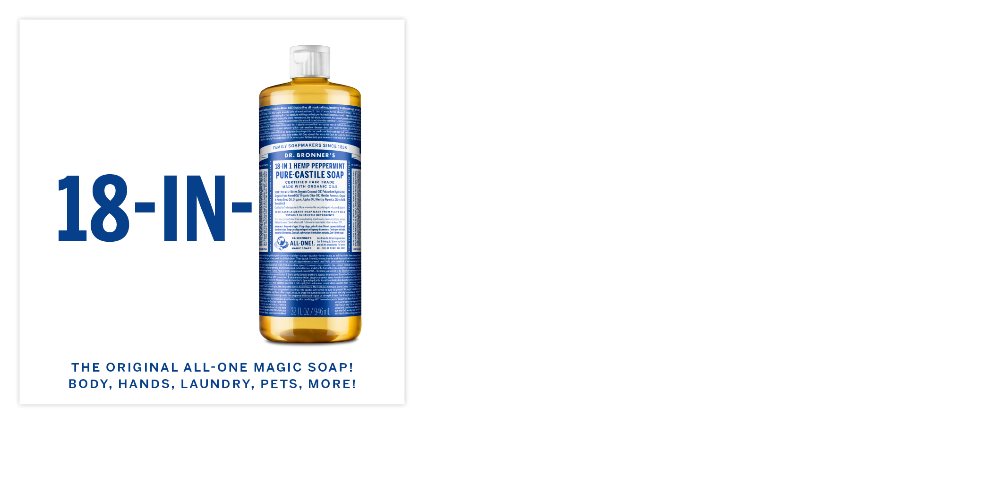








Shelf Talker: 3” x 3"

Slide 9
We are All-One!
Use the All-One! Brand Signage alongside any Dr. Bronner’s product
Endcap Header:
18” x 36”
Shelf Sign:
3.5” x 8.5”
Shelf Talker:
3” x 3”

Slide 10
Pure-Castile Liquid Soap
The original All-One Magic Soap! Body, hands, laundry, pets, more!
Endcap Header:
18” x 36”
Shelf Sign:
3.5” x 8.5”
Shelf Talker:
3” x 3”

Slide 11


Pure-Castile Bar Soap
Made with organic oils. Soft, smooth lather moisturizes face-body-hands!
Endcap Header:
18” x 36”
Shelf Talker:
3” x 3”

Slide 12
Magic All-one chocolate
Delicious & good, for Earth & farmers—Dr. Bronner’s calls it Magic!
Endcap Header:
18” x 36”
Shelf Sign:
3.5” x 8.5”
Shelf Talker:
3” x 3”

Slide 13
Virgin Coconut Oil
Regenerative Organic Certified™ = Good for you & planet!
Endcap Header:
18” x 36”
Shelf Sign:
3.5” x 8.5”
Shelf Talker:
3” x 3”

Slide 14

Organic Hand Sanitizer
Clean, light feel! Organic & 99.9% effective against germs
Endcap Header:
18” x 36”
Shelf Talker:
3” x 3”

Slide 15
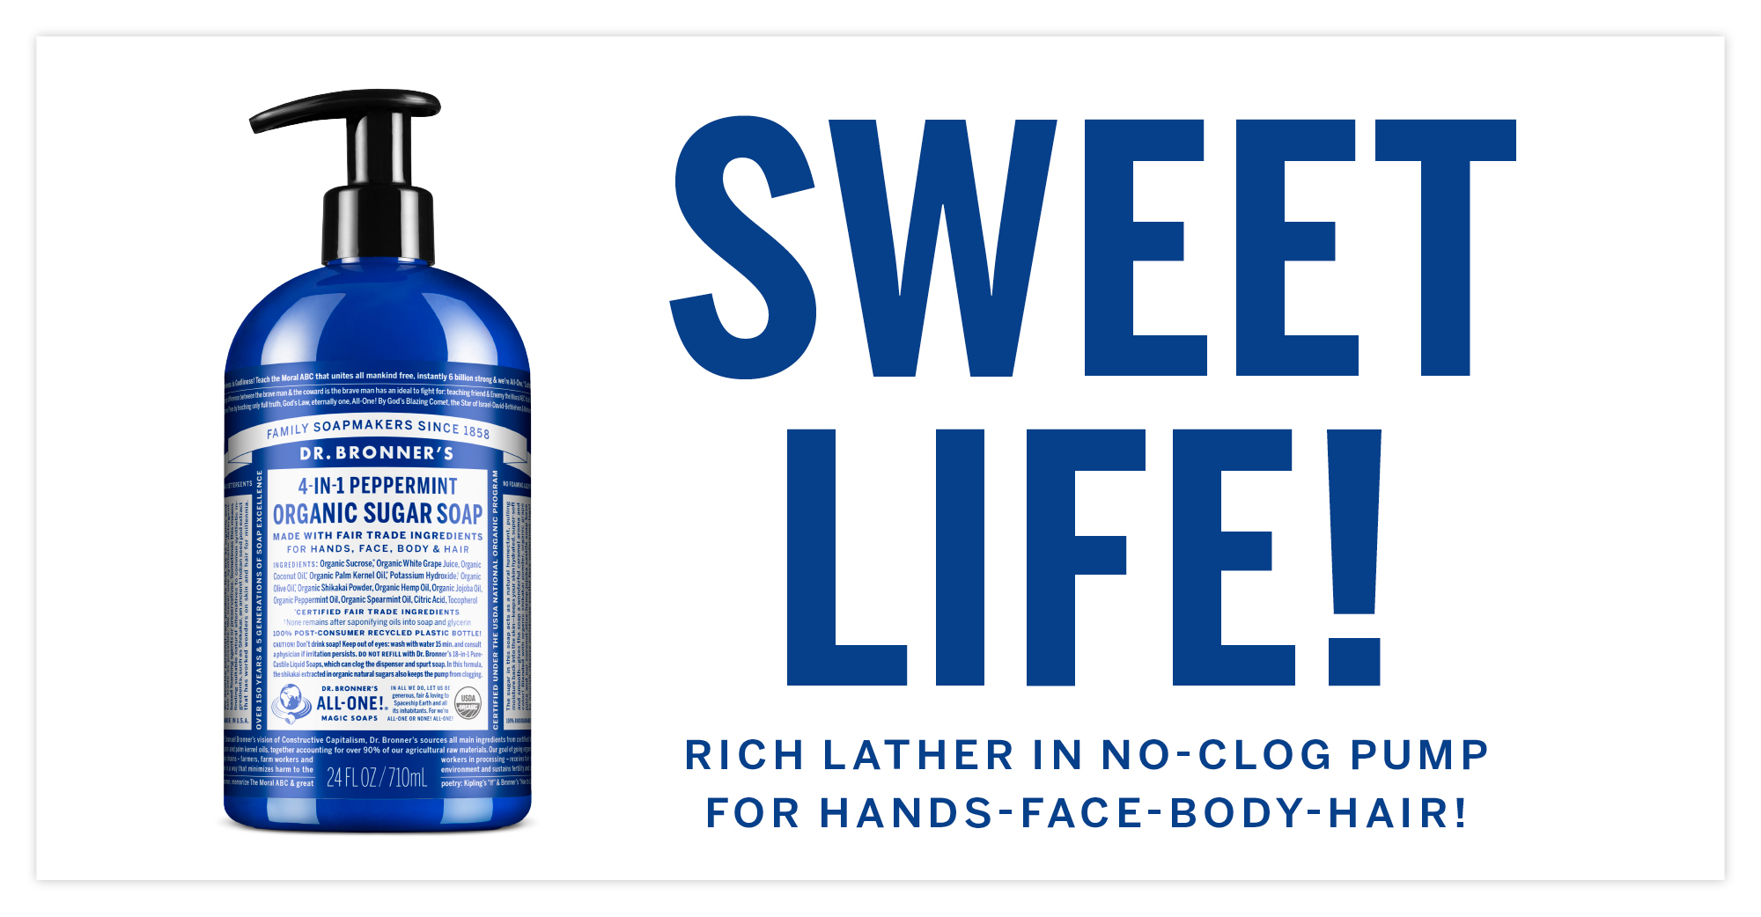
Organic sugar soap
Rich lather in no-clog pump — Keep skin-hair hydrated & smooth!
Endcap Header:
18” x 36”
Shelf Sign:
3.5” x 8.5”
Shelf Talker:
3” x 3”

Slide 16

All-One Toothpaste
Simple ingredients that really work! Brush with trust – Truth Paste!
Endcap Header:
18” x 36”
Shelf Talker:
3” x 3”

Slide 17

Sal Suds Biodegradable Cleaner
Sal Suds gets the job done: laundry, dishes, bathrooms, floors, kitchen, more!
Endcap Header:
18” x 36”
Shelf Talker:
3” x 3”

Slide 18

Baby Unscented Products
Mild formula for sensitive skin. Safe enough for pets!
Endcap Header:
18” x 36”
Shelf Talker:
3” x 3”

Slide 19
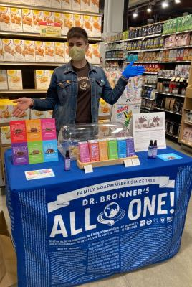
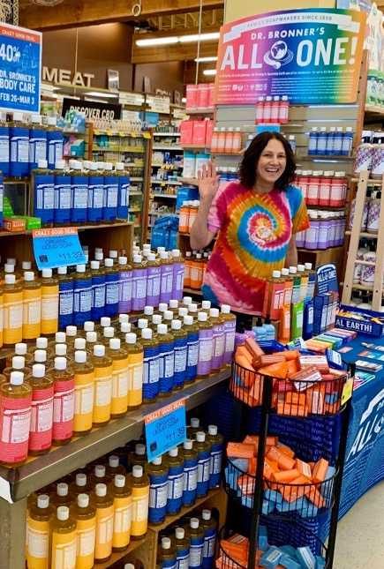
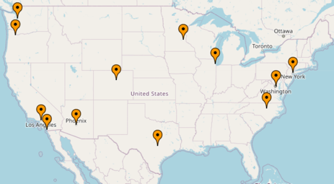
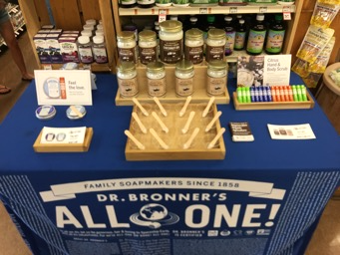

National Demo Program
National demo program will be comprised of 12 demo reps in key markets in 11 different states across the U.S.
Retailers can request active or passive demos through Dr. Bronner’s Regional Sales Managers or reaching out directly to the Demo & Event Coordinator.
Demos will focus solely on Magic All-One Chocolate and new product launches and will average at 180 national demos per month. For more information, contact caroline@drbronner.com.

Slide 20

retailer education program
Dive deep into the soap & soul of Dr. Bronner’s!

Slide 21
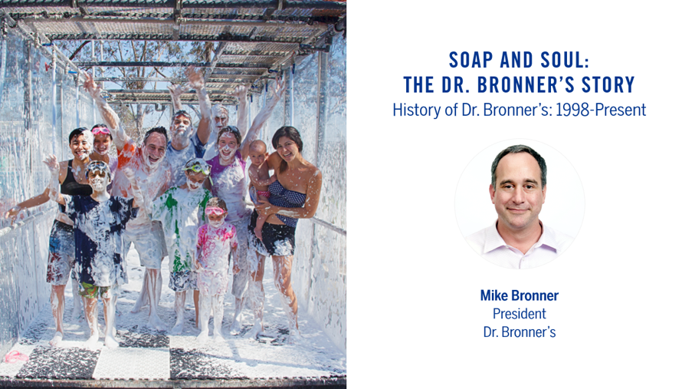
retailer education program
Pre-Recorded Training Decks Presented by Dr. Bronner’s Leadership & Staff, Include:
Soap & Soul: the Dr. Bronner’ s Story
Ethical Sourcing: Regenerative, Organic & Fair Trade
18-in-1 Pure-Castile Liquid & Bar Soap
Regenerative, Organic & Fair Trade Virgin Coconut Oil
Toothpaste: Better Ingredients & Low-Foaming Formula
USDA Certified Body Care Products
Home Cleaning Essentials: Sal Suds & Liquid Castile
The Fight for Organic Integrity
Baby Unscented Line: Good for Moms, Baby & Earth
Example Training Deck

Slide 22
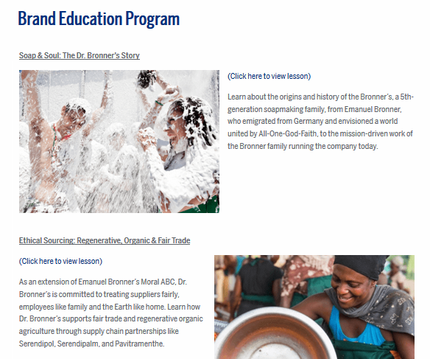
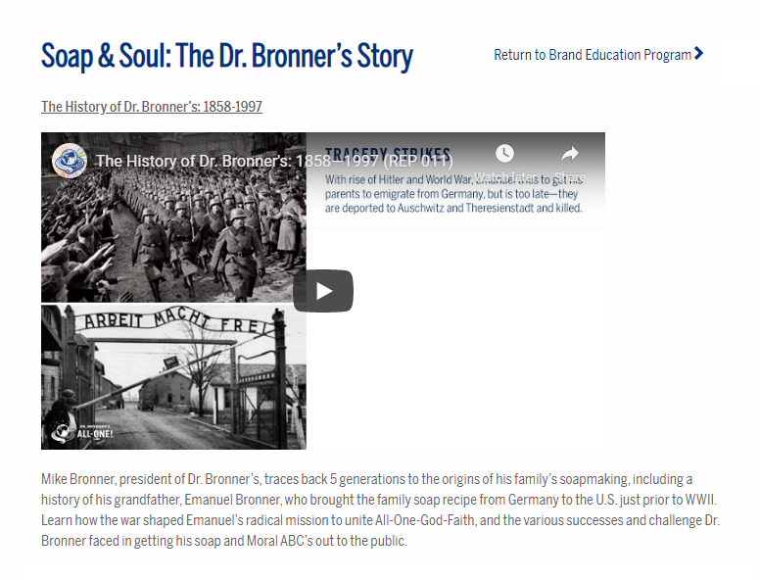
retailer education program
Available @ DrBronner.com
Access all Content on Dr. Bronner’s Website!
Trainings Embedded on Website for Easy Access & Immediate Viewing
Login Credentials for training participants:
URL: drbronner.com/brand-education
Password: w3ar3all1

