Slide 1
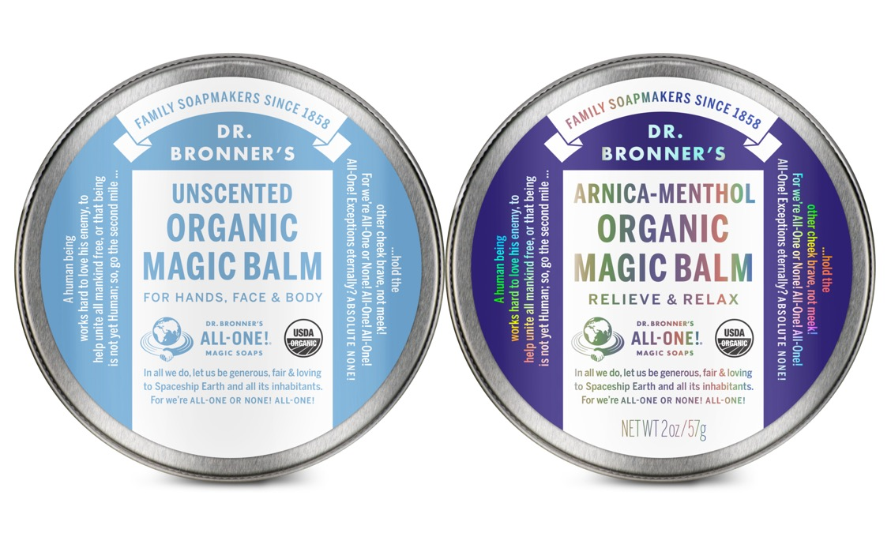
ORGANIC magic balm
Nourish-moisturize-soothe dry skin & sore muscles
2 OZ. ORGANIC MAGIC BALM AVAILABLE IN: Unscented & Arnica-Menthol

Slide 2
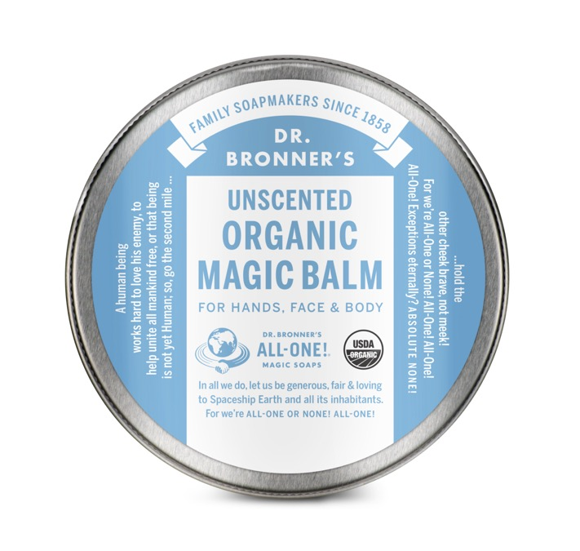
Unscented Organic Magic Balm
Moisturize chapped chin and cheeks, chafed skin and cuticles!
Soothes skin safely & simply – no synthetic ingredients.
Made from nourishing blend of organic beeswax and organic avocado, jojoba, coconut, olive and hemp seed oils.
Now made with U.S.-grown hemp seed oil!
Provides relief and protection from wind-cold-clothing that has rubbed you wrong
Helps skin heal and revive, never harsh
Certified to the same National Organic Program that certifies food
Very best balm for baby bum, body and Earth!
Ingredients: Organic Avocado Oil, Organic Jojoba Oil, Organic Beeswax, Organic Coconut Oil*, Organic Olive Oil*, Organic Hemp Seed Oil, Tocopherol
*CERTIFIED FAIR TRADE INGREDIENTS
Made with U.S.-grown hemp seed oil! Packaged in 100% recyclable tins.

Slide 3
EVERY INGREDIENT HAS AN IMPORTANT FUNCTION
BENEFIT | UNSCENTED BALM
MAKES SKIN SUPPLE | Organic Persea Gratissima (Avocado) Oil
MOISTURIZES | Organic Simmondsia Chinensis (Jojoba) Seed Oil
GIVES BALM BODY UNIFORMITY & MALLEABILITY | Organic Cera Alba (Beeswax)
SOFTENS & MOISTURIZES | Organic Cocos Nucifera (Coconut) Oil
MAKES SKIN SILKY SMOOTH | Organic Olea Europaea (Olive) Oil
HELPS REPAIR SKIN & REDUCE INFLAMMATION | Organic Cannabis Sativa (Hemp) Seed Oil
ANTIOXIDANT | Tocopherol

Slide 4
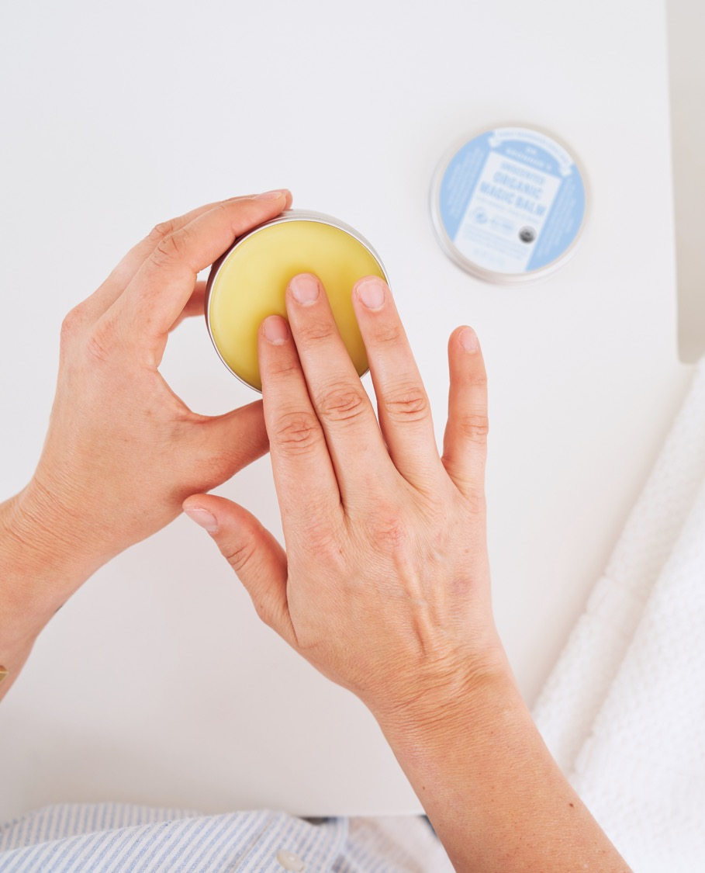
UNSCENTED
For chapped, dry or sensitive skin
Moisturize dry, chafed, or cracking skin
Soften calloused heels & elbows
Relieve itchy skin
Soothe stretching pregnant bellies
Nourish under eyes
Soften hard cuticles & prevent hangnails
Nourish brittle nails
Heal recent tattoos & brighten old tattoos
Beard styling
Massage
Baby care: preventing diaper rash, soothe red crease lines, heal chapped chins & cheeks

Slide 5
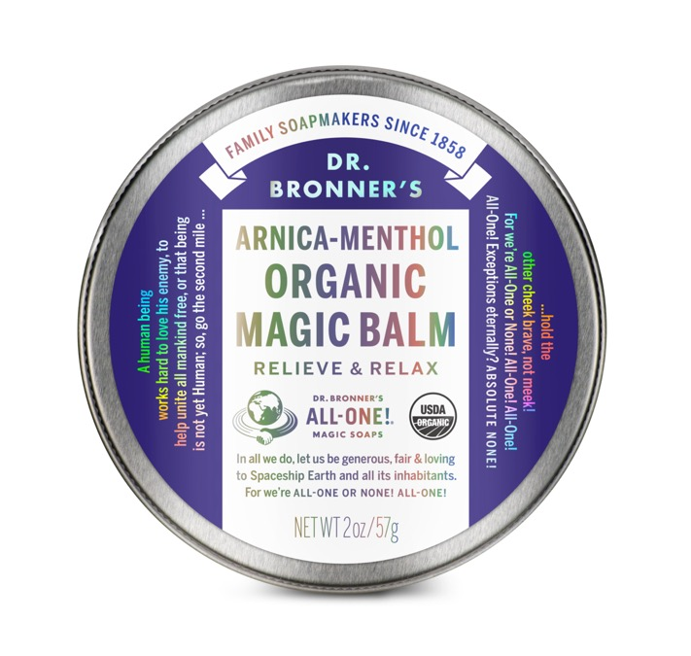
Arnica-menthol Organic Magic Balm
Helps cool and soothe sore muscles & achy joints.
Potent blend of arnica, camphor and menthol oils!
Supports clear breathing and open sinuses!
Made from nourishing blend of organic beeswax and organic olive, avocado, coconut, jojoba and hemp seed oils.
Now made with U.S.-grown hemp seed oil!
No synthetic ingredients—none!
Massage gently into sore muscles—arms, legs, chest and back
Ingredients: Organic Avocado Oil, Organic Coconut Oil*, Organic Beeswax, Organic Mentha Arvensis (Peppermint Oil), Organic Olive Oil*, Organic Camphor Oil, Organic Menthol Crystals, Organic Jojoba Oil, Organic Hemp Seed Oil, Organic Arnica Oil, Organic Mentha Piperita (Peppermint) Oil, Tocopherol
*CERTIFIED FAIR TRADE INGREDIENTS
Made with U.S.-grown hemp seed oil! Packaged in 100% recyclable tins.

Slide 6
EVERY INGREDIENT HAS AN IMPORTANT FUNCTION
BENEFIT | ARNICA-MENTHOL BALM
MAKES SKIN SUPPLE | Organic Persea Gratissima (Avocado) Oil
SOFTENS & MOISTURIZES | Organic Cocos Nucifera (Coconut) Oil
GIVES BALM BODY UNIFORMITY & MALLEABILITY | Organic Cera Alba (Beeswax)
COOLS & STIMULATES SKIN | Organic Mentha Arvensis (Peppermint) Oil Organic Mentha Piperita (Peppermint) Oil
MAKES SKIN SILKY SMOOTH | Organic Olea Europaea (Olive) Oil
COOLS & SOOTHES ACHING JOINTS & MUSCLES | Organic Cinnamomum (Camphor) Oil
MINTY SCENT & STIMULATING AROMA | Organic Mentha Arvensis (Menthol) Crystals
MOISTURIZES | Organic Simmondsia Chinensis (Jojoba) Seed Oil
HELPS REPAIR SKIN & REDUCE INFLAMMATION | Organic Cannabis Sativa (Hemp) Seed Oil
HELPS RELIEVE PAIN FOR SORE MUSCLES | Organic Arnica Montana (Arnica) Oil
ANTIOXIDANT | Tocopherol

Slide 7
ARNICA-MENTHOL
For athletes, parents, manual laborers, and everyday folks who need effective relief
Arnica-menthol balm brings relief to
Sore muscles
Achy joints
Tired feet
Hurting backs
Throbbing headaches
Sinus congestion
Insect bites

Slide 8
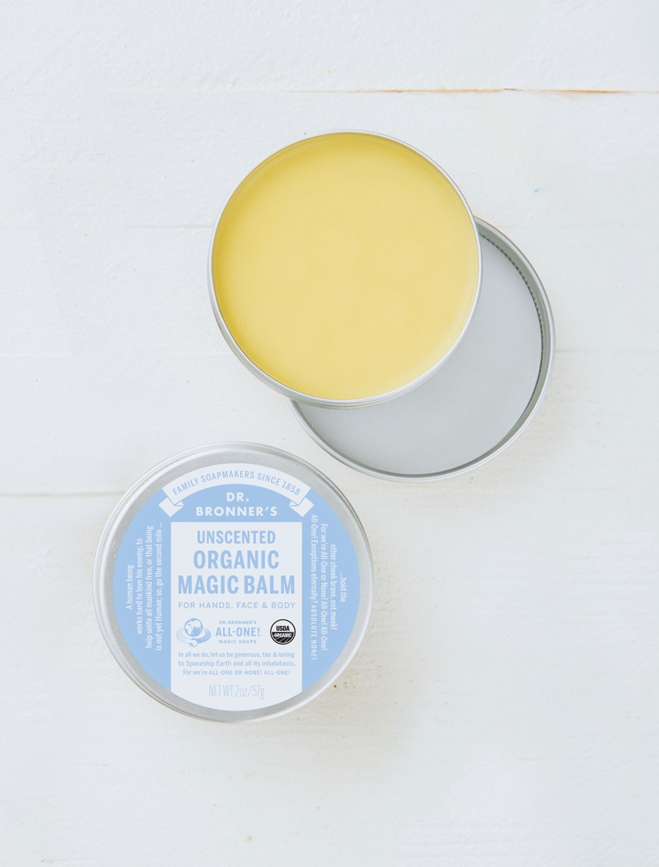
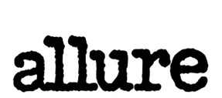
As seen in:
These Are Allure Editors’ Favorite New Beauty Products for February 2020
Dr. Bronner’s Sources 100 Percent of Its Organic Hemp Seed Oil From U.S. Farmers—Here’s Why That Matters
The Best Ointments for Muscle Pain (And What You Can Reasonably Expect from Them)

Slide 9
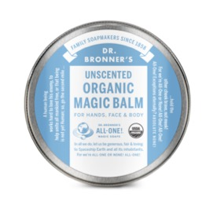
Faqs: ORGANIC MAGIC BALM
What makes the Unscented Organic Magic Balm unique?
Our balm is one of the few on the market that is certified organic and bears the USDA organic seal. In addition, many of the ingredients are certified fair trade, including coconut and olive oils.
How should the Unscented Organic Magic Balm be used?
Our Unscented Organic Magic Balm is excellent for moisturizing, healing chapped skin and cuticles, and protecting skin from the elements. It soothes baby bums & diaper rash, and can also be used to revive old tattoos and to generally refresh the skin.
How should the Arnica-Menthol Organic Magic Balm be used? How does it work?
The potent combination of menthol crystals with arnica, camphor and two kinds of peppermint oils in our Arnica-Menthol Organic Magic Balm make it an excellent muscle rub, perfect for relieving muscle soreness and aches. Menthol, peppermint and camphor oils cool & numb muscles, helping to calm minor pains, while arnica oil has traditionally been used to reduce inflammation. Rub the balm gently into sore muscles.
Menthol and camphor oils’ cooling effects also help to calm irritated air passageways and to relieve congestion. Breathe deeply, but do not rub under nose as the strong vapors may irritate nose and eyes. Instead, rub a little on the chest.
What areas of the body should be avoided?
Our Arnica-Menthol Organic Balm has a high concentration of essential oils, which can irritate the eyes and any other sensitive areas. Avoid rubbing the balm too close to your eyes, as the vapors from the balm can cause you to tear up (although this effect will dissipate after a few minutes). Do not rub the balm internally—it is meant for external use only!
Do not use Arnica-Menthol Organic Magic Balm on children under 2 years of age. Do not use on skin ulcerations, cuts or burns.
Can the Unscented Organic Magic Balm be used to treat diaper rash?
Our balm can help soothe diaper rash. If diaper rash becomes more serious and develops into a candida infection, then ask your pediatrician for advice. To use our baby balm to soothe diaper rash (or to help prevent it) simply rub balm gently over baby bottom and hips after the old diaper has been removed and baby’s body has been cleaned. If you are concerned how your baby’s skin will react to our balm, test it on a small area of skin first.
What makes the Arnica-Menthol Organic Magic Balm Unique?
Our muscle rub is powered by a potent blend of organic arnica-camphor-menthol-peppermint oils and organic menthol crystals, with our organic base—no synthetics or petroleum-based ingredients! Bears the USDA organic seal, with certified fair trade coconut and olive oils too.

