Slide 1
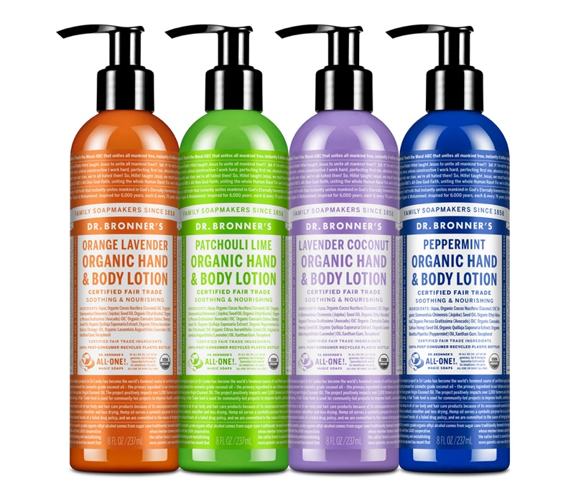
Organic Lotion
Soothe & replenish—light & hydrating
8 OZ. LOTION AVAILABLE IN: Orange Lavender, Patchouli Lime, Lavender Coconut & Peppermint

Slide 2
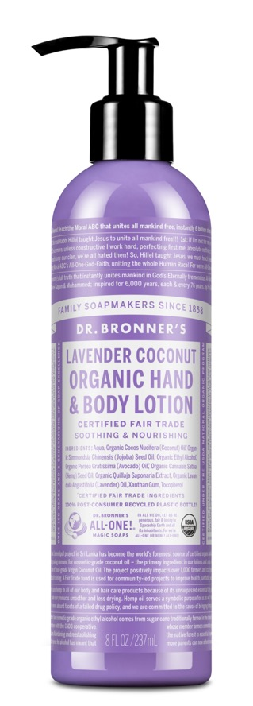
Organic Lotion
Fair trade & USDA certified organic
For sensitive-dry-rough-or combination skin
Can be used on hands, face, body—anywhere!
Only organic essential oils for fragrance
Organic jojoba oil heals and soothes
Organic coconut oil moisturizes
Organic hemp seed and avocado oils keep skin smooth & supple
Now made with U.S.-grown hemp seed oil!
Absorbs quickly and highly emollient, a small amount will do!
Ingredients: Water, Organic Coconut Oil*, Organic Jojoba Oil, Organic Ethyl Alcohol*, Organic Avocado Oil*, Organic Hemp Seed Oil, Organic Quillaja Saponaria Extract, Organic Essential Oils, Xanthan Gum, Tocopherol
*CERTIFIED FAIR TRADE INGREDIENTS
** Essential oils vary by scent.
Made with U.S.-grown hemp seed oil! Packaged in 100% post-consumer recycled plastic bottle.

Slide 3
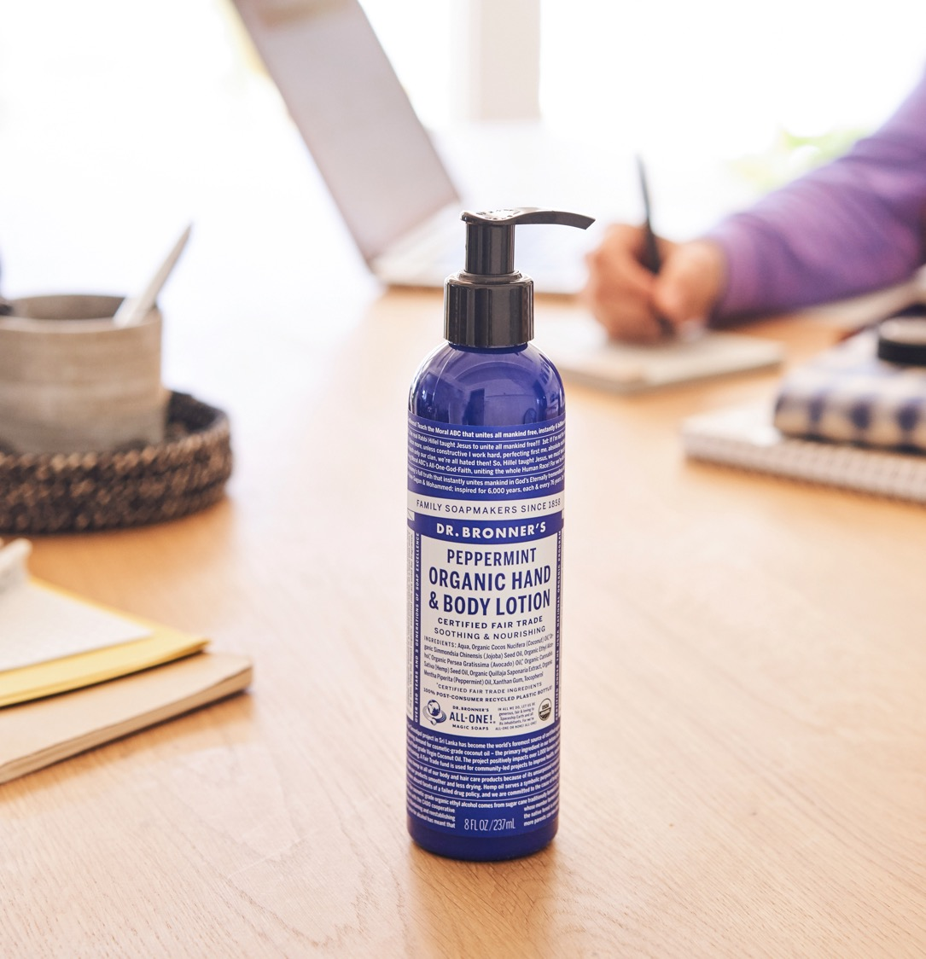
As seen in:
Ask the Strategist: Can You Find Me
a Mint Skin Moisturizer?
Top 10 Organic Body Lotions in 2020
How to Care for a Fresh Tattoo

