Slide 1
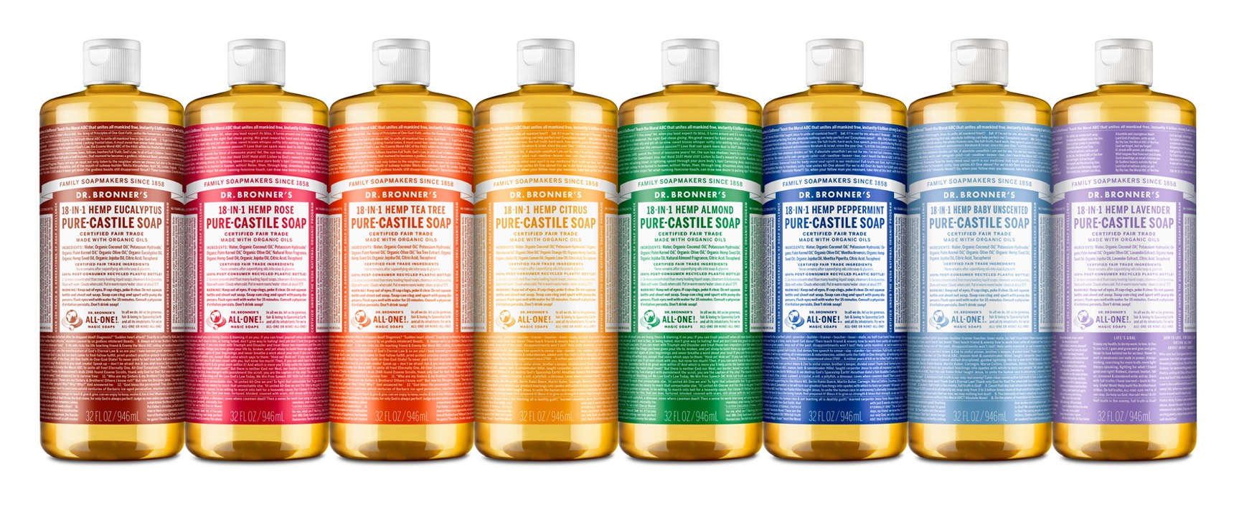
pure-Castile liquid soap
The original All-One Magic soap—body, hands, laundry, pets, more!
SCENTS: Eucalyptus, Rose, Tea Tree, Citrus, Almond, Peppermint, Baby Unscented & Lavender SIZES: 2 oz., 4 oz. (except Citrus & Rose), 8 oz., 16 oz., 32 oz., ½ gal. (Peppermint only) & 1 gal.

Slide 2
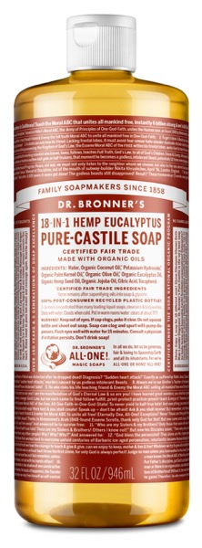
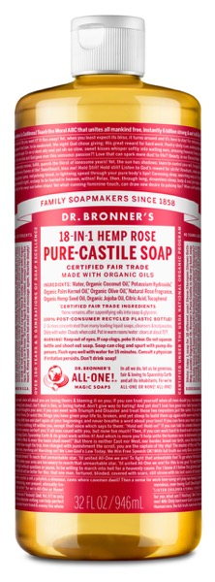
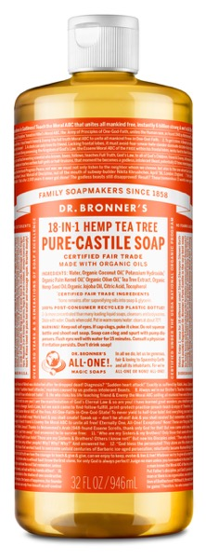
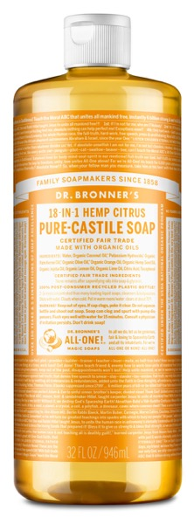
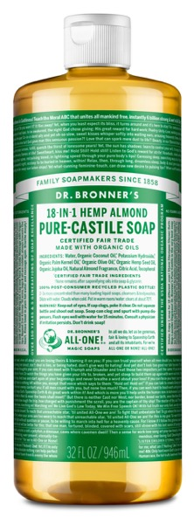
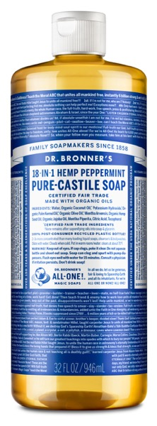
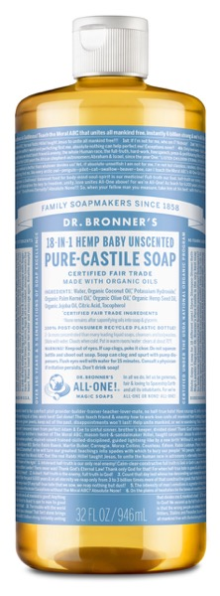
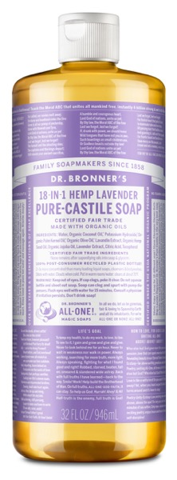
Essential oils to fit every situation & season
EUCALYPTUS Warm
Invigorating
ROSE Delicate Comforting
TEA TREE Therapeutic Cleansing
CITRUS Fresh
Bright
ALMOND Warm
Comforting
PEPPERMINT Cooling
Tingling
Refreshing
BABY UNSCENTED Simple
Nourishing
LAVENDER Relaxing
Calming
Notes:
No artificial fragrance. Not only can artificial fragrances be composed of a plethora of nasty stuff, but they give no true benefit – just a smell and that might not be all that nice. Essential oils on the other hand each have their own unique property.

Slide 3
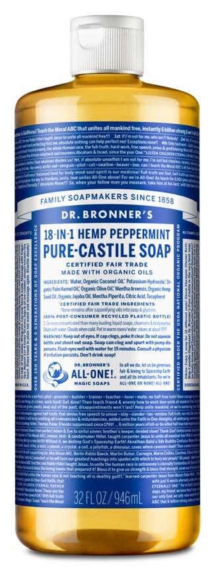
pure-Castile liquid soap
Effective, ecological, versatile
Made with organic oils: coconut-olive-hemp seed-jojoba
Certified Fair Trade by IMO
Vegan and cruelty-free
Multi-purpose: use for face-hands-body-hair and just about any cleaning task
No synthetic preservatives, detergents or foaming agents
2-3x more concentrated for superior value
Biodegradable
Packed in 100% post-consumer recycled (PCR) Plastic bottle (except ½ and 1 gallon)
Now made with U.S.-grown hemp seed oil!
Ingredients: Water, Organic Coconut Oil*, Potassium Hydroxide†, Organic Palm Kernel Oil*, Organic Olive Oil*, Organic Hemp Seed Oil, Organic Jojoba Oil, Organic Essential Oils, Tocopherol
*CERTIFIED FAIR TRADE INGREDIENTS
†None remains after saponifying oils into soap & glycerin.
Made with U.S.-grown hemp seed oil! Liquid Soaps are packaged in 100% post-consumer recycled plastic bottles. Excludes 1 gallon.

Slide 4
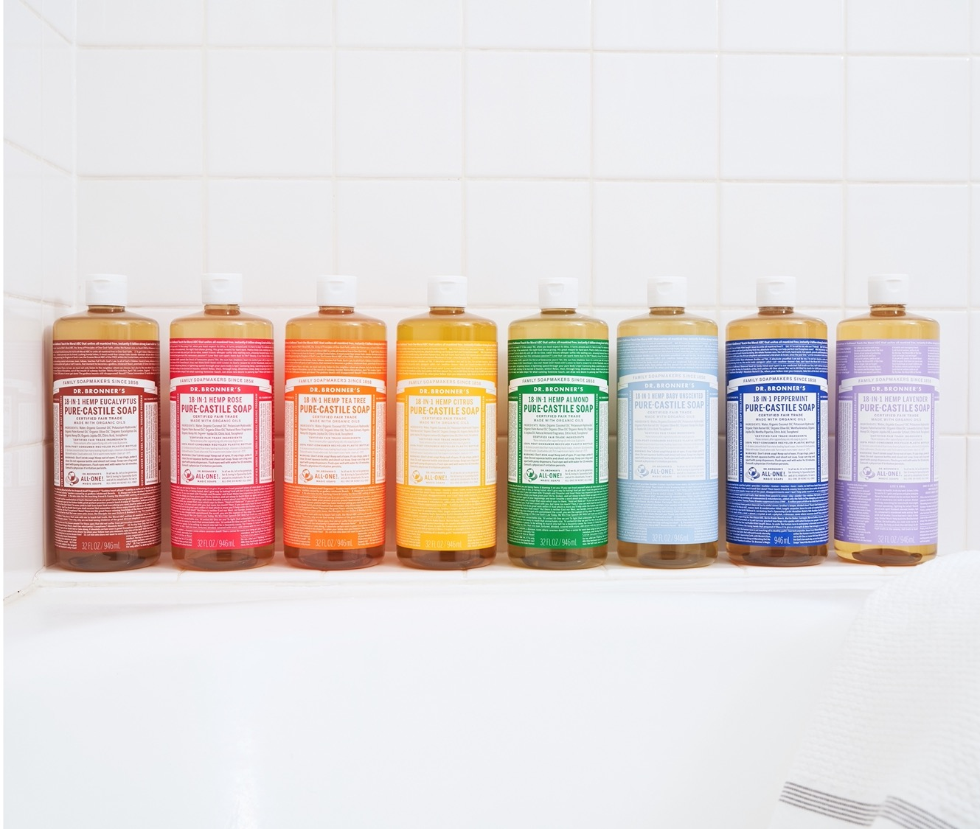
CONCENTRATED
Three times more concentrated than most liquid soaps
Cleans quickly and thoroughly
Deodorizes
Eliminates germs effectively
Reduces packaging
Budget-friendly
Notes:
Have you ever had the frustration of washing your hands, and then feeling like you need to wash them again? That doesn’t happen with Dr. Bronner’s castile. It is concentrated to handle any job, the first time. You can test this by coating your hands in olive oil. Many soaps would not get this off in one go – your hands would still feel greasy, but with Dr. Bronner’s there is such a high concentration of actual soap, that it can grab it all in one go.

Slide 5
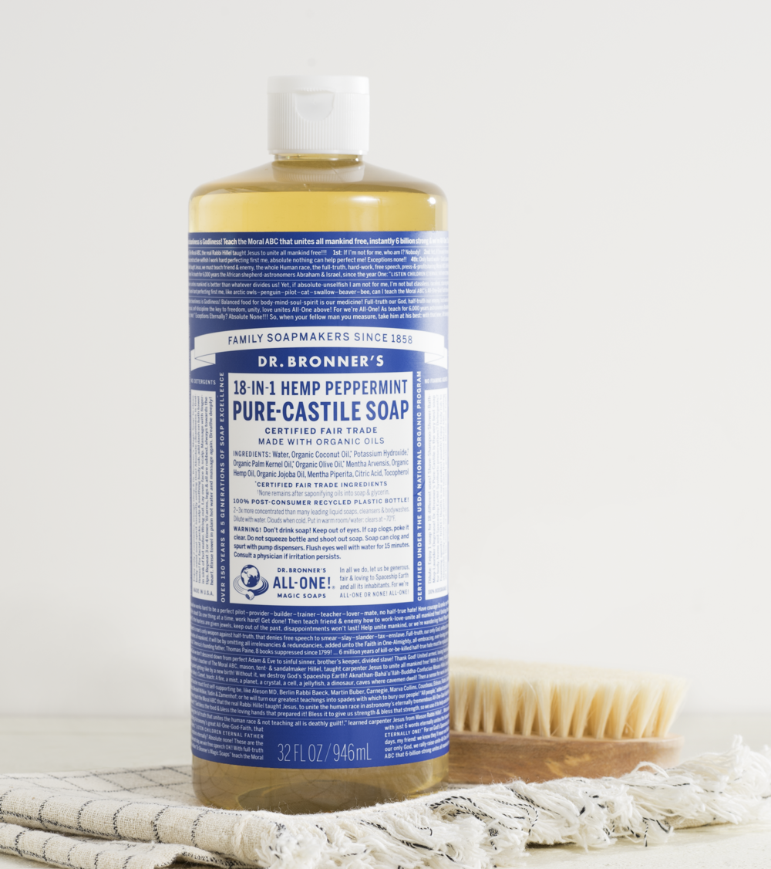
SUPREME VERSATILITY
Counters
Dishes
Windows
Carpets
Laundry
Fruits and veggies
Tile floors
Stone
Tubs
Sinks
Toilets
Painted walls
Make-up brushes
Microsuede
Stainless steel appliances
GIY solutions—housecleaning wipes, soft scrub
Notes:
The soap can wash just about anything. Soap and water is all you need. You don’t need complicated detergents. You don’t need a different cleaner for every surface. Our Castile soap can do it all. It is simple, straightforward, gets right to the grime, and gets it clean. Look at this list. Check out this picture. “Everything in this picture, from the tub to the walls to the baby, can be cleaned with Castile soap.”

Slide 6
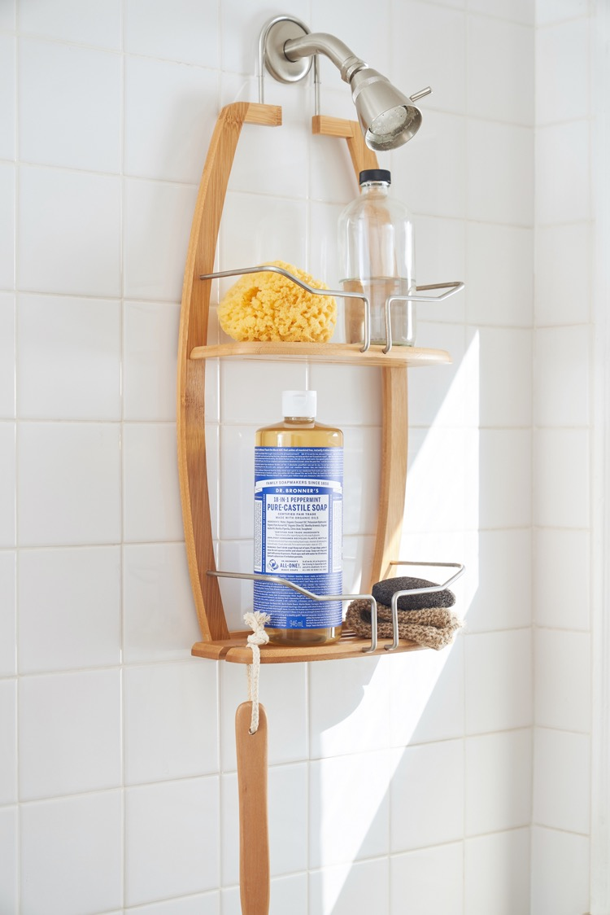
As seen in:
The Clean Living Show: Clean Beauty/8 Drugstore Beauty Product Launches To Try
16 Clean Beauty Product Winners From the 2020 Readers’ Choice Awards
Dr. Bronner's Baby Unscented Castile Soap Is the Reason My Skin Is So Soft

Slide 7
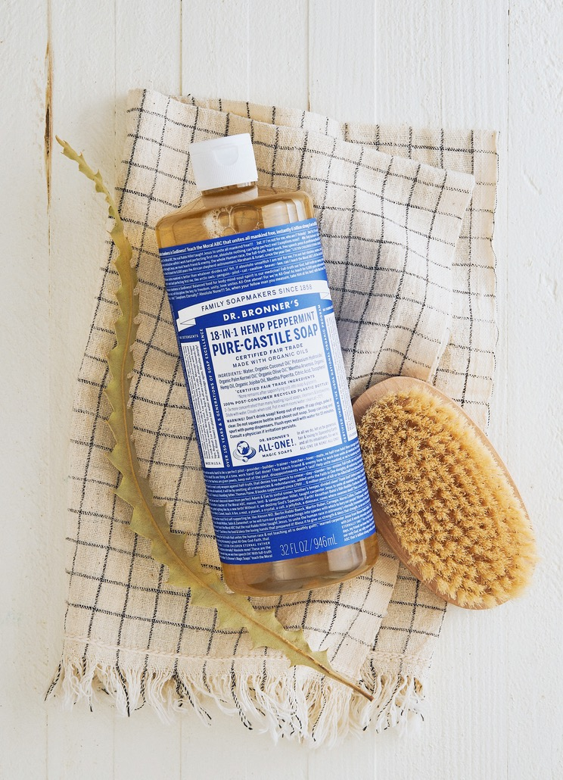
As seen in:
Clean your kitchen top to bottom with homemade solutions that reduce waste and cut costs
9 Little Habits to Break for a Less Wasteful Home
Target Clean beauty guide: 7 top-rated products of 2021
HGTV Editors' Favorite All-Purpose Cleaners
Notes:
Washington Post: https://www.washingtonpost.com/food/2021/04/25/homemade-kitchen-cleaners/
Real Simple: https://www.realsimple.com/home-organizing/cleaning/wasteful-home-habits
NBC News: https://www.nbcnews.com/select/shopping/target-clean-beauty-products-ncna1254814
HGTV: https://www.hgtv.com/lifestyle/clean-and-organize/best-all-purpose-cleaners

Slide 8
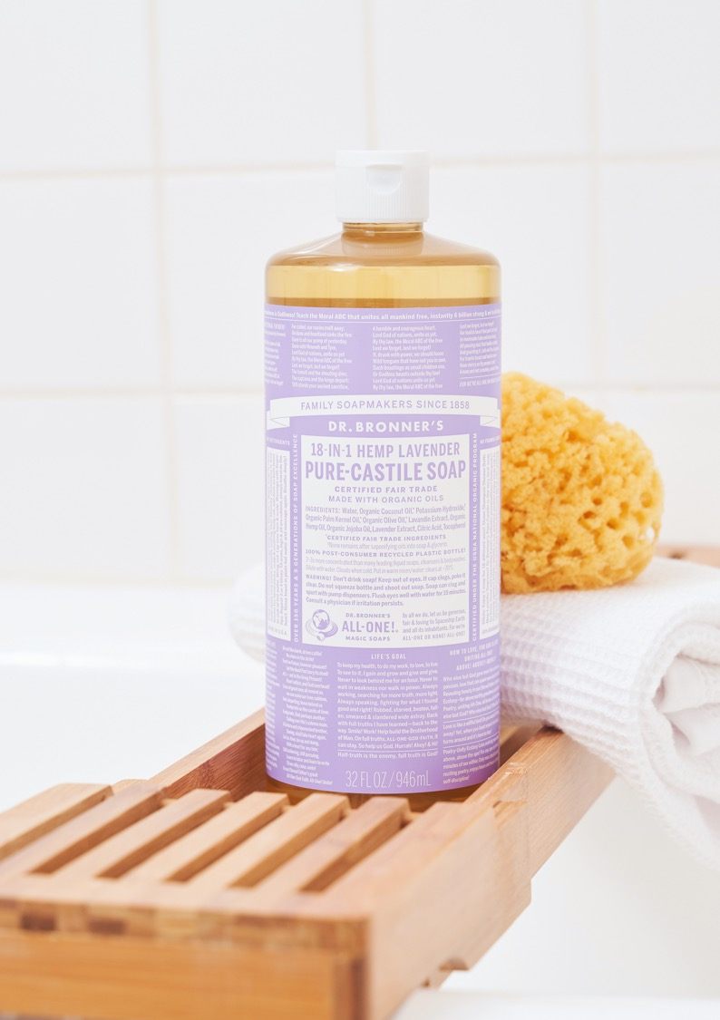
As seen in:
The T List: Five Things We Recommend This Week
10 Cult Beauty Products You Should Know
How to Keep up Your Grooming Routine While Traveling
A Dirtbag's Guide to Sanitation During a Pandemic

Slide 9
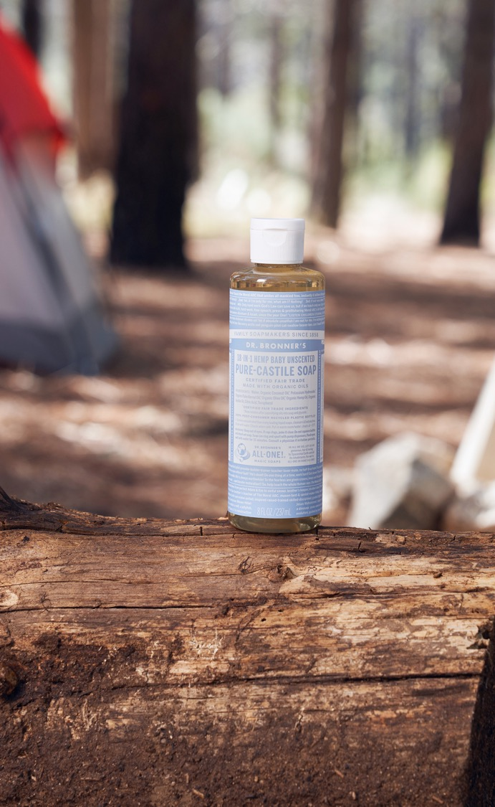
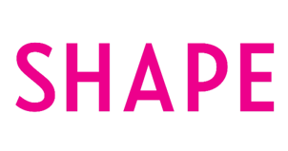
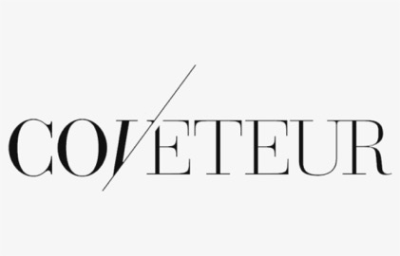
As seen in:
The 9 Best Natural Cleaning Products, According to Experts
How to Care for Your New Tattoo According to Experts
19 products to help make camping safer during a pandemic
Lenny Kravitz on His Signature Scent, His Beach Beauty Routine, and the Secret to His Longevity

Slide 10
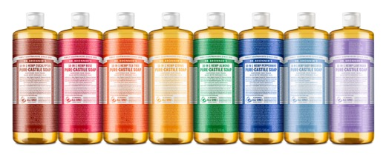
castile soap FAQs
What are the “18-in-1” uses? Where can I find recipes and dilutions for your soaps?
You can use Dr. Bronner’s soaps for washing your face, body, hands and hair, for bathing, shaving, brushing your teeth, rinsing fruit, aromatherapy, washing dishes by hand, doing laundry, mopping floors, all-purpose cleaning, washing windows, scrubbing toilets, washing dogs, controlling dust mites, and killing ants and aphids. Now, that’s eighteen uses right there, but customers have told us over time about many more uses they have found for our soaps. For recipes and dilutions, visit Lisa Bronner’s blog, Going Green with Lisa Bronner.
What does “Castile” mean? Is your bar soap also a castile soap like the liquid? What is the difference between your bar and liquid soaps?
Castile Soap has two widely accepted definitions. The first is a soap that is made purely with olive oil. The second, which is accepted just as widely, is a soap that’s made with no animal fats, only vegetable oils. Dr. Bronner’s defines “pure-castile” as soap made from pure plant oils without synthetic. Unfortunately, many synthetic detergent blends are deceptively labeled as “Liquid Soap” despite the fact that they contain absolutely no real soap whatsoever. Dr. Bronner’s Castile Liquid and Bar Soaps are both pure-castile, as they are all vegetable oil-based. The difference between the liquid and bar soaps is that the liquid soaps use potassium hydroxide to saponify the vegetable oils, while the bar soaps use sodium hydroxide instead.
Which of your products are vegan? Do you test your products on animals?
All of Dr. Bronner’s products sold in the U.S. and Canada are Certified Vegan, except for our Organic Lip Balms and Organic Body Balms, which contain organic beeswax. All of our products carry the “Leaping Bunny” seal, which indicates that they are cruelty-free and that there is no animal testing done with them. Although our product lines are otherwise vegan, we do use certified organic beeswax in our lip and body balms. We have not yet been able to find a certified organic plant-based wax, and Sue Kastensen, the creator of our balms, insisted that she had not found a plant-based alternative that could substitute for the amazing qualities of natural beeswax. Based on her experience, and her extensive training and mentoring under the Native American herbalist Keewaydinoquay, Sue formulated her original lip balms with just avocado oil and beeswax, because beeswax has natural antibacterial and sunblock qualities and provides a superior barrier to keep moisture in. We buy our certified organic beeswax from Zambia, where we have confirmed that the queen bees are not killed each year, a practice sometimes employed in conventional beekeeping to maximize yields.

Slide 11
castile soap FAQs
Are your tropical oils, including palm and palm kernel oils, produced sustainably?
It is devastating to see the degree to which irresponsible palm harvesting is destroying natural habitats. While our Bar Soaps do contain palm oil, we have gone to great lengths to ensure that our fair trade and organic palm oil is sustainably harvested in a way that does not damage the environment. All our palm oil comes from smallholder farms in Ghana, where oil palms have been grown for centuries, and where no new deforestation is occurring. We are constantly striving to improve sustainability, and we support growers with organic methods for improving palm fruit yields—thus getting more oil out of the same amount of land. In short, we believe that it’s not simply what you grow, but how you grow it. You can read more about our palm oil project in Ghana on our website. We also have a video on our Fair Trade Palm Oil Project in Ghana.
Why is palm kernel oil now in the liquid soap? Is it sustainable?
As our company continues to grow, we can partner with more and more organic and fair trade projects around the world, thereby supporting organic farming practices, fair wages, and economic development. Adding fair trade and organic palm kernel oil to our soaps allows us to support the good work being done by Natural Habitats in Ecuador, where small-scale farmers grow oil palms sustainably and receive a fair price for their palm fruits. Because the fatty acid profile of coconut and palm kernel oils are so similar, they can be used interchangeably in soapmaking, where they produce an identical rich and copious lather.
Is Dr. Bronner’s considering going plastic-free?
Dr. Bronner’s exclusively uses 100% post-consumer recycled (PCR) polyethylene (PET) plastic bottles for all our liquid and pump soaps and have been using 100% PCR PET bottles for more than 10 years. PCR plastic bottles are made from plastic sourced from curbside pickups. This means that some of our bottles are made from 100% post-consumer recycled PET and may even include some plastic from old Dr. Bronner’s bottles!
By turning used plastic bottles into new plastic bottles and products, we help conserve virgin resources, reduce landfill, and capitalize on the energy already invested in making existing plastic. Recycling one ton of PET containers saves 7.4 cubic yards of landfill!
“Bottle-to-bottle” recycling, the recycling of plastic bottles into new bottles, is also uncommon. Most times the plastic picked up at the curbside is “downcycled,” or shipped to countries abroad, where it’s used to create synthetic fabrics for carpets and clothes, which are then shipped back to the United States for sale. Bottle-to-bottle recycling helps to close the loop and results in fewer greenhouse gas emissions.
We also continue to keep close tabs on innovations taking place in bioplastics research. Bioplastics use renewable resources like plants and bacteria to create plastics that would otherwise be produced from petroleum. This technology is still in its early stages and doesn’t yet produce plastics that are resilient enough for our purposes. Energy intensity and feedstock matter a great deal as well. Currently it is still more energy intensive to turn plants into plastic than it is to recycle used plastic.
Bioplastics made from pesticide-intensive non-organic sugar, potato, or GMO corn may not represent a sustainability advantage over 100% post-consumer recycled plastics. The best container for liquids may be glass, but considering that most of our products are used in wet and potentially slippery locations, glass is not a viable option.

