Slide 1
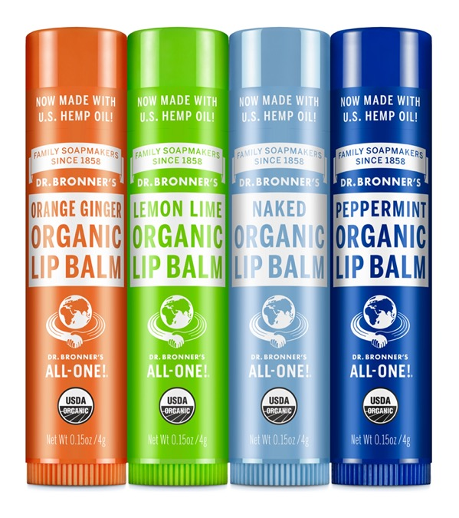
Organic Lip Balm
Protect and moisturize your lips with organic beeswax and oils!
0.15 OZ. LIP BALM AVAILABLE IN: Orange Ginger, Lemon Lime, Naked & Peppermint Also Available in Lip Balm Display (12 Count Shelf Case) and Mixed Lip Balm Display (48 Count Display)

Slide 2
Organic Lip Balm
Now made with U.S.-grown hemp seed oil!
Not just for lips! Use for dry hands and feet, chapped chins and cheeks!
Organic beeswax to protect against cold, wind, dry weather
Organic jojoba-avocado-hemp seed oils for extra moisture
Only the finest organic essential oils for fragrance
Certified organic to USDA National Organic Program standards
What you put on your lips goes into your body
Hand-made and poured by employees at headquarters in Vista, CA
Ingredients: Organic Avocado Oil, Organic Jojoba Oil, Organic Beeswax, Organic Hemp Seed Oil, Organic Essential Oils,** Tocopherol
*CERTIFIED FAIR TRADE INGREDIENTS
**Essential oils vary by scent.
Made with U.S.-grown hemp seed oil!

Slide 3
ORGANIC LIP BALM
Not just for lips
Extra deep relief for cracking skin on knuckles and cuticles—stays put on tough skin
Eyebrow balm and shaping
On-the-go convenience

Slide 4
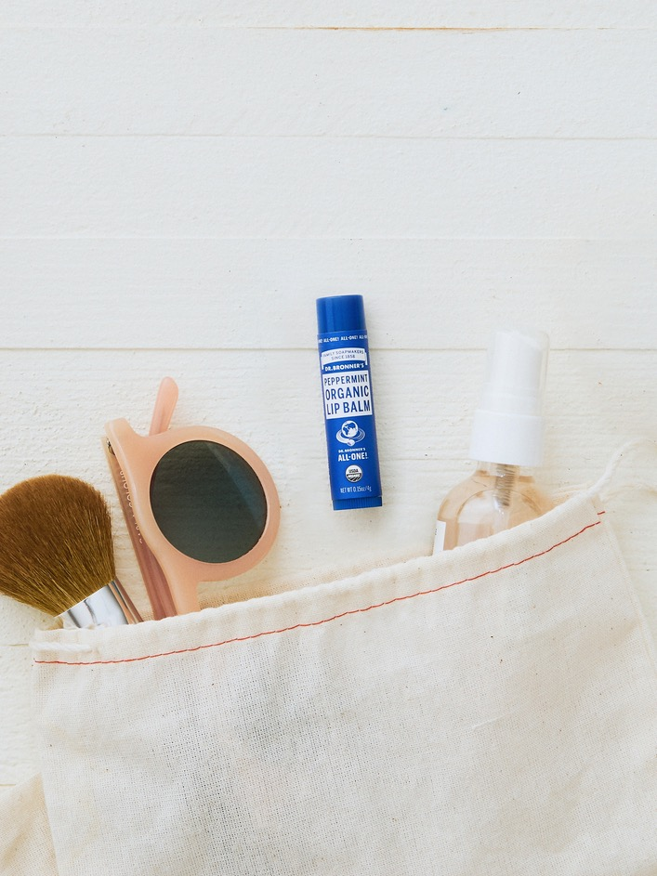
As seen in:
TODAY Online: 28 Eco-Friendly Beauty Products to Try in Honor of Earth Day
Dr. Bronner’s Sources 100 Percent of Its Organic Hemp Seed Oil From U.S. Farmers—Here’s Why That Matters
The Best Lip Balms for Men

