Slide 1
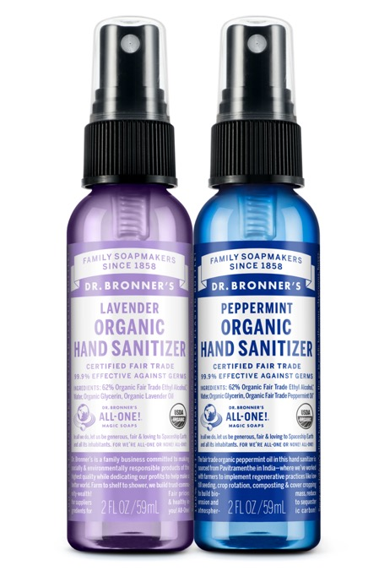
ORGANIC HAND SANITIZER
Organic and 99% effective against germs—smells & feels fantastic!
NEW!
2 OZ. HAND SANITIZER AVAILABLE IN: Lavender & Peppermint

Slide 2
ORGANIC HAND SANITIZER
Just as effective as conventional sanitizers without the nasty chemicals
Only fair trade organic ethyl alcohol, organic lavender oil, organic glycerin and water to sanitize skin
No GMO-ethanol or petrochemical thickeners
Certified under same National Organic Program that certifies food
Spray on children’s sticky hands—wipe clean
Use as air freshener or deodorizer—spray into air for wonderful lavender aroma
Ingredients: 62% Organic Ethyl Alcohol,* Water, Organic Glycerin,** Organic Lavender
*CERTIFIED FAIR TRADE INGREDIENTS
**Sourced from Organic Soy
Packaged in 100% post-consumer recycled plastic bottle.

Slide 3
ORGANIC HAND SANITIZER
Sanitize organically, wake up your senses
Just as effective as conventional sanitizers without the nasty chemicals
Only fair trade organic ethyl alcohol, water, organic glycerin and fair trade organic peppermint oil from Pavitramenthe in India, where we’ve partnered to implement regenerative organic practices.
No GMO-ethanol or petrochemical thickeners
Use on the go, spray on surfaces in public bathrooms, classrooms, buses, planes—clean screens!
Pure peppermint aroma to stimulate the senses and focus the mind
Supports climate-friendly regenerative practices like low-till seeding, crop rotation, composting & cover cropping to build healthy soils, reduce erosion and sequester atmospheric carbon!
Ingredients: 62% Organic Ethyl Alcohol,* Water, Organic Glycerin,** Organic Fair Trade Peppermint Oil*
*CERTIFIED FAIR TRADE INGREDIENTS
**Sourced from Organic Soy
Packaged in 100% post-consumer recycled plastic bottle.

Slide 4
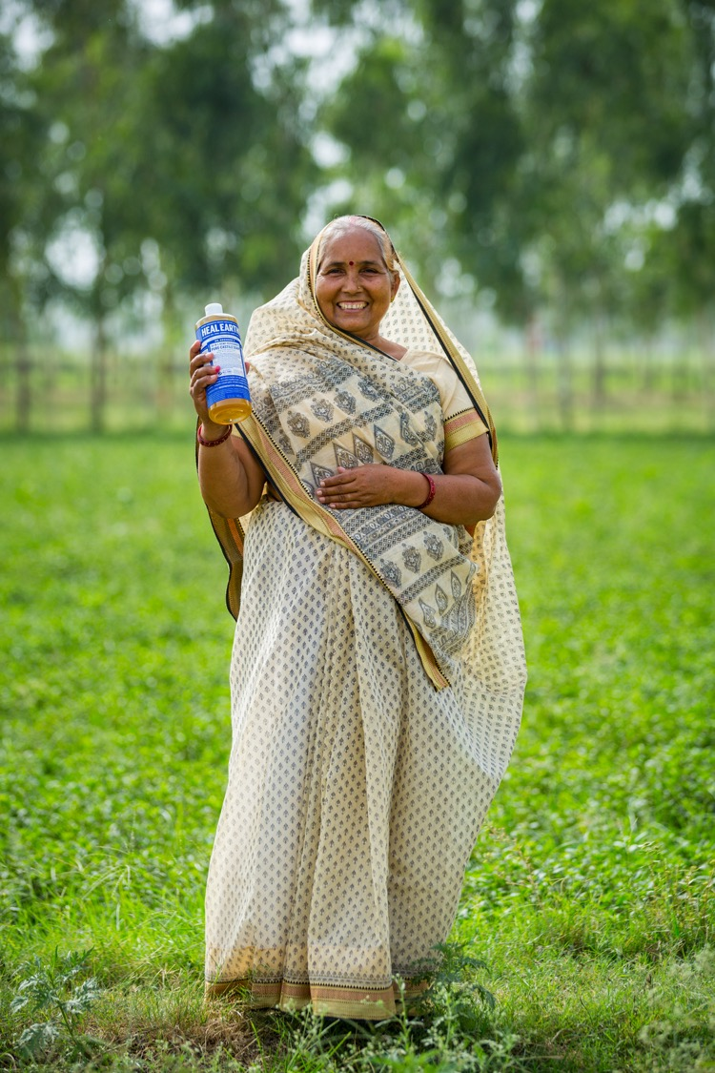
mint Oil
Regenerative Organic Certified™ (ROC™)
The peppermint oil in this hand sanitizer spray is Regenerative Organic Certified and sourced from Pavitramenthe in India—where we work with farmers to implement climate-friendly practices like low-till seeding, diverse crop rotation, composting & cover cropping to build healthy soils reduce erosion and sequester atmospheric carbon!
Fair trade practices are included in the ROC standards and ensure that farmers and their families benefit with fair prices and community development projects!

Slide 5
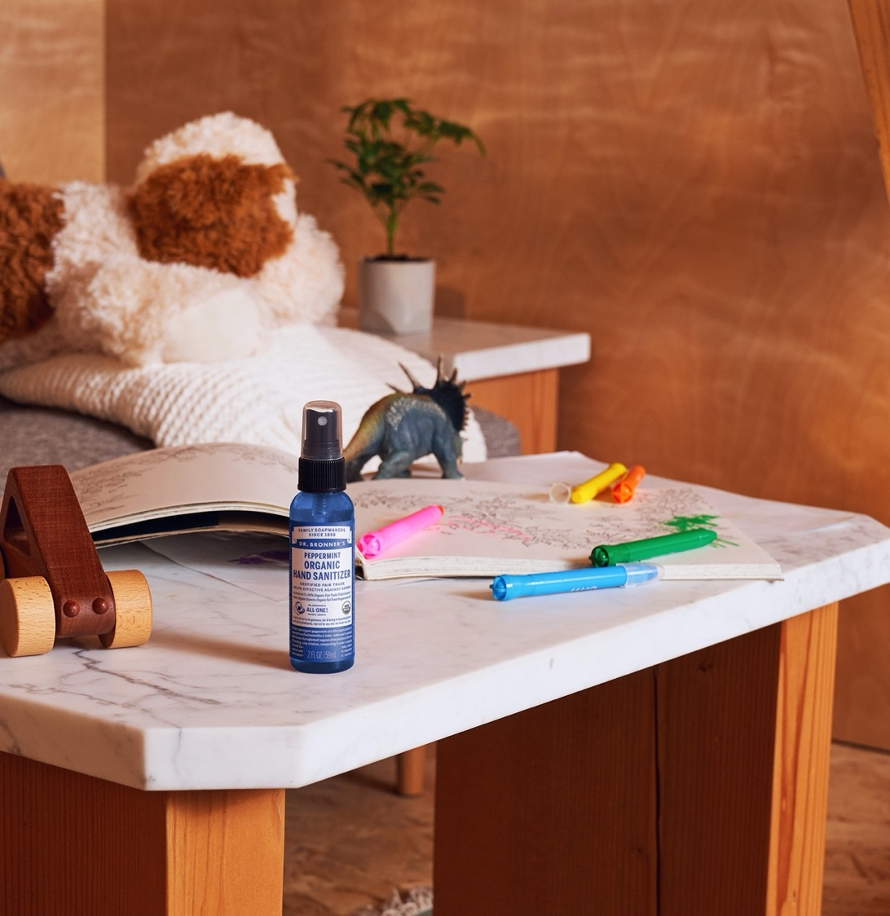
ORGANIC HAND SANITIZER
Not just for germy hands
Fight germs on:
Shopping cart handles
Airplane seat trays
Restaurant highchairs
Steering wheels
Toilet seats & handles
Remove stickiness
Freshen air and pillows
Deodorize organically
Relieve insect bites

Slide 6
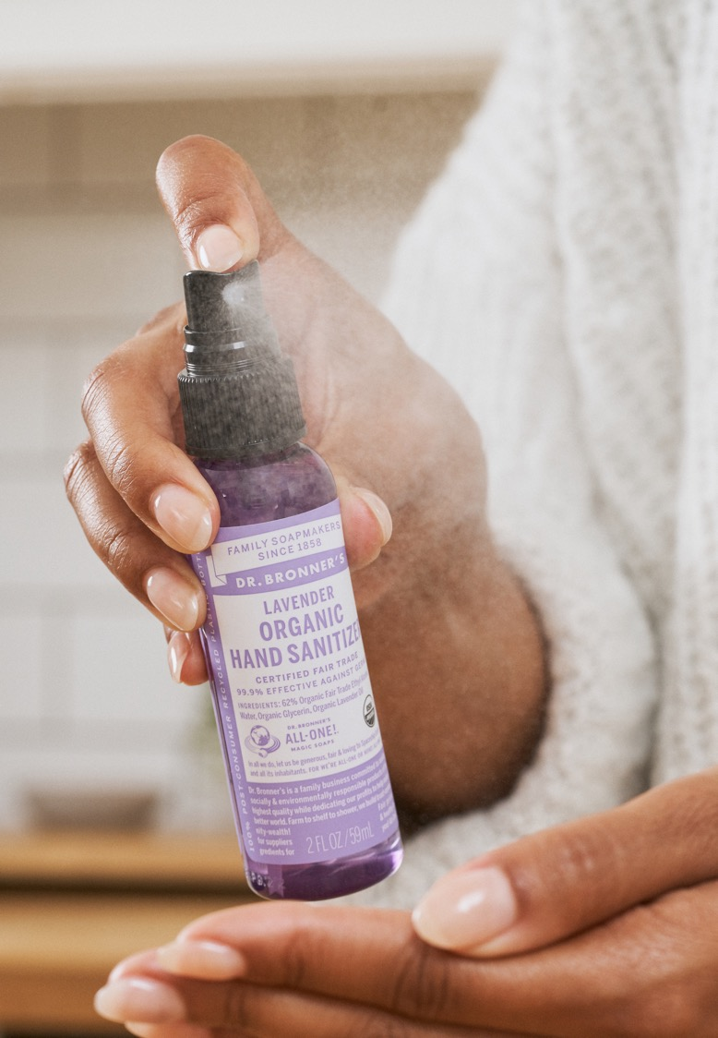
As seen in:
SAG Awards 2020: See What’s Inside This Year’s Gift Bags
Nifty Sanitization Stuff to Make Everything in Your Life Less Gross
16 Hand Sanitizers That Actually Smell Good
The 5 Best Hand Sanitizers for the 2020 Cold and Flu Season
The 11 Best Hand Sanitizers to Carry With You Everywhere

Slide 7
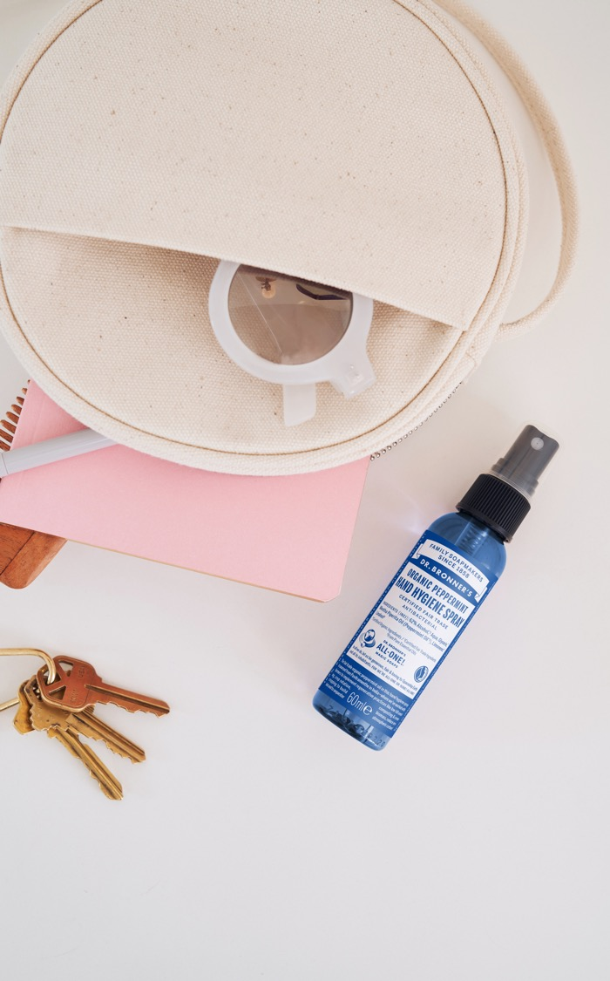
As seen in:
The 25 Best Hand Sanitizers to Clean Hands in a Pinch
I'm Obsessed With Joe Biden’s Dr. Bronner’s-ass Hand Sanitizer
The Best Hand Sanitizers to Stick Into Your Backpack, Purse, and Carry-On
Going Back to the Office Again? Here’s Everything You Need for a Seamless Transition
How This Bride Planned Her Own Micro-Wedding in the Scottish Highlands
Notes:
Forbes
https://www.forbes.com/sites/christophermarquis/2021/07/02/from-soap-to--chocolate-dr-bronners-launches-into-food-as-extension-of-supply-chains-positive-impact/?sh=74b4c98b1aab
Conde Nast Traveler (2x)
https://www.cntraveler.com/gallery/best-hand-sanitizers-for-travel?mbid=synd_yahoo_rss
https://www.cntraveler.com/story/what-super-travelers-always-have-in-their-beach-bags
Gear Patrol
https://www.gearpatrol.com/style/a745840/hand-sanitizers/
Variety
https://variety.com/2021/shopping/news/office-desk-items-essentials-1235022820/
Vogue
https://www.vogue.com/slideshow/elle-mie-jin-mcpherson-yoon-angus-tweedie-scottish-highlands-wedding

Slide 8
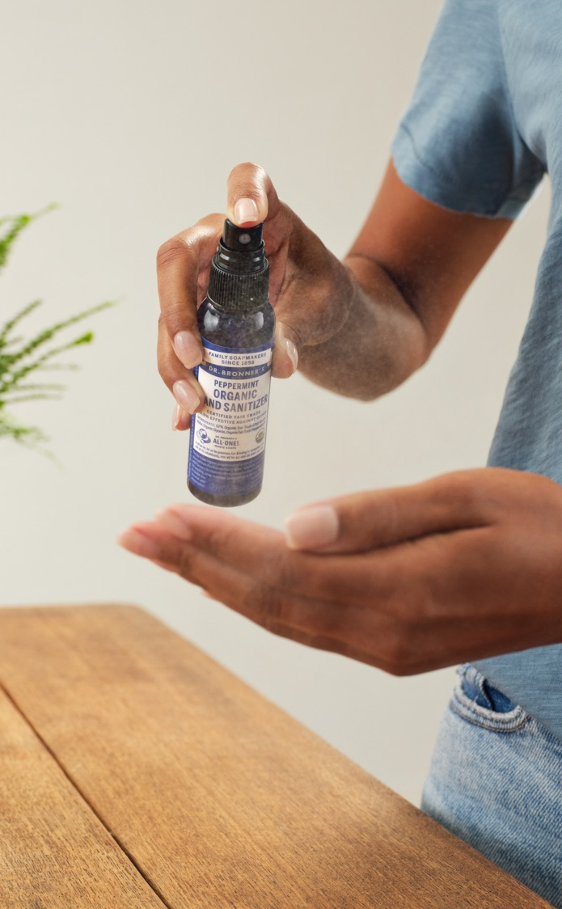
As seen in:
Dr. Bronner’s Had a Hand Sanitizer Hangup: Not Enough Bottles
10 Great Hand Sanitizers That Aren’t Purell
These 14 Hand Sanitizers Kill Germs Without Wreaking Havoc on Your Skin
The 25 Best Hand Sanitizers to Clean Hands in a Pinch
These Things That Make Us Happy Brought Our Editors Summer Joy This Week

