Slide 1
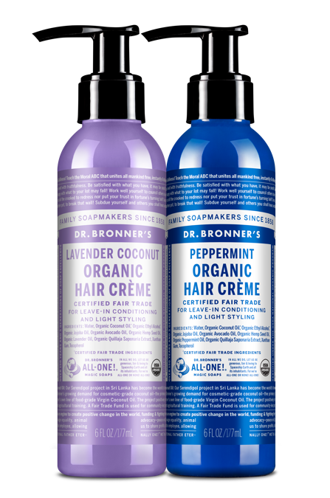
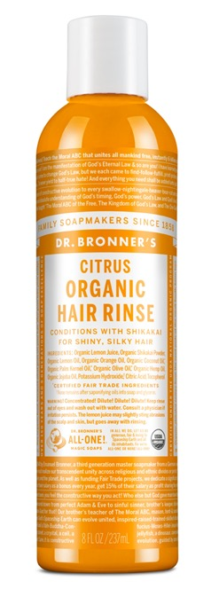
Organic Hair Rinse & hair crème
Organic hair care—soft-healthy hair in 3 steps!
8 OZ. ORGANIC HAIR RINSE AVAILABLE IN: Citrus 6 OZ. ORGANIC HAIR CRÈME AVAILABLE IN: Lavender Coconut & Peppermint

Slide 2
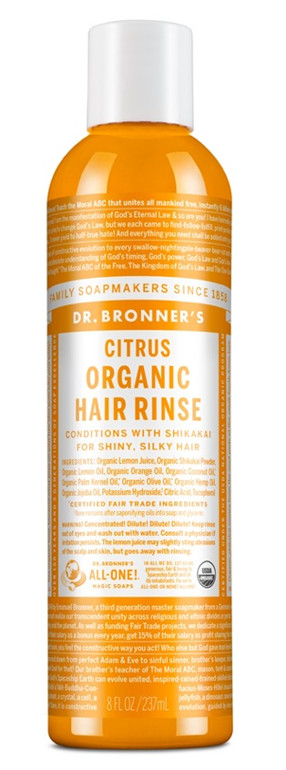
organic hair rinse
USDA certified organic
Simple formulation is the perfect follow up to shampooing with any of our soaps
Organic lemon juice rinses and tightens hair shaft for excellent manageability
Good for straight-curly-kinky-any type hair
Organic shikakai gently cleans, conditions & nourishes–leaves hair shiny
Organic coconut-olive-hemp-jojoba oils moisturize for silky-smooth feel
Now made with U.S.-grown hemp oil!
Packaged in 100% post-consumer recycled plastic bottle.
Ingredients: Organic Lemon Juice, Organic Shikakai Powder, Organic Lemon Oil, Organic Orange Oil, Organic Coconut Oil*, Organic Palm Kernel Oil*, Organic Olive Oil*, Organic Hemp Oil, Organic Jojoba Oil, Potassium Hydroxide†, Citric Acid, Tocopherol
*CERTIFIED FAIR TRADE INGREDIENTS
†None remains after saponifying oils into soap & glycerin.
Made with U.S.-grown hemp seed oil! Packaged in 100% post-consumer recycled plastic bottle.

Slide 3
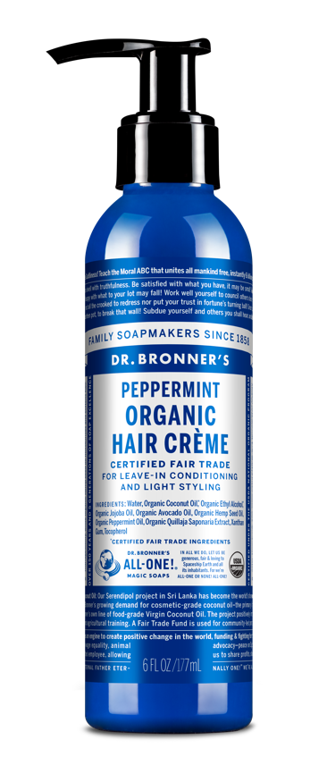
Organic Hair crème
Fair trade & USDA certified organic
Organic coconut oil for strong, shiny hair
Organic jojoba oil for excellent manageability
Organic hemp seed oil moisturizes and softens hair
Now made with U.S.-grown hemp seed oil!
Light styling hold and silky-soft hair
Use after shampooing for additional conditioning and styling
Packaged in 100% post-consumer recycled plastic bottle.
Ingredients: Water, Organic Coconut Oil,* Organic Ethyl Alcohol,* Organic Jojoba Oil, Organic Avocado Oil, Organic Hemp Seed Oil, Organic Essential Oils,** Organic Quillaja Saponaria Extract, Xanthan Gum, Tocopherol
*CERTIFIED FAIR TRADE INGREDIENTS
**Essential oils vary by scent.
Made with U.S.-grown hemp seed oil! Packaged in 100% post-consumer recycled plastic bottle.

Slide 4
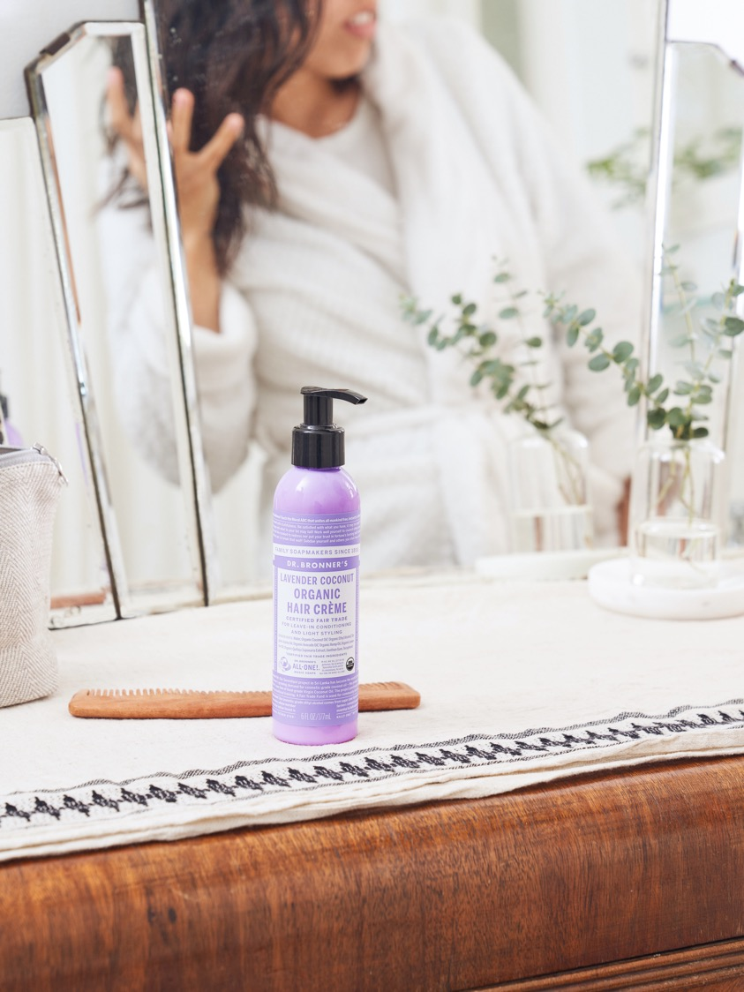
As seen in:
8 Simple Swaps to Make Your Personal Care Eco-Friendly
I’m Obsessed with This Magical Multipurpose Cleaner That’s Been Around Since 1858
Best Organic Soap on Amazon: Dr. Bronner’s 18-in-1 Pure Castile Soap
10 Lavender Hair Products for a Better Night’s Sleep
Notes:
One Green Planet
https://www.onegreenplanet.org/lifestyle/8-simple-swaps-to-make-your-personal-care-eco-friendly/
Apartment Therapy
https://www.apartmenttherapy.com/amazon-best-organic-soap-dr-bronners-review-36863114?utm_source=RSS&utm_medium=feed&utm_campaign=Category%2FChannel%3A+main
Sephina
https://sephina.com/2021/02/27/best-organic-soap-on-amazon-dr-bronners-18-in-1-pure-castile-soap/
Gear Moose
https://gearmoose.com/best-natural-lip-balms/
Mane Addicts
https://maneaddicts.com/10-lavender-hair-products-better-nights-sleep/?slide=3

