Slide 1
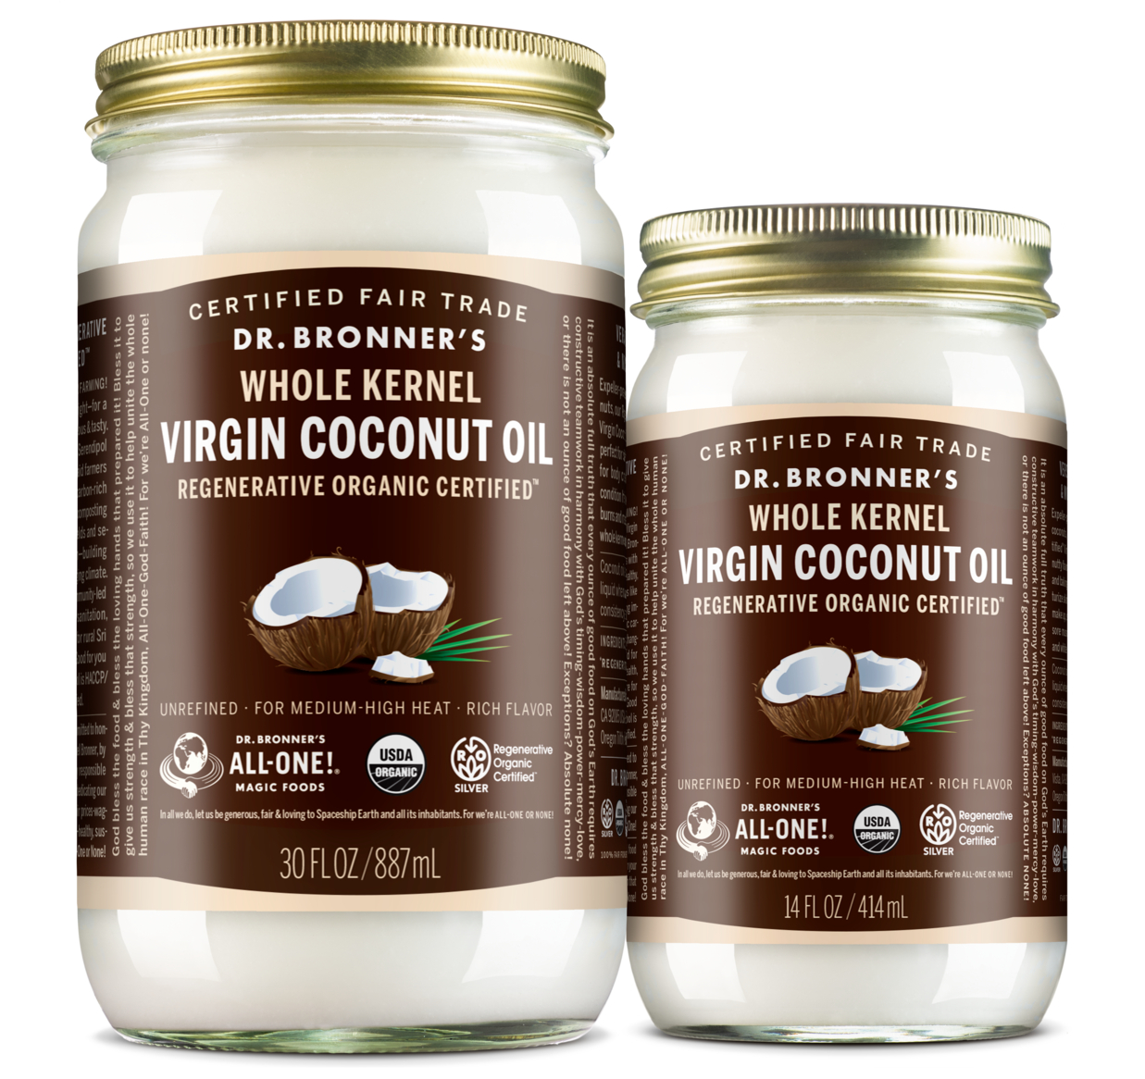
VIRGIN COCONUT OIL
Regenerative Organic Certified®—righteous & tasty!
WHOLE KERNEL COCONUT OIL AVAILABLE IN 14 OZ. & 30 OZ.

Slide 2
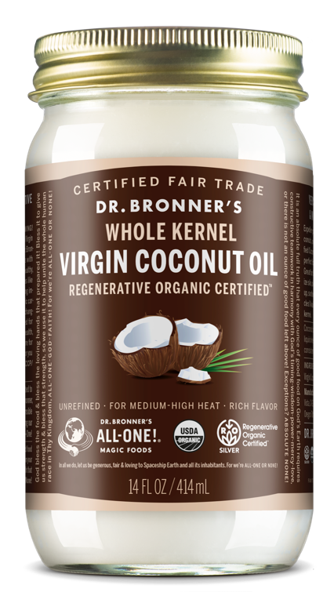
VIRGIN COCONUT OIL
Regenerative Organic Certified®—righteous & tasty!
Loved for its taste, equally great for body and hair
Expeller-pressed from fresh, carefully dried coconuts—brown inner skins left on for a rich, nutty flavor
Healthy, delicious and moisturizing too
Ingredients: Organic Unrefined Virgin Coconut Oil* **
*CERTIFIED FAIR TRADE INGREDIENTS
**Regenerative Organic Certified

Slide 3
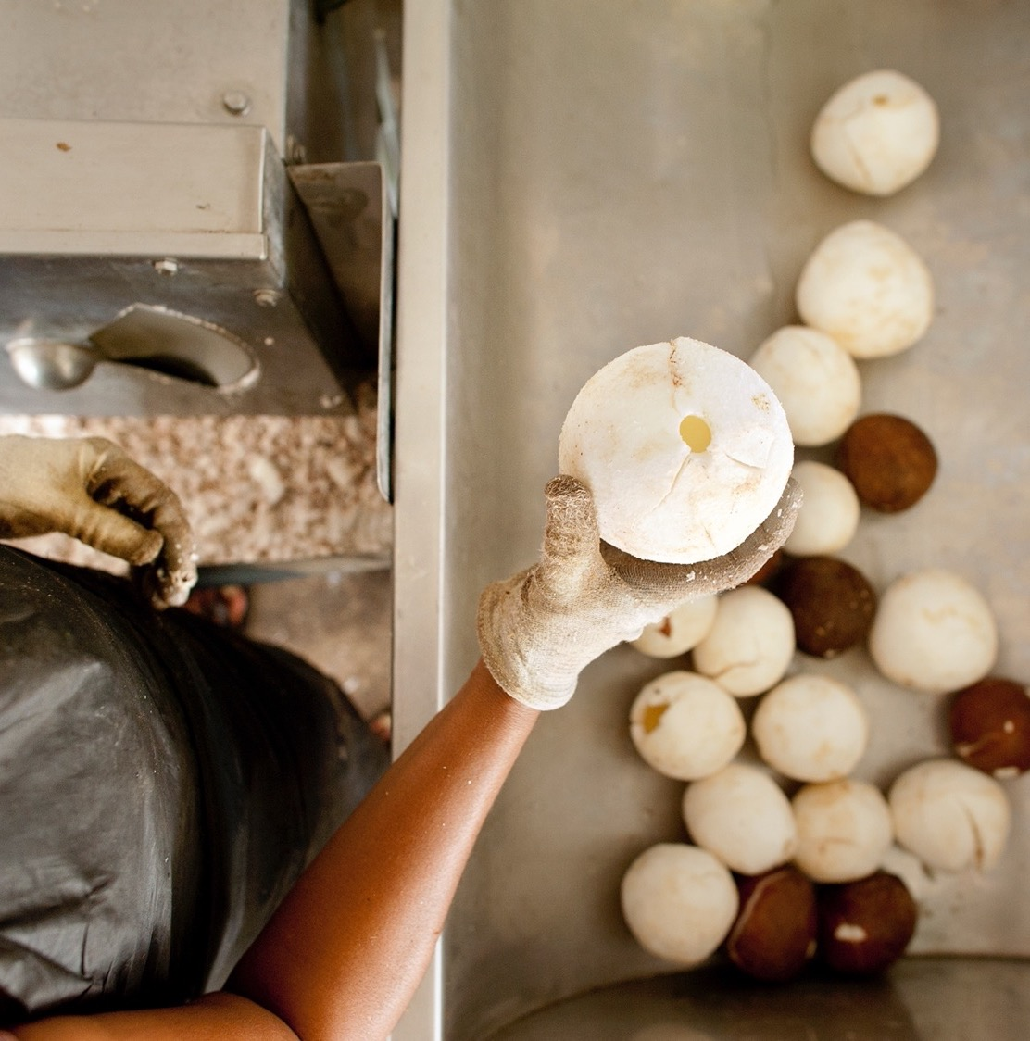
THE ONLY WHOLE KERNEL COCONUT OIL ON THE MARKET
Grown and processed in Sri Lanka’s Coconut Triangle
Coconuts are dried for just the right amount of time
Pressed as soon as they’re ready
Very rich coconut flavor, you can really smell the coconut!
Pressed together with the thin brown “skin” that surrounds the white coconut flesh.
Gives the coconut oil an even nuttier, richer flavor
Contains additional vitamins and minerals
Notes:
We hear it from our customers all the time: our coconut oil has a rich flavor that really comes through, and you can actually smell the coconut! There are several factors that contribute to our coconut oil’s rich taste and smell. For one, our coconut oil is single origin. Instead of buying from brokers who might source from different parts of the world, we source our coconut oil from trees grown only in the heart of Sri Lanka, a region known as the coconut triangle. This region of Sri Lanka has been growing coconuts for decades, and coconut oil is an important part of the local culinary tradition.
Our coconuts are processed near to the farms. They are brought to our processing plant at Serendipol where they are dried for just the right amount of time, then pressed as soon as they are ready. It is this careful attention to detail at every step of the way that leads to such high quality coconut oil.

Slide 4
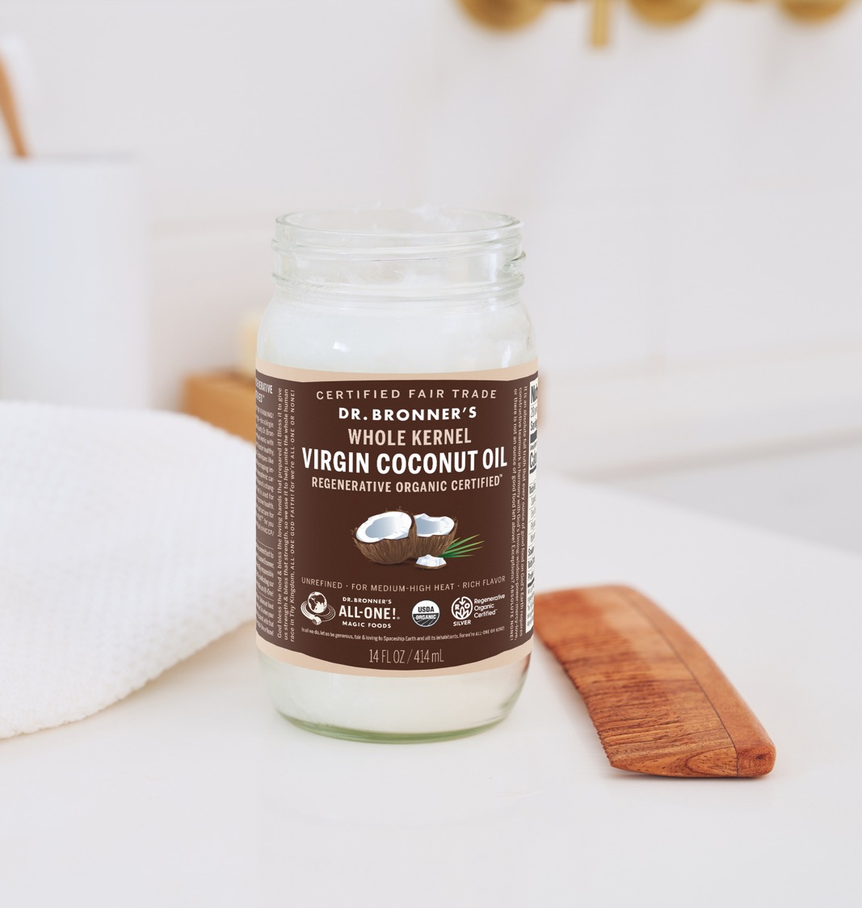
MULTIPURPOSE & VERSATILE!
Cooking
Baking (Vegan replacement for butter)
Sautéing
Stir-fries
Eat straight from spoon!
Body care
Skin care (moisturize, clean make-up)
Hair care (condition)
Oral care (oil pulling)
Massage
Notes:
Like all of our products, our coconut oil has multiple uses, part of what makes it a valuable addition to any cupboard. In cooking it is a healthy oil that has a somewhat higher smoking point than olive oil. This makes it ideal for stir-fries and sautées. It is a great butter replacement for vegan baking recipes, and can be eaten raw on toast or in smoothies.
Of course, coconut oil is super-versatile useful in many body care applications. It can be used to moisturize skin, or to clean make-up. It can be used to condition hair, e

Slide 5
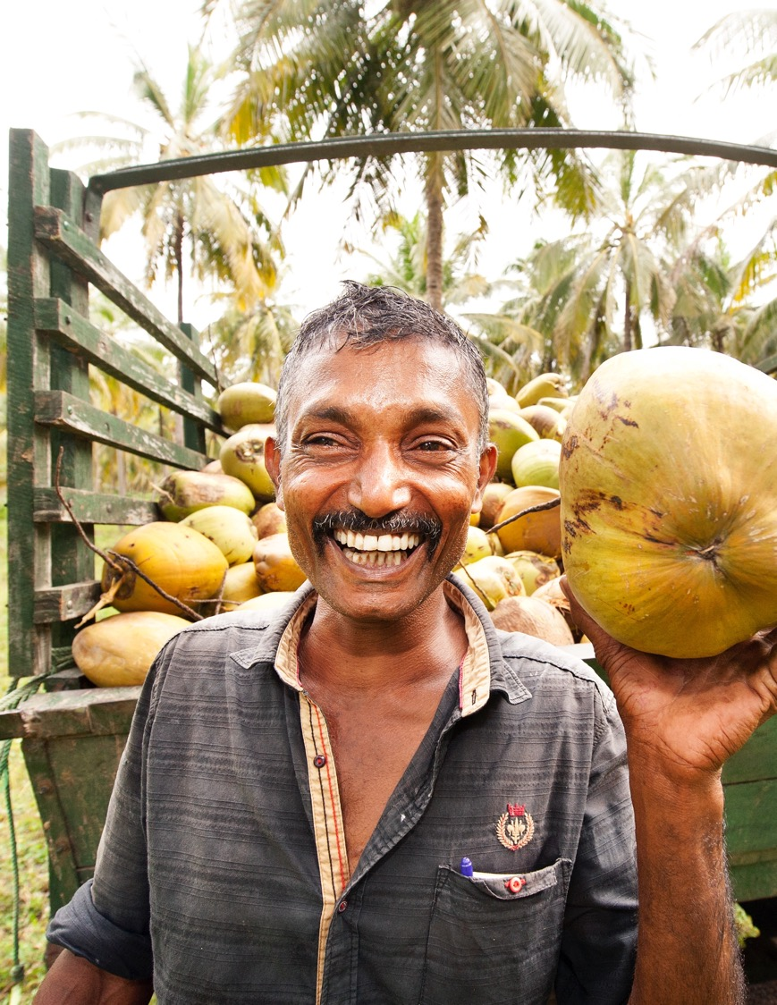
Coconut oil with soul!
Regenerative Organic Certified® and Fair Trade
Nurtures soil health and resilient communities
Sequesters carbon in the soil
Helps soil retain more water
Creates biodiversity
Helps mitigate catastrophic climate change
Notes:
One of the most exciting things about Dr. Bronner’s Coconut Oil is it’s impact on the communities that grow and process the coconuts. Fair trade and regenerative organic practices means that we have an opportunity, through the production of this coconut oil, to make a real on the land and the people.

Slide 6
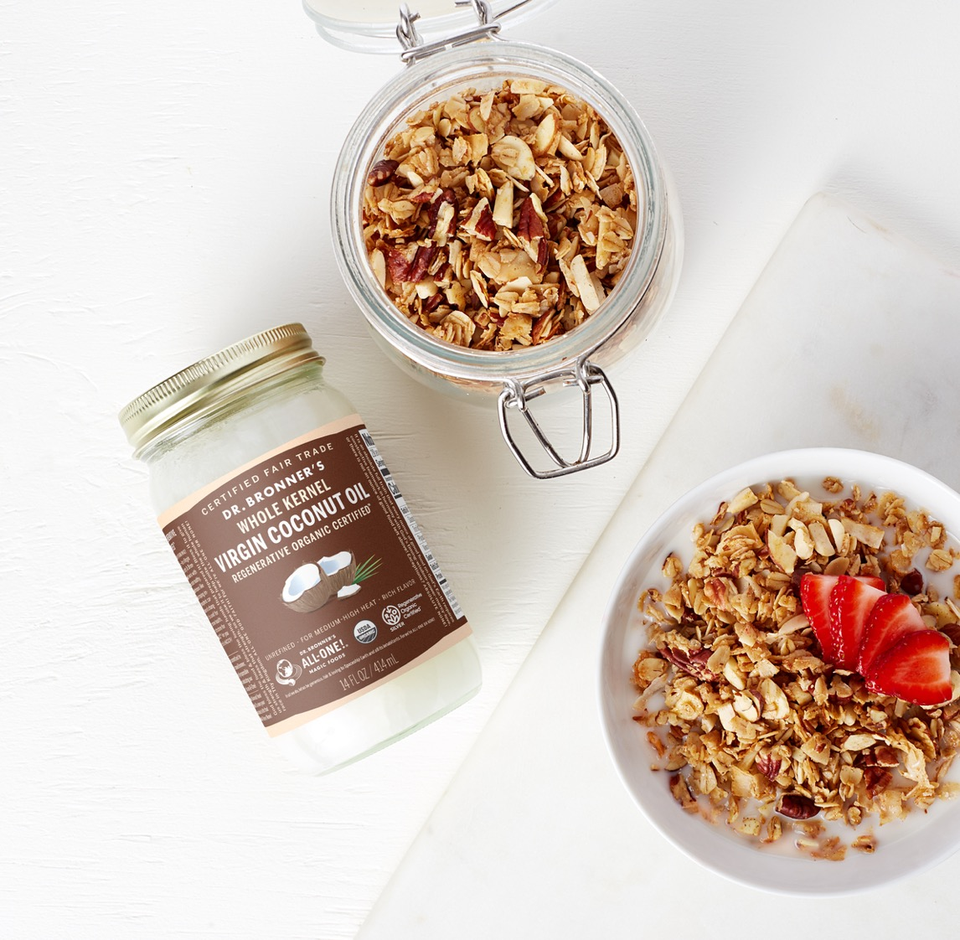
VIRGIN COCONUT OIL AND CARDIOVASCULAR HEALTH
Used as a part of a varied, mostly plant-based diet, VCO is a healthy fat that has been shown to have salutary effects.
Coconut oil is rich in lauric acid—which the body processes differently than it does other saturated fats.
In Sri Lanka, where coconut oil is an important part of the traditional diet, heart health is very good.
Notes:
You may have heard a lot of conflicting information about whether Coconut Oil is healthy. It is classified as a saturated fat, and saturated fats have come in and our of favor over the years. As with many blanket statements, the question of whether saturated fats are good or bad for you, has left customers confused and generally distrusting the ability of health professionals to determine what a healthy diet is.
The bottom line is that despite decades of research and billions of dollars spent, scientists still haven't been able to demonstrate a clear link between saturated fats and cardiovascular disease and several recent review studies that combined data from multiple other studies, found that there really is no link.
The best dietary advice seems to be Michael Pollan’s edict: eat real food, mostly plants, not too much!

Slide 7
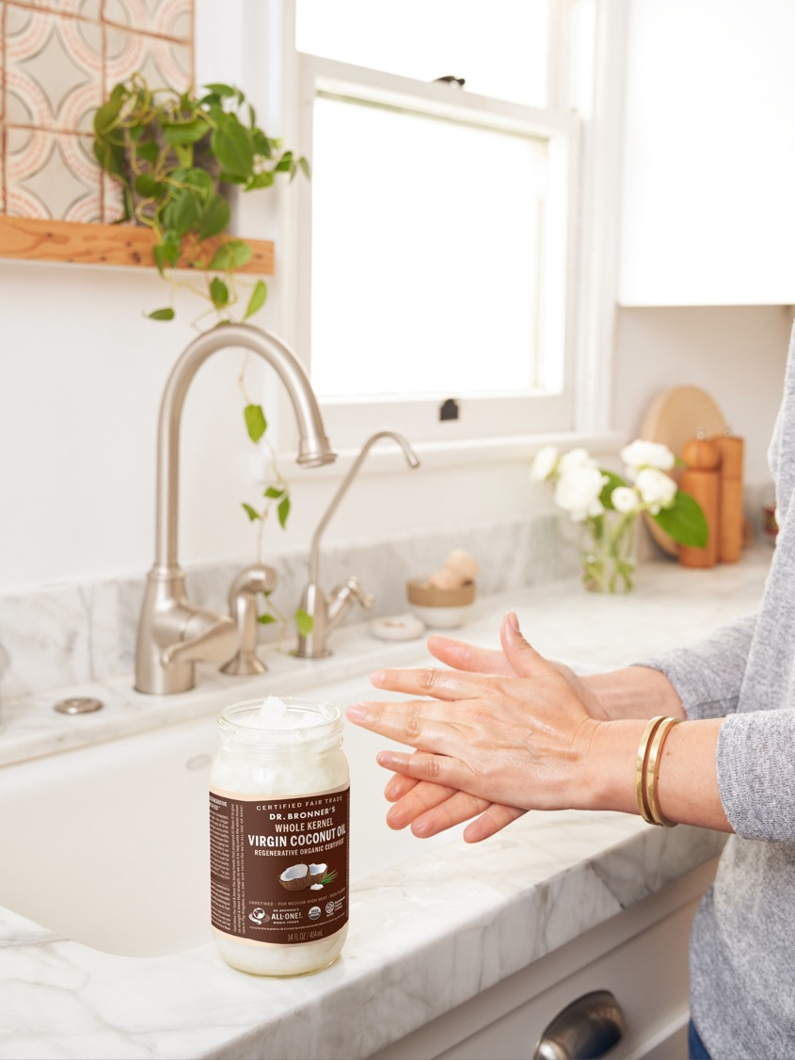
As seen in:
Dr. Bronner’s Joins Brands In A Push For Regenerative Organic Certification
With Regenerative Organic Certified Set to Launch, its Social Justice Component is More Prescient Than Ever
The 7 Best Coconut Oils for Skin & Allover Hydration (Your Smooth Skin Awaits!)
What Singer Jhene Aiko Can’t Live Without
What Author Rumaan Alam Can’t Live Without

Slide 8
Virgin coconut oil FAQ
How is your coconut oil made?
Dr. Bronner’s Regenerative Organic Certified® Virgin Coconut Oils are made using a “dry process”—after the coconuts are harvested, nuts mature for three weeks on the farm or at the factory. Then the outer, fibrous husks are removed, and the nuts are processed into oil within two days. After shelling and washing, the coconut kernel is ground and air-dried in a fluidized bed dryer. Within twelve hours, the ground and dried kernel is expeller-pressed. The oil then goes through a two-stage filtering process to remove solids, producing a clear oil. Our Whole Kernel oil is made from the whole coconut kernel, with the brown parings (the soft inner skin) left intact.

Slide 9
Regenerative organic certified® FAQs
What is Regenerative Organic Certified? Regenerative Organic Certified is a holistic agriculture certification encompassing robust, high-bar standards for ensuring soil health and ecological land management, pasture-based animal welfare, and fairness for farmers and workers. It was created to model an ecological and ethical system for agricultural production that addresses the problems of factory farming, climate change, and economic injustice, both locally and globally.
Why is Dr. Bronner’s supporting Regenerative Organic Certified? Industrial agriculture and the factory farming of animals are top contributors to climate change. At Dr. Bronner’s, we believe we need to shift our focus to clear, calculated changes to our food and agricultural production system in order to make regenerative organic agriculture the new model, both locally and globally. Specific ecological and ethical approaches to farming can produce immediate improvements to soil health; the well-being of animals, farmers, and workers; and the climate itself.
What does Silver certification mean? What’s the difference between the tiers? There are three tiers for Regenerative Organic Certified: Bronze, Silver, and Gold. To achieve Regenerative Organic Certified Silver, more than 50% of fiber- or food-producing land and more than 50% of fiber or food production revenue is required to undergo the Regenerative Organic Certified certification and Regenerative Organic Certified scope. In cases where the levels for these requirements do not align, the certification level shall defer to the lower level. For example, if 60% of the physical land is Regenerative Organic Certified, but this represents only 10% of the operation’s revenue from fiber or food production, the operation would receive Bronze certification. Gold certification is achieved when 100% of fiber- or food-producing land and production revenue meet Regenerative Organic Certified standards.

