Slide 1
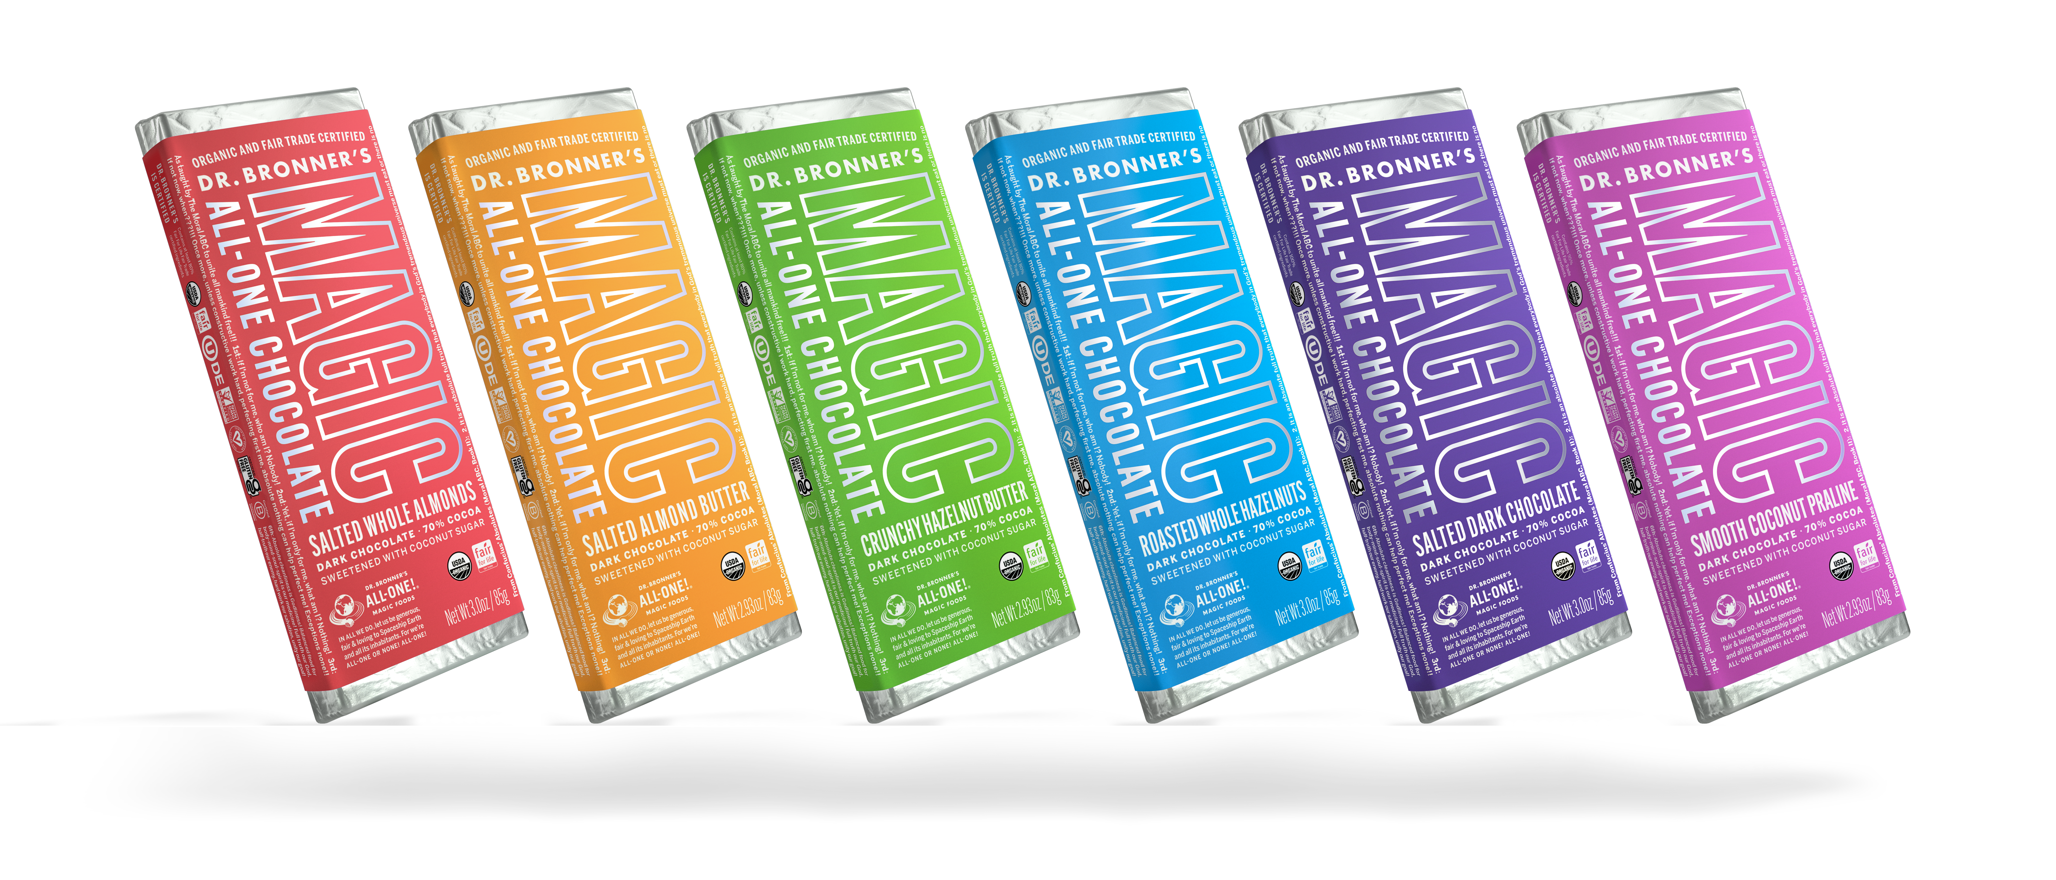
Magic all-one chocolate
Delicious and good, for Earth and farmers
2.93 OZ. AVAILABLE IN: Crunchy Hazelnut Butter, Salted Almond Butter, Smooth Coconut Praline 3 OZ. AVAILABLE IN: Roasted Whole Hazelnuts, Salted Dark Chocolate, Salted Whole Almonds

Slide 2
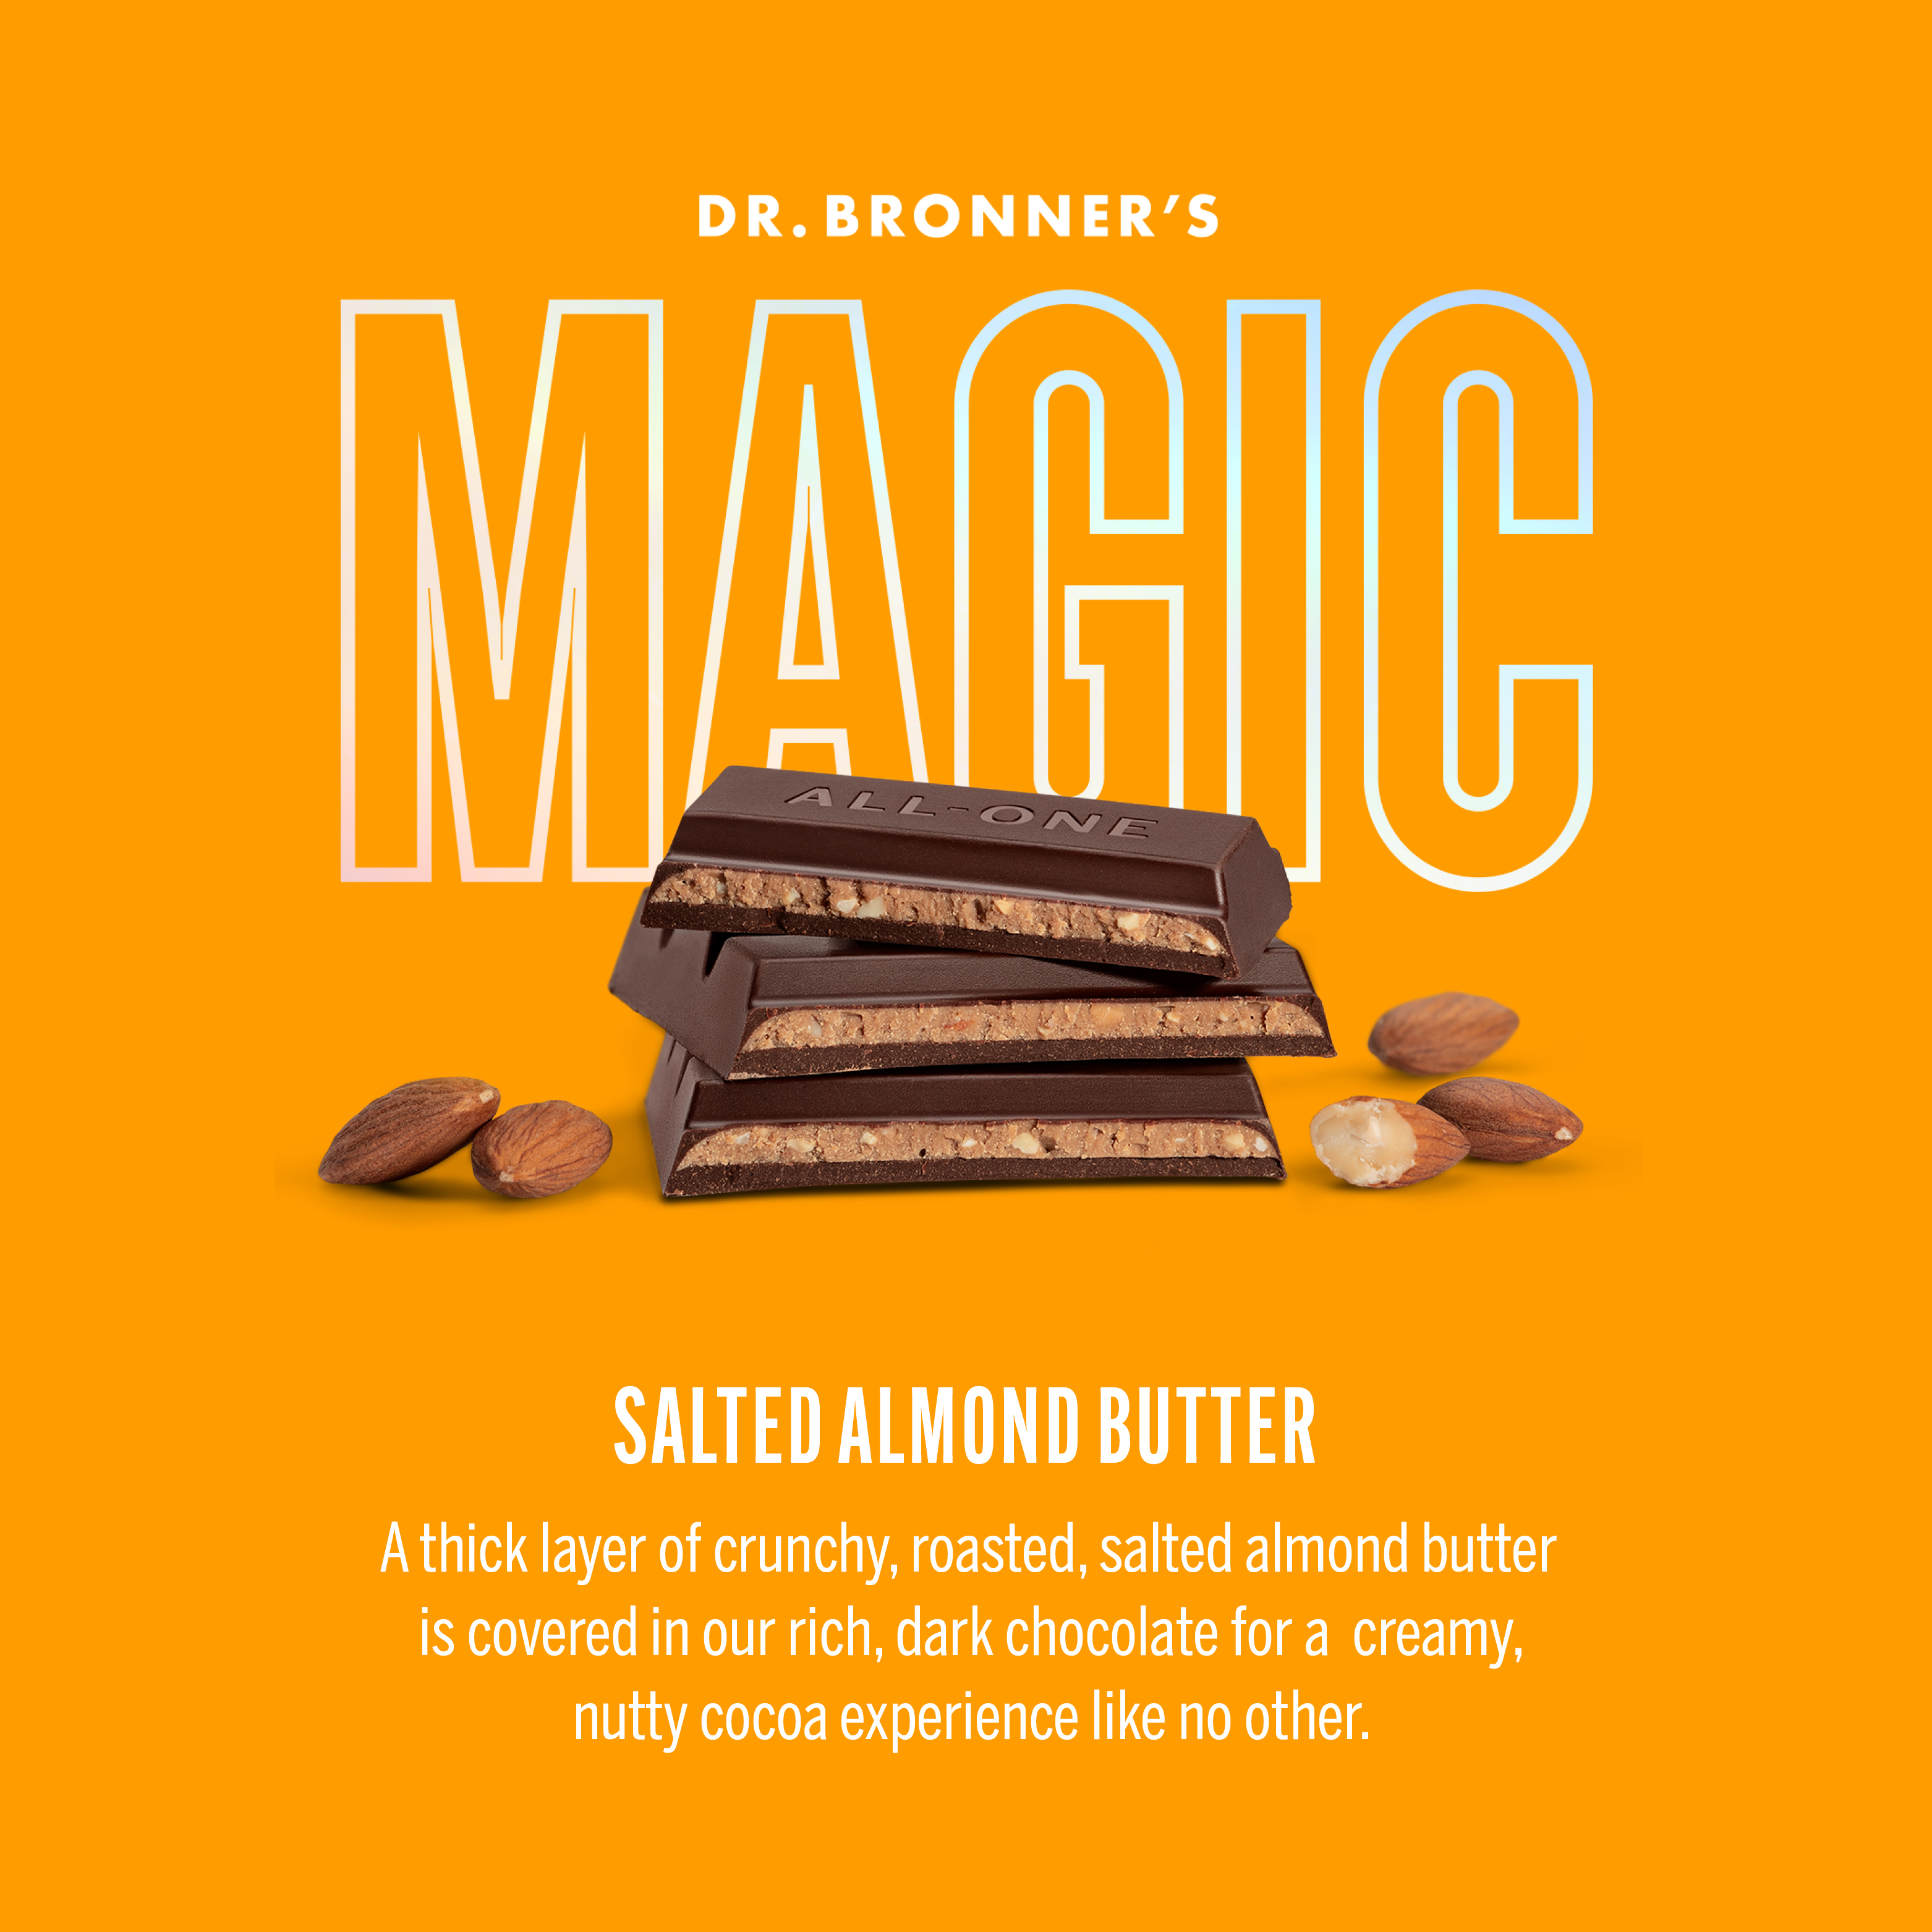
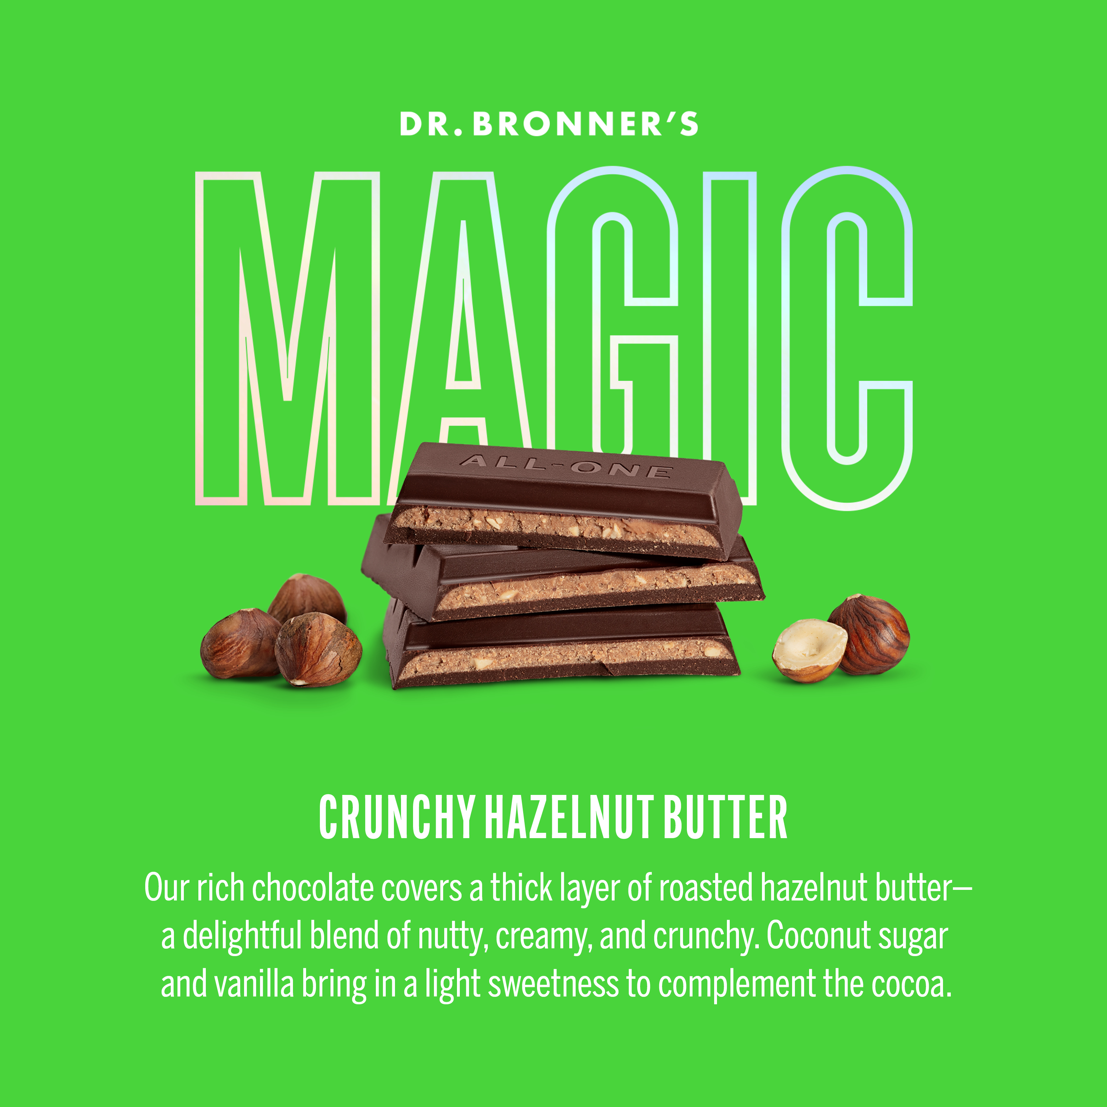
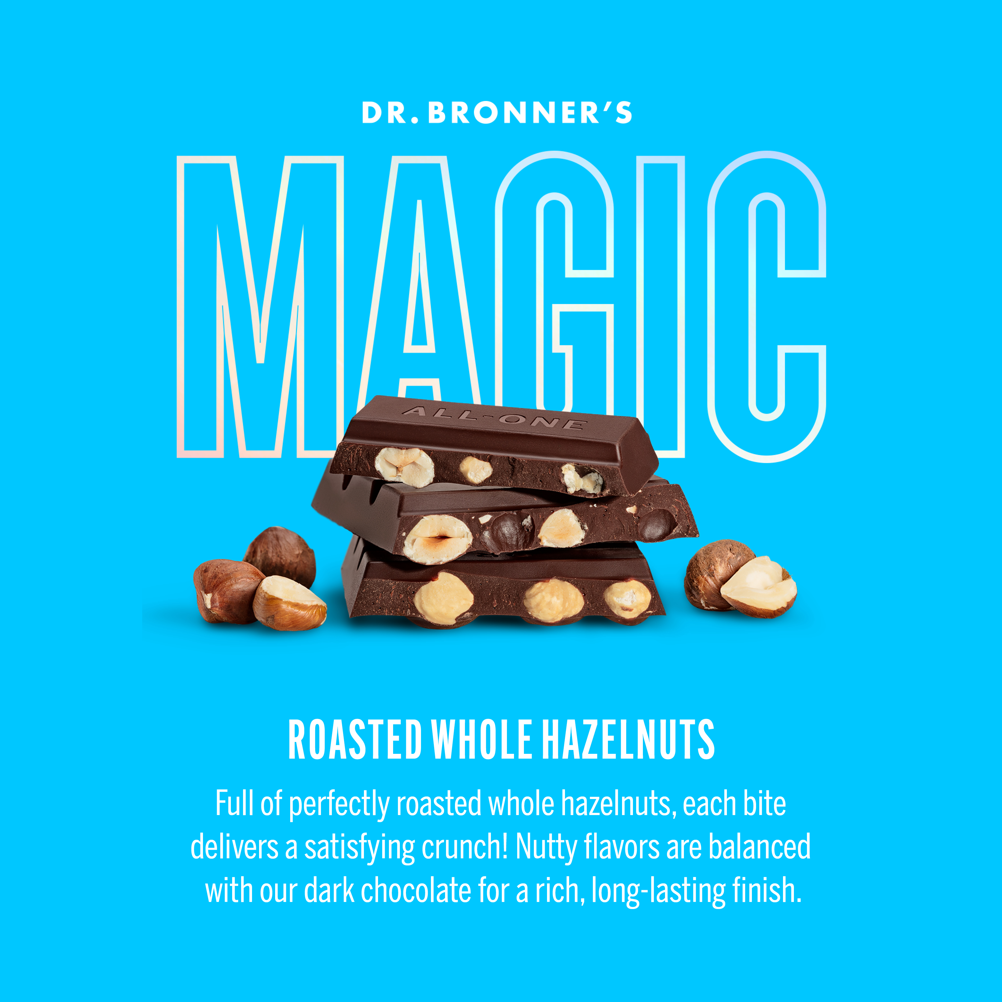
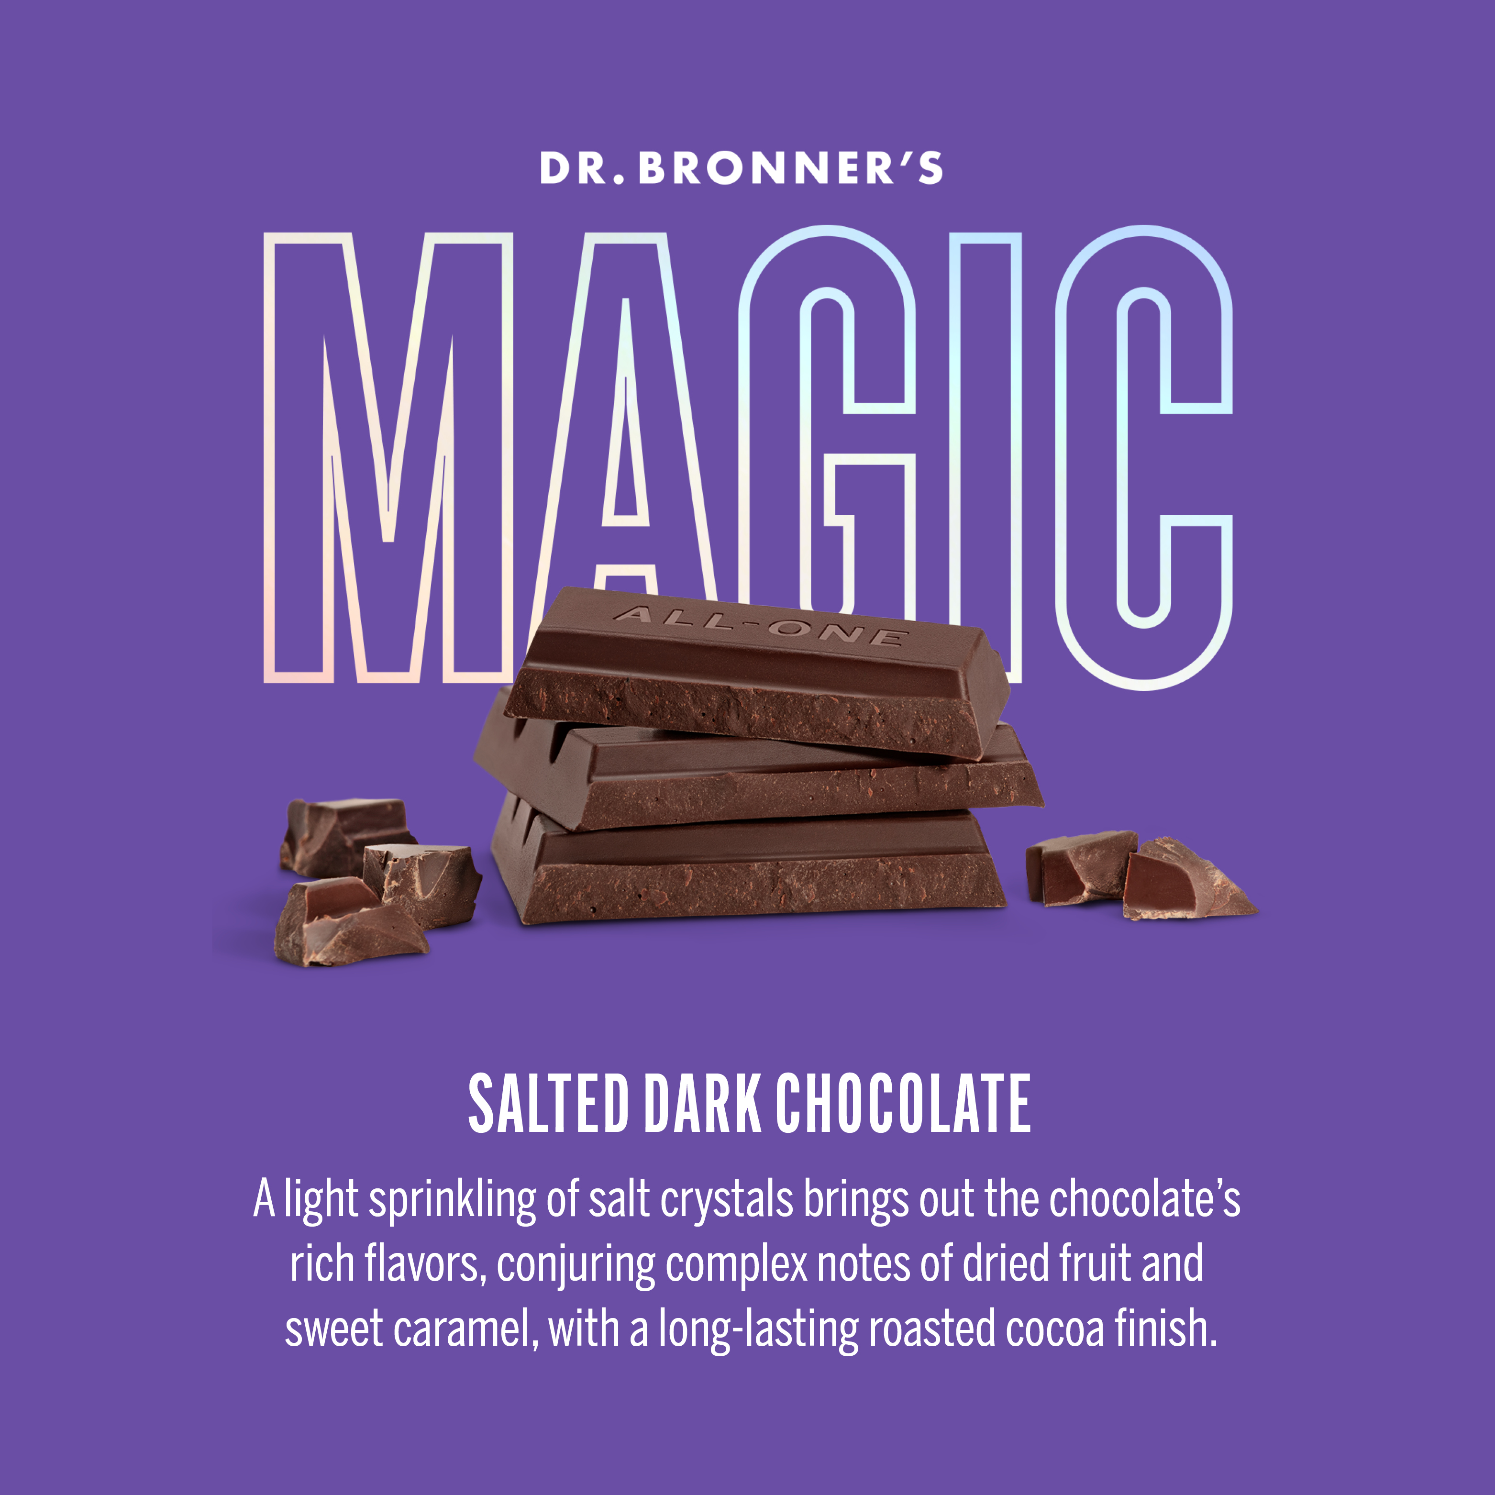
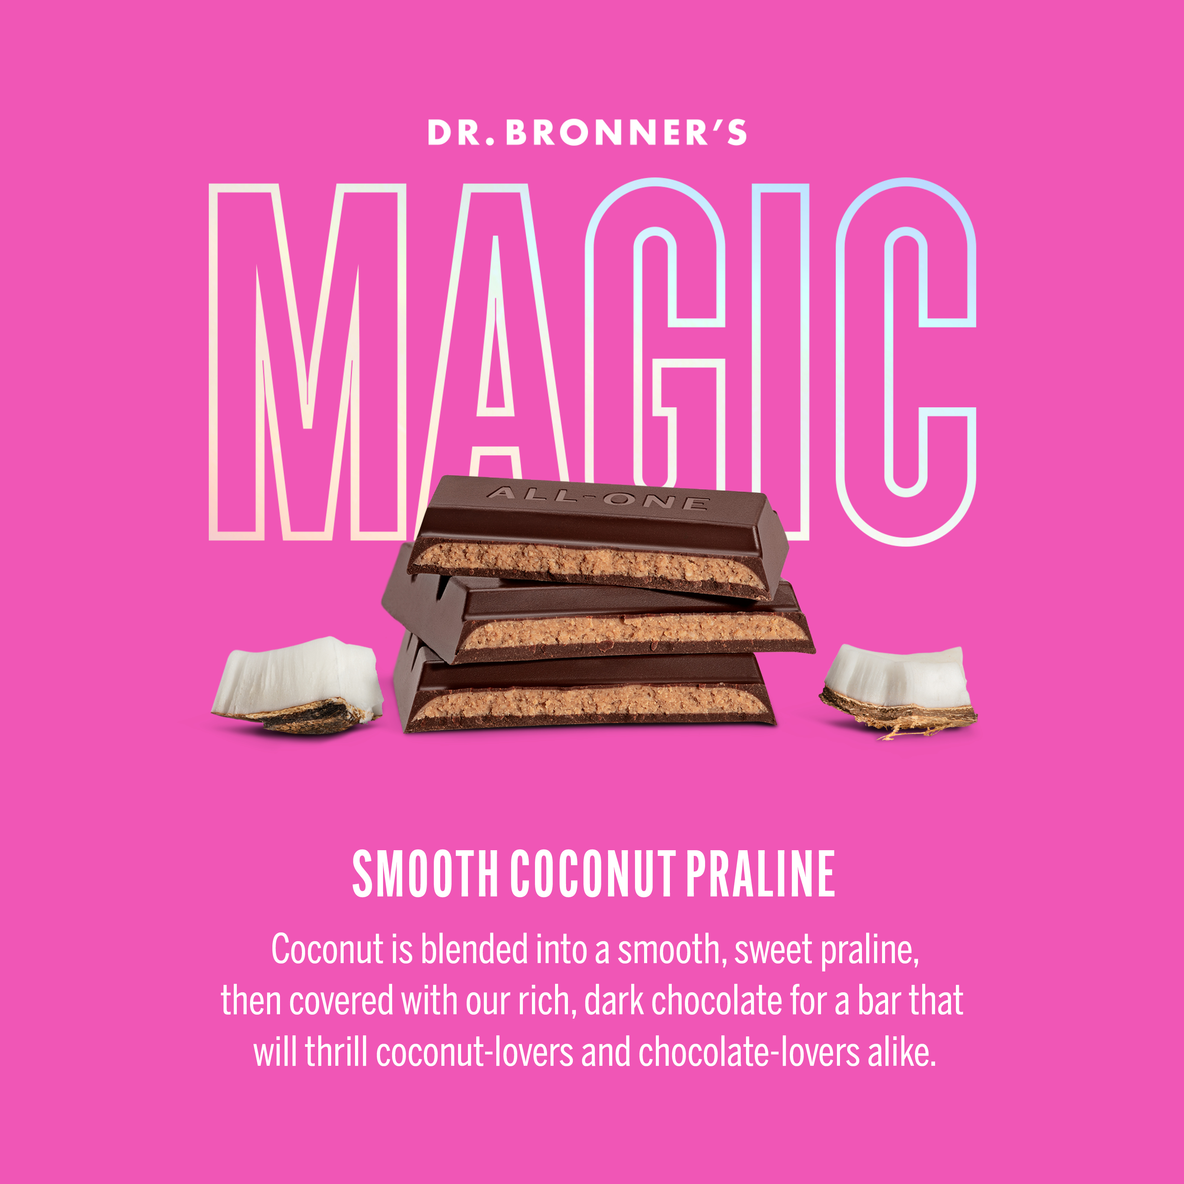

Slide 3
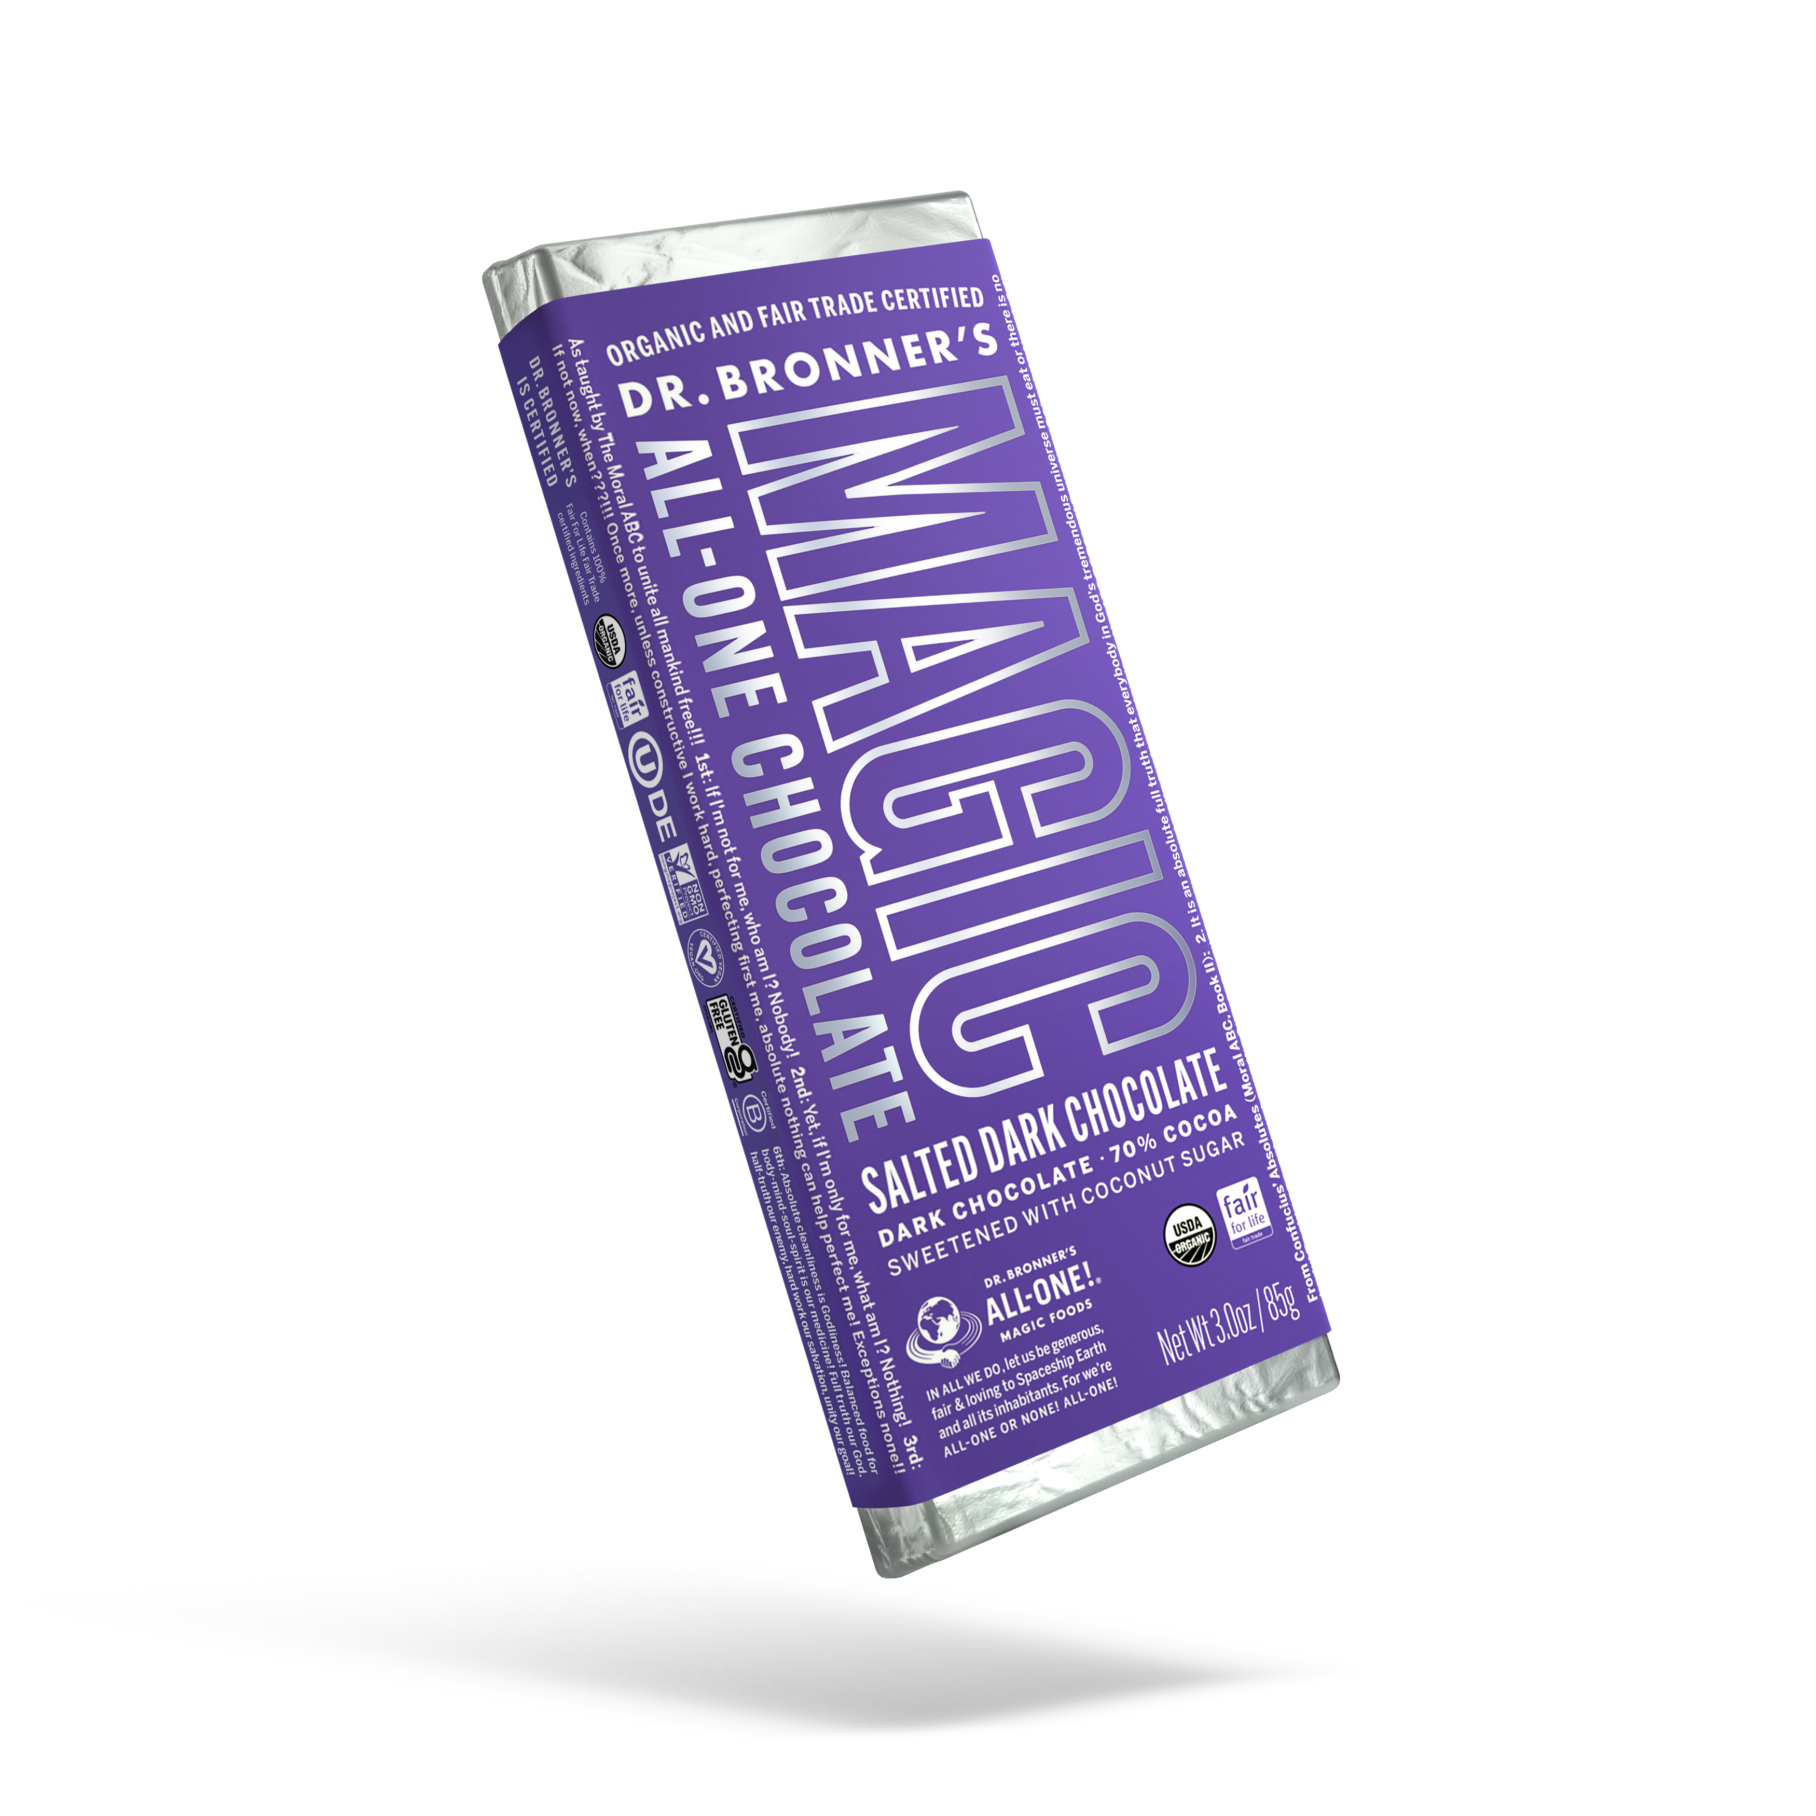
Magic all-one chocolate
Delicious and good, for Earth and farmers
Certified organic & fair trade, 70% cocoa, all vegan, coconut-sugar sweetened, and perfectly balanced!
Pairs world-class Swiss chocolatiers with fairly-treated cocoa farmers practicing regenerative organic agriculture.
Light sprinkling of salt crystals brings out the chocolate’s rich flavors, conjuring complex notes of dried fruit and sweet caramel, with a long-lasting roasted cocoa finish.
Ingredients: Fair trade organic cocoa beans, fair trade organic coconut sugar, fair trade organic cocoa butter, sea salt, fair trade organic bourbon vanilla bean

Slide 4
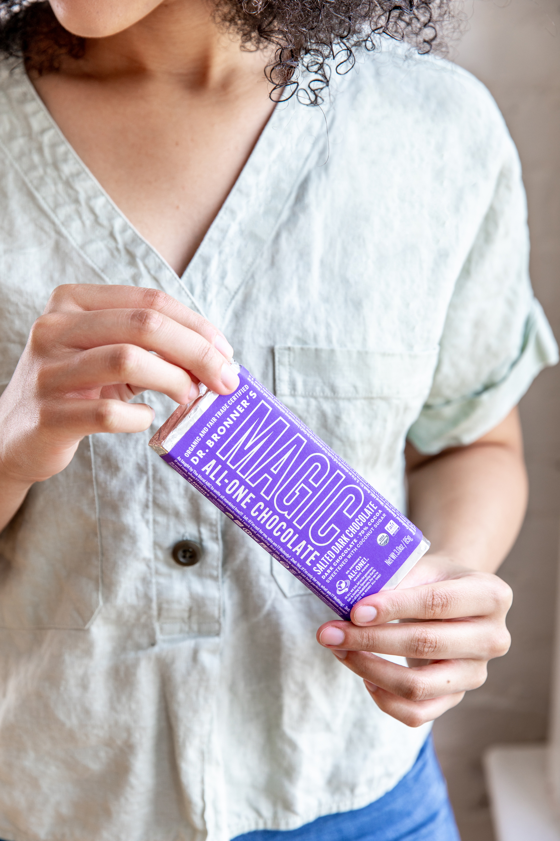
As seen in:
Will Dr. Bronner’s Chocolate Change My Life the Way Its Soap Did?
Dr. Bronner’s Makes Vegan Chocolate Like It Makes Soap: Sustainably
From Soap To Chocolate: Dr. Bronner’s Launches Into Food As Extension Of Supply Chain’s Positive Impact
Dr. Bronner's Is Making Chocolate (But Don't Try Bathing with It)
Notes:
Eater
https://www.eater.com/22568756/dr-bronners-pure-castile-soap-is-making-chocolate-now
VegNews
https://vegnews.com/2021/8/vegan-chocolate-dr-bronners
Forbes
https://www.forbes.com/sites/christophermarquis/2021/07/02/from-soap-to--chocolate-dr-bronners-launches-into-food-as-extension-of-supply-chains-positive-impact/?sh=3d9160e21aab
Food & Wine
https://www.foodandwine.com/news/dr-bronners-chocolate

Slide 5
Magic all-one chocolate faqs
Is Dr. Bronner’s chocolate vegan, organic, fair trade, gluten-free, kosher? Yes! All Dr. Bronner’s Magic All-One Chocolate flavors are certified vegan, organic & fair trade. Dr. Bronner’s chocolate recently achieved gluten-free certification for current and future production runs. All flavors of Dr. Bronner’s chocolate are Kosher certified, but Smooth Coconut Praline has recently received certification and will begin carrying the certification in future production runs.
Why isn’t there a nut-free chocolate?
We offer two bars with neither whole nuts nor nut butters, our Salted Dark and Smooth Coconut Praline. However, both do still contain coconut sugar, and while it does not taste like coconut, it is still a tree nut.
Will Dr. Bronner’s chocolate compromise Dr. Bronner’s nut-free operations?
Dr. Bronner’s Magic All-One Chocolate is manufactured, stored & shipped completely separately from all our soaps and other product lines. Apart from our Magic All-One Chocolate, all of Dr. Bronner’s products are produced and packaged in facilities that are peanut free.
Where is your chocolate made?
Our chocolate is made in Switzerland by award winning chocolatiers who have been honing their craft for over 160 years. We searched high & low for the right chocolate manufacturing partners who share our values, produce amazing chocolate, and are as excited as we are to deliver the most delicious chocolate made with coconut sugar.
Are any of your chocolate bars salt-free or low in sodium?
Three of our Magic All-One Chocolate bars do not contain added salt: Roasted Whole Hazelnut (5mg sodium), Smooth Coconut Praline (10mg sodium), and Crunchy Hazelnut Butter (10mg). Nutritional information for all our bars can be found on drbronner.com.
Why did Dr. Bronner’s create Magic All-One Chocolate?
Dr. Bronner’s saw an opportunity: Pair world-class Swiss chocolatiers with fairly-treated cocoa farmers practicing regenerative organic agriculture to create a rich, delicious dark chocolate that enriches our world.
When we learned that many of the 800 farmers in our Serendipalm project in Ghana also grow cocoa, it seemed like the perfect opportunity to create a line of chocolate that benefits farmers, the planet & consumers. The chocolate trade has a well-documented history of causing widespread ecological destruction, climate instability, poverty, worker exploitation, child labor, and even slavery. Our mission is to address these ecological & social issues in the chocolate industry by modeling more sustainable practices in the sourcing & production of Dr. Bronner’s Magic All-One Chocolate.

