Slide 1
Dr. Bronner’s customers
Dr. Bronner’s 2018 Users: Reasons for Buying*
Personal and Planetary Health
  Safe on my skin
  Avoids toxins/pesticides
  Products promote sustainability in the environment
Engaging
  High quality
  I wanted to try new things
Values Driven
  The brand aligns with my values
  Company’s values appeal to me
  Top attributes: Purest Organic, Cruelty-Free, Fair Trade and Biodegradable
 | TOTAL GEN POP* | DR. BRONNER’S PY USERS: SURVEY*
Sample size | 3,007 | 184
Male | 48% | 52%
Female | 52% | 48%
18-39 (net) | 38% | 58%
18-29 | 21% | 26%
30-39 | 17% | 32%
40-49 | 16% | 21%
50-64 | 26% | 15%
65+ | 20% | 6%
Median Income | $72K | $105.2K
Children in HH | 34% | 53%
College Grad+ | 32% | 54%
Hispanic | 16% | 21%
African American | 13% | 17%
LOHAS® | 15% | 23%
Naturalites® | 21% | 17%
Drifters® | 29% | 20%
Conventionals® | 16% | 31%
Unconcerneds® | 18% | 10%

Slide 2
Dr. Bronner’s social media community size
Facebook | Instagram | Twitter | LinkedIn | Pinterest
259,625 | 208,000 | 65,800 | 13,885 | 9,300

Slide 3

spins ranking: natural enhanced channel
BAR SOAP | CHOCOLATE | COCONUT OIL | HAIR CARE | HAND SANITIZER | LIP BALM | LIQUID SOAP
Peppermint | Crunchy Hazelnut Butter | Whole Kernel 30 oz. | Lavender Hair Crème | Lavender | Naked | Peppermint 32 oz.
Lavender | Smooth Coconut Praline | Whole Kernel 14 oz. | Peppermint Hair Crème | Peppermint | Peppermint | Lavender 32 oz.
Baby Unscented | Salted Dark Chocolate | White Kernel 14 oz. | Citrus Organic Hair Rinse |  | Lemon Lime | Baby Unscented 32 oz.
Almond | Salted Almond Butter |  |  |  | Orange Ginger | Almond 32 oz.
Citrus | Roasted Whole Hazelnuts |  |  |  |  | Peppermint 16 oz.
Tea Tree | Salted Whole Almonds |  |  |  |  | Tea Tree 32 oz.
Eucalyptus |  |  |  |  |  | Citrus 32 oz.
Rose |  |  |  |  |  | Eucalyptus 32 oz.
LOTION | SUGAR SOAP 12 OZ. | SUGAR SOAP 24 OZ. | MAGIC BALM | SHAVING SOAP | TOOTHPASTE | Lavender 16 oz.
Lavender Coconut | Lavender | Lavender | Arnica Menthol | Lavender | Peppermint | Rose 32 oz.
Peppermint | Peppermint | Peppermint | Baby Unscented | Unscented | Spearmint | Baby Unscented 16 oz.
Patchouli Lime | Baby Unscented | Baby Unscented |  | Peppermint | Cinnamon | Peppermint 64 oz.
Orange Lavender | Lemongrass Lime | Lemongrass Lime |  | Lemongrass Lime | Anise | Peppermint 8 oz.
 | Tea Tree | Tea Tree |  | Tea Tree | Peppermint 1 oz. | Peppermint 128 oz.

Slide 4
Wholesale Pricing
PRODUCT | SIZE | CASE PACK | SUGGESTED RETAIL | WHOLESALE EACH | WHOLESALE CASE
Dr. Bronner’s Magic All-One Chocolate | 2.93 oz. & 3 oz. | 108 & 144 | 5.49 | 3.66 | 395.28 & 527.04
Pure-Castile Liquid Soap | 2 oz. | 12 | 3.19 | 1.91 | 22.92
Pure-Castile Liquid Soap | 4 oz. | 12 | 4.59 | 2.77 | 33.24
Pure-Castile Liquid Soap | 8 oz. | 12 | 6.99 | 4.13 | 49.56
Pure-Castile Liquid Soap | 16 oz. | 6 | 11.29 | 6.79 | 40.74
Pure-Castile Liquid Soap | 32 oz. | 6 | 18.49 | 11.11 | 66.66
Pure-Castile Liquid Soap | Gallon | 1 | 65.99 | 39.54 | 39.54
Pure-Castile Liquid Soap | 5 Gallon | 1 | 329.95 | 197.70 | 197.70
Pure-Castile Bar Soap | 5 oz. Bar | 12 | 4.79 | 2.89 | 34.68
Sal Suds Biodegradable Cleaner | 16 oz. | 6 | 9.99 | 6.62 | 39.72
Sal Suds Biodegradable Cleaner | 32 oz. | 6 | 14.99 | 9.94 | 59.64
Sal Suds Biodegradable Cleaner | Gallon | 1 | 46.99 | 28.19 | 28.19
Mixed Soap Display – Liquid | 16 oz. bottles & 5 oz. bars | 32 | - | - | 217.28
Mixed Soap Display – Liquid & Bar | 16 oz. bottles | 144 | - | - | 603.36
Mixed Toothpaste Display | 5 oz. toothpaste | 60 | - | - | 233.40
Mixed Organic Hand Sanitizer Display | 2 oz. sanitizer | 144 | - | - | 430.56
Organic Lip Balm | 0.15 oz. | 12 | 3.49 | 2.09 | 25.08
Mixed Lip Balm Display | Assorted | 6 | 167.52 | 100.32 | 601.92
Organic Hand & Body Lotion | 8 oz. | 6 | 9.99 | 5.99 | 35.94
Organic Shaving Soap | 7 oz. | 6 | 9.99 | 5.99 | 35.94
Organic Sugar Soap | 12 oz. | 6 | 10.99 | 6.59 | 39.54
Organic Sugar Soap | 24 oz. | 6 | 19.99 | 11.99 | 71.94
Organic Pump Soap Bulk Refill | 64 oz. | 1 | 42.99 | 25.79 | 25.79
Organic Hair Rinse | 8 oz. | 6 | 9.99 | 5.99 | 35.94
Organic Hair Crème | 6 oz. | 6 | 7.99 | 4.79 | 28.74
Organic Hand Sanitizer | 2 oz. | 12 | 4.99 | 2.99 | 35.88
Virgin Coconut Oil | 14 fl. oz. | 12 | 11.99 | 7.99 | 95.88
Virgin Coconut Oil | 30 fl. oz. | 12 | 21.99 | 14.66 | 175.92
All One Toothpaste | 5 oz. | 12 | 6.49 | 3.89 | 46.68
Travel Toothpaste | 1 oz. | 12 | 2.49 | 1.50 | 18.00
Baby Unscented Organic Magic Balm | 2 oz. | 6 | 9.99 | 5.99 | 35.94
Arnica Menthol Organic Magic Balm | 2 oz. | 6 | 11.99 | 7.19 | 43.14

Slide 5

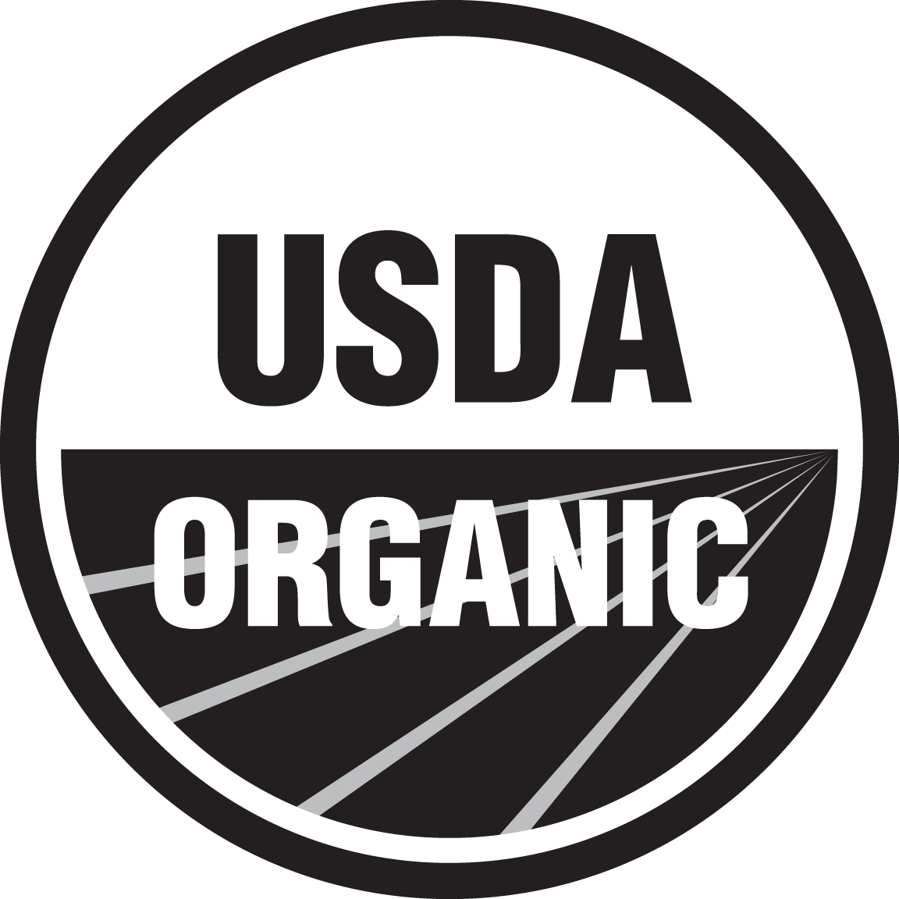

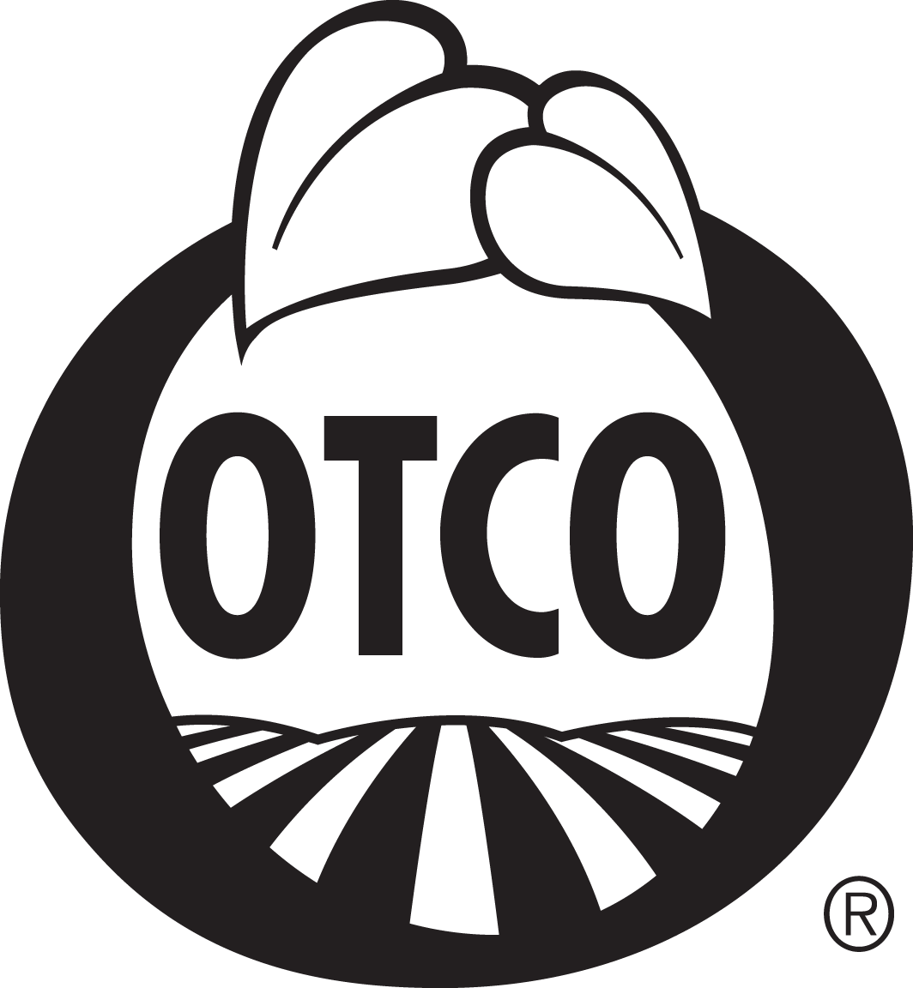


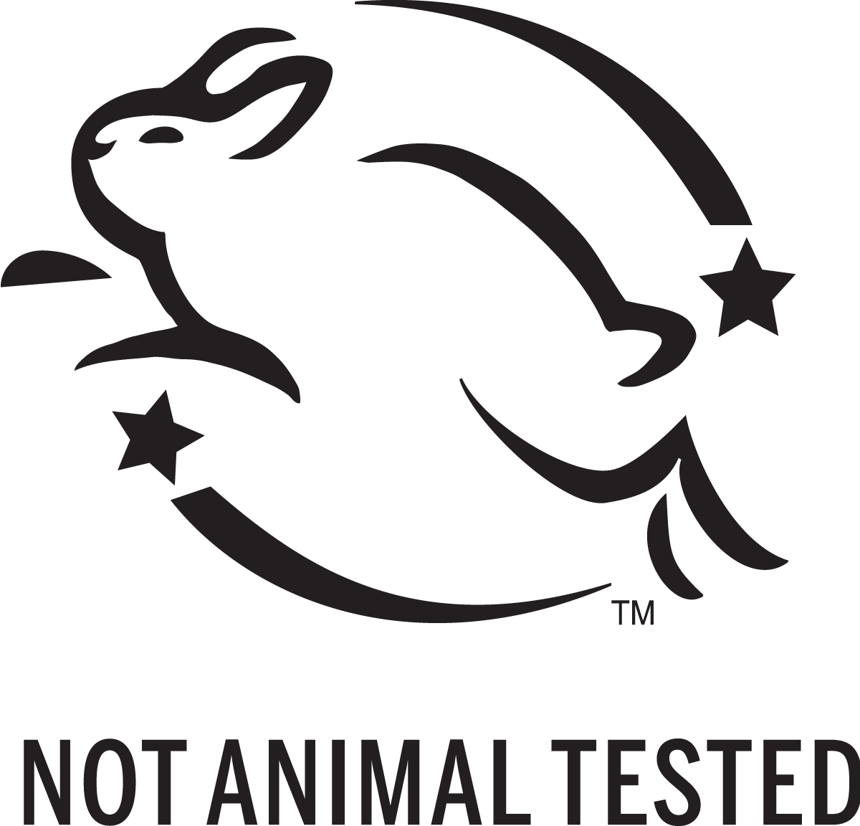




Dr. Bronner’s is certified
REGENERATIVE ORGANIC | USDA | FAIR FOR LIFE | OREGON TILTH | VEGAN
Dr. Bronner’s—a founding member of the Regenerative Organic Alliance—piloted ROC standards with three ingredients in 2019: coconut oil (Serendipol, Sri Lanka), palm oil (Serendipalm, Ghana), and mint oil (Pavitramenthe, India); each earned ROC-Silver designation. ROC is a holistic agriculture certification requiring USDA organic certification as a baseline and encompasses pasture-based animal welfare, fairness for farmers and workers, and robust requirements for soil health and land management. | Dr. Bronner’s products are certified organic to USDA National Organic Program (NOP) standards, the same standards which consumers trust to certify their organic food, by Oregon Tilth, a nonprofit organization supporting and promoting biologically sound, socially equitable agriculture. | Dr. Bronner’s main ingredients are certified Fair Trade by EcoCert, through their Fair for Life Social & Fair Trade Certification Program, indicating that ethical working conditions and fair prices are provided along the entire supply chain. Considered innovators in the world of Fair Trade, we were the first company to establish certified fair trade supply chains for coconut oil and palm oil. | Dr. Bronner’s products are certified organic to USDA National Organic Program (NOP) standards, the same standards which consumers trust to certify their organic food, by Oregon Tilth, a nonprofit organization supporting and promoting biologically sound, socially equitable agriculture. | Dr. Bronner’s vegan products are now certified vegan by Vegan Action, indicating that they do not contain any animal products or byproducts, and that no animal products are used in the manufacturing process. While most of our products are vegan, we do make a few that are not: our lip balms and body balms contain beeswax, and our facial toners (sold in Taiwan and Korea) contain honey.
NON-GMO | LEAPING BUNNY | B CORPORATION | GLUTEN FREE | KOSHER
Dr. Bronner’s products are non-GMO verified by the Non-GMO Project, indicating that they do not contain any genetically modified ingredients/organisms. A genetically modified ingredient is any plant or organism whose genetic makeup has been modified using gene splicing technology. This non-GMO verification ensures that our products and ingredients are free from GMO engineering or contamination. | Dr. Bronner’s products qualify for the “Leaping Bunny” logo through the Coalition for Consumer Information on Cosmetic’s (CCIC) Leaping Bunny Program, indicating that they and their ingredients are certified as not being tested on animals. The CCIC, a coalition of animal rights organizations, requires independent audit for confirmation. | As a benefit corporation, we are committed to measuring our social and environmental performance according to an independent 3rd-party standard. We’ve selected the B Impact Assessment standard developed by the nonprofit B Lab for its rigor and integrity. The assessment results demonstrate we are exceeding our benefit corporation goals by rigorous objective measures. | Dr. Bronner’s Magic All-One Chocolate is certified Gluten-Free under the supervision of the Gluten-Free Certification Organization (GFCO). In accordance with the GFCO standards, our chocolate bars are certified gluten-free (to 10 ppm gluten or less). GFCO’s focus on consumer safety has made it the most widely used and trusted gluten-free certification mark. | Dr. Bronner’s ROC Virgin Coconut Oils are certified kosher. Final products, along with our manufacturing processes, comply with a strict policy based on kosher food laws, including cleanliness, purity, and quality. Dr. Bronner’s Magic All-One Chocolate is certified kosher by Kosher OU, indicating that the final products, along with our manufacturing processes, comply with a strict policy based on kosher food laws, including cleanliness, purity and quality. The “DE” in the symbol indicates that our product was made on equipment that also processes dairy.

