Slide 1
pure-Castile bar soap
Made with organic oils—mild, ecological, vegan!
5 OZ. BARS AVAILABLE IN:
Eucalyptus, Rose, Tea Tree, Citrus, Almond, Peppermint, Baby Unscented & Lavender

Slide 2
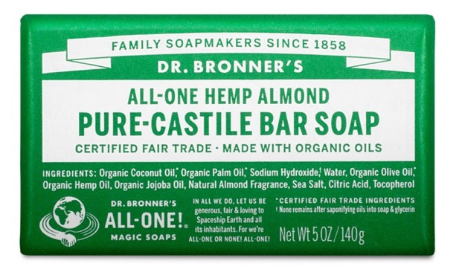
pure-Castile bar soap
Made with organic oils—mild, ecological, vegan!
Soft, smooth lather that won’t dry face-body-hair
Gentle, effective, mild
Made with organic oils: coconut-olive-hemp seed-jojoba
Certified Fair Trade by IMO
Vegan
No synthetic preservatives, detergents or foaming agents
Biodegradable
Packed in 100% post-consumer recycled (PCR) wrapper
Now made with U.S.-grown hemp seed oil!
Ingredients: Organic Coconut Oil,* Organic Palm Oil,* Sodium Hydroxide,† Water, Organic Olive Oil,* Organic Hemp Seed Oil, Organic Jojoba Oil, Essential Oils,** Sea Salt, Citric Acid, Tocopherol
*CERTIFIED FAIR TRADE INGREDIENTS
†None remains after saponifying oils into soap & glycerin / **Essential oils vary by scent.
Made with U.S.-grown hemp seed oil!

Slide 3
As seen in:
The 7 Best Bars of Soap for Daily Use
The Clean Personal Care Products Beauty Experts Swear By
7 Of the Best Natural Beauty Products You Can Get At A Drugstore

Slide 4
As seen in:
These Are The 25 Best Body Products You Can Buy On Amazon
The Beauty Products Bella Hadid’s Makeup Artist Uses to the Last Drop
The plastic problem isn't your fault, but you can be part of the solution

