Slide 1
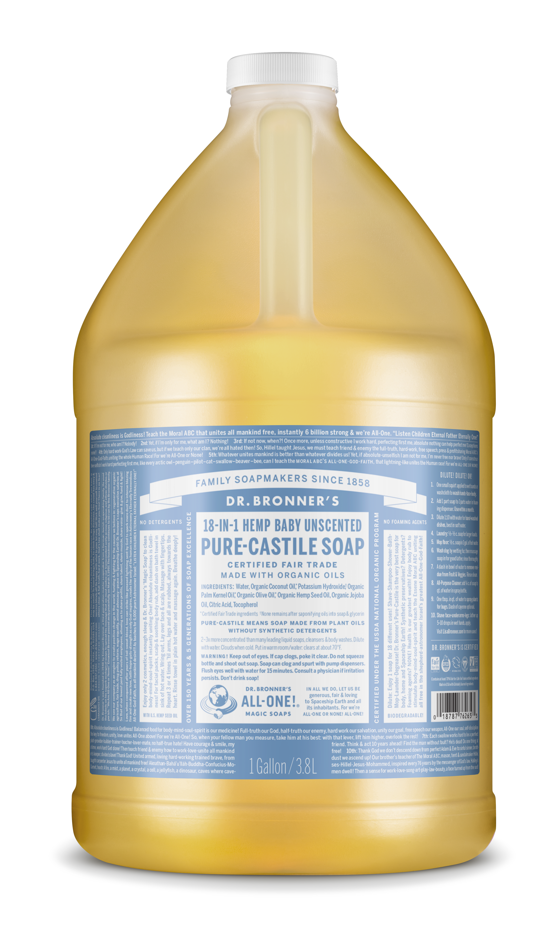
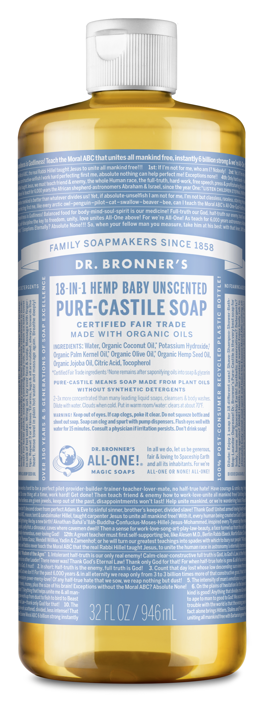
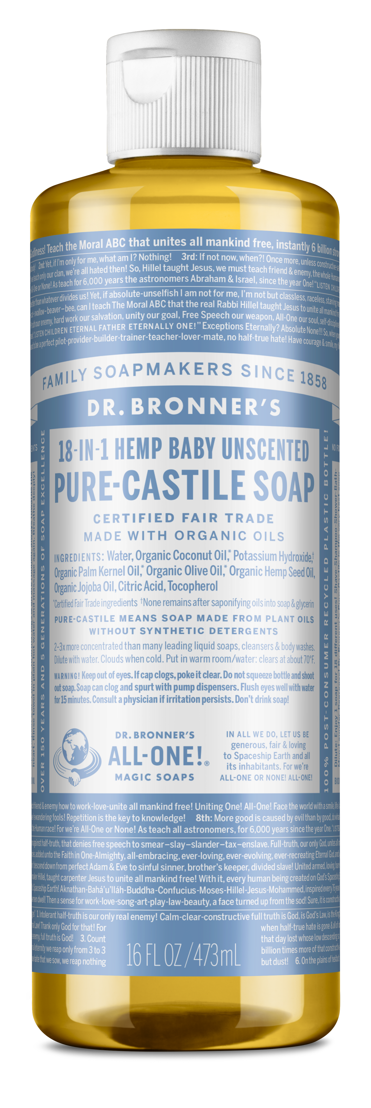
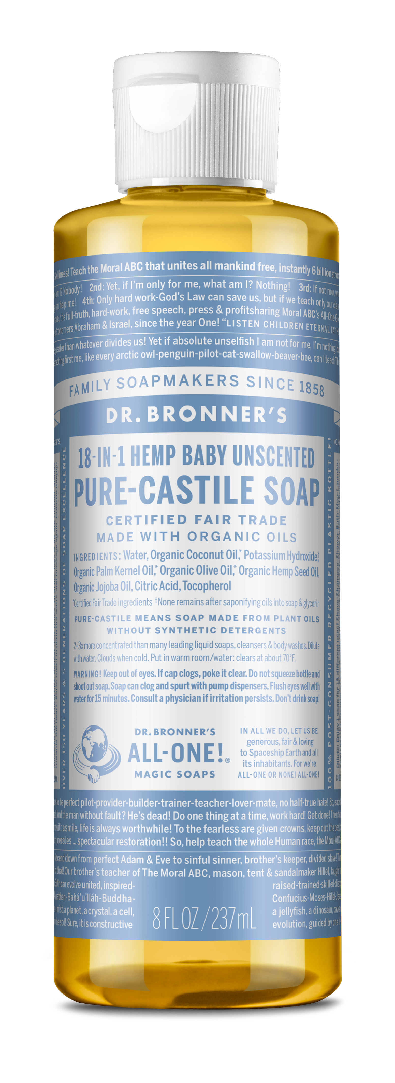
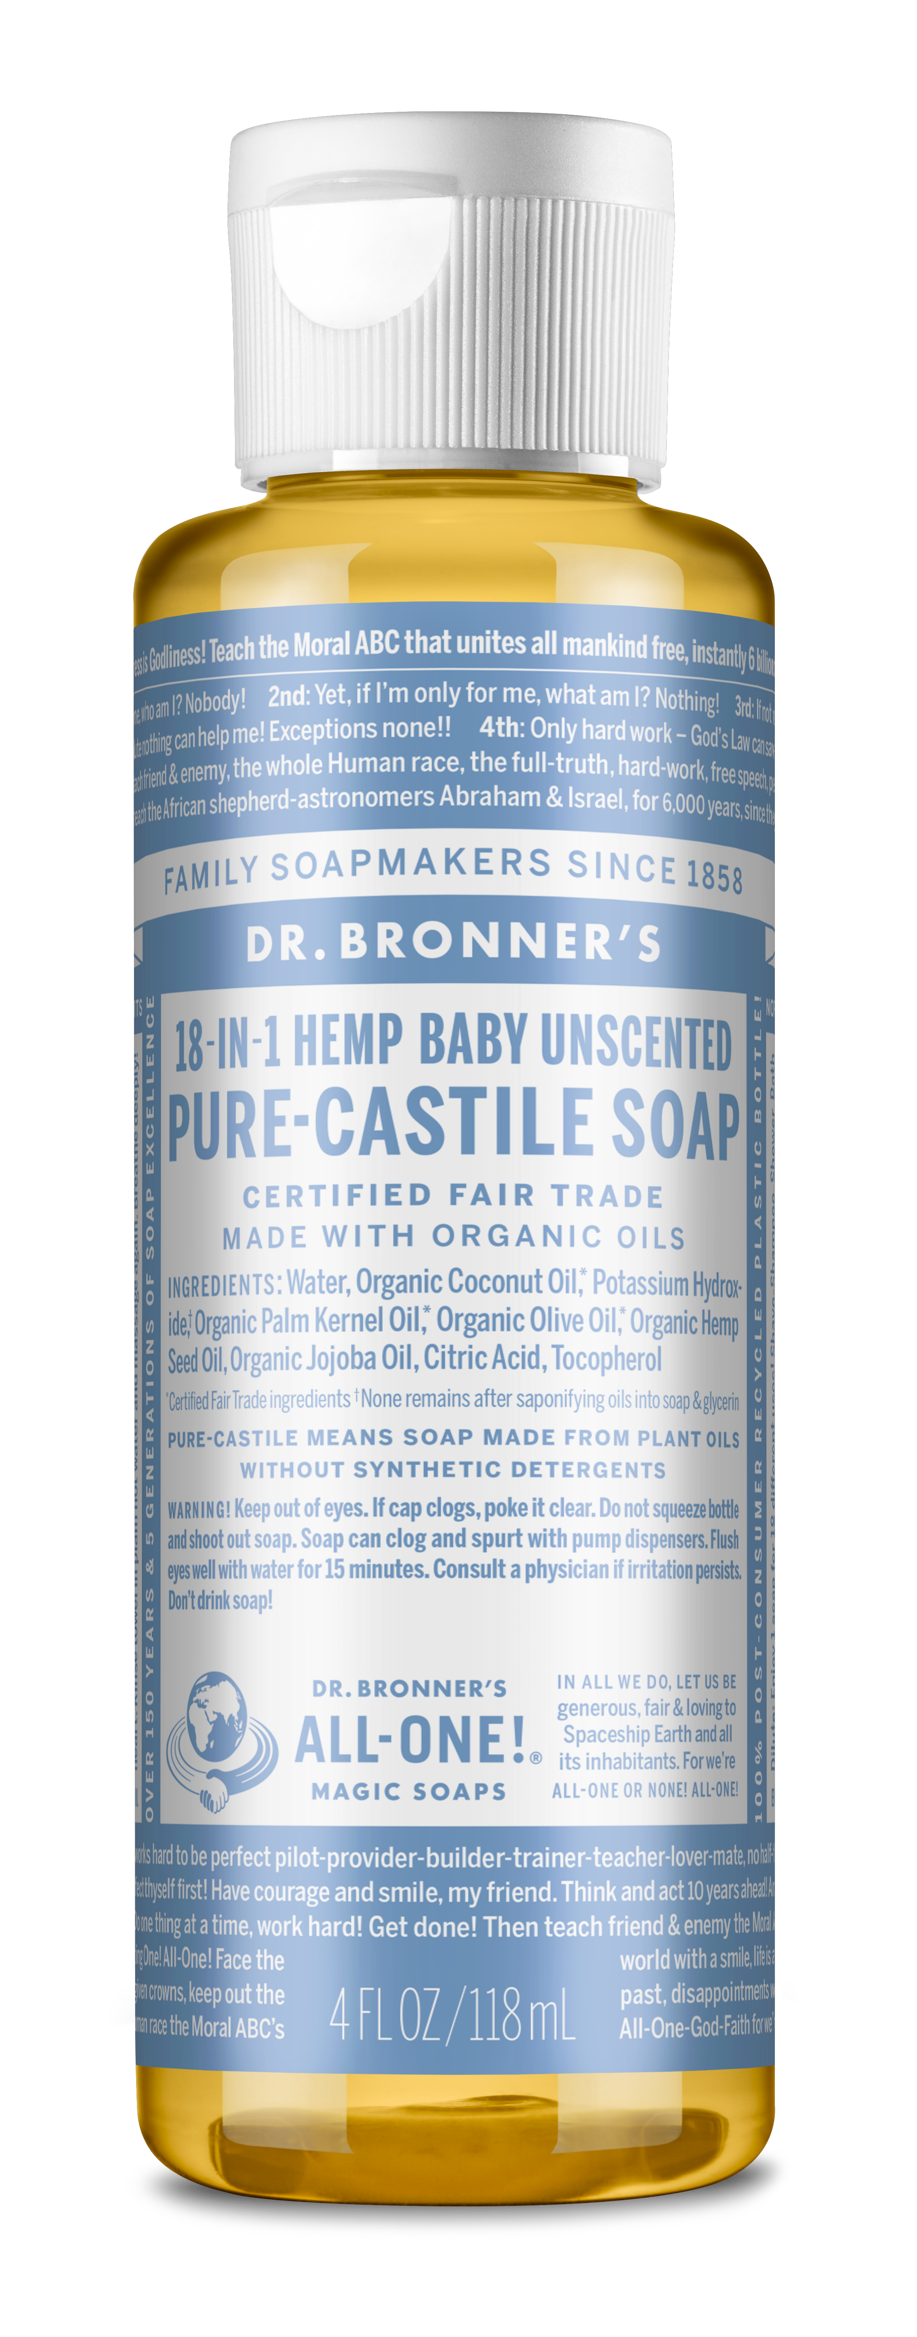
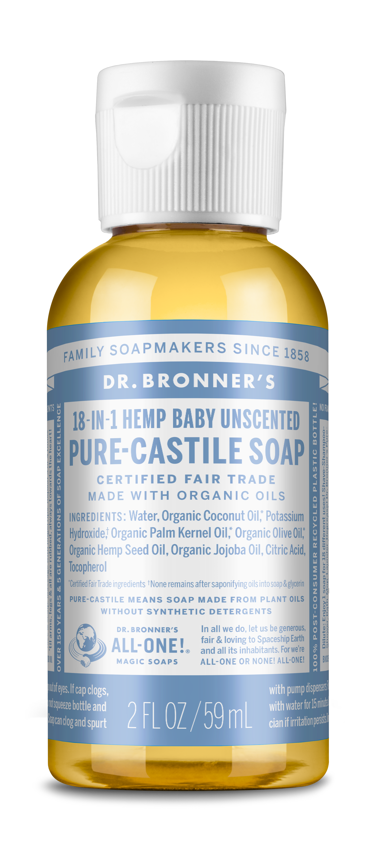
Baby Unscented pure-castile liquid soap
Mild formula for sensitive skin—made with organic oils
SIZES: 2 oz., 4 oz., 8 oz., 16 oz., 32 oz., & 1 gal.

Slide 2
Baby Unscented pure-castile liquid soap
Mild formula for sensitive skin—made with organic oils
Requested by and developed for the UCLA Medical Center maternity ward
Double the amount of olive oil for superb nourishing
For babies and the very young, though not “tear free”
For anyone who:
Has sensitive skin
Is sensitive to scents
Works around other who may be sensitive to scents
For customizing with other essential oils
For washing cats or other animals sensitive to essential oils
Ingredients: Water, Organic Coconut Oil,* Potassium Hydroxide,† Organic Palm Kernel Oil,* Organic Olive Oil,* Organic Hemp Seed Oil, Organic Jojoba Oil, Essential Oils,** Citric Acid, Tocopherol
*CERTIFIED FAIR TRADE INGREDIENTS
†None remains after saponifying oils into soap & glycerin / **Essential oils vary by scent.
Made with U.S.-grown hemp seed oil! Liquid Soaps are packaged in 100% post-consumer recycled plastic bottles. Excludes 1 gallon.

Slide 3
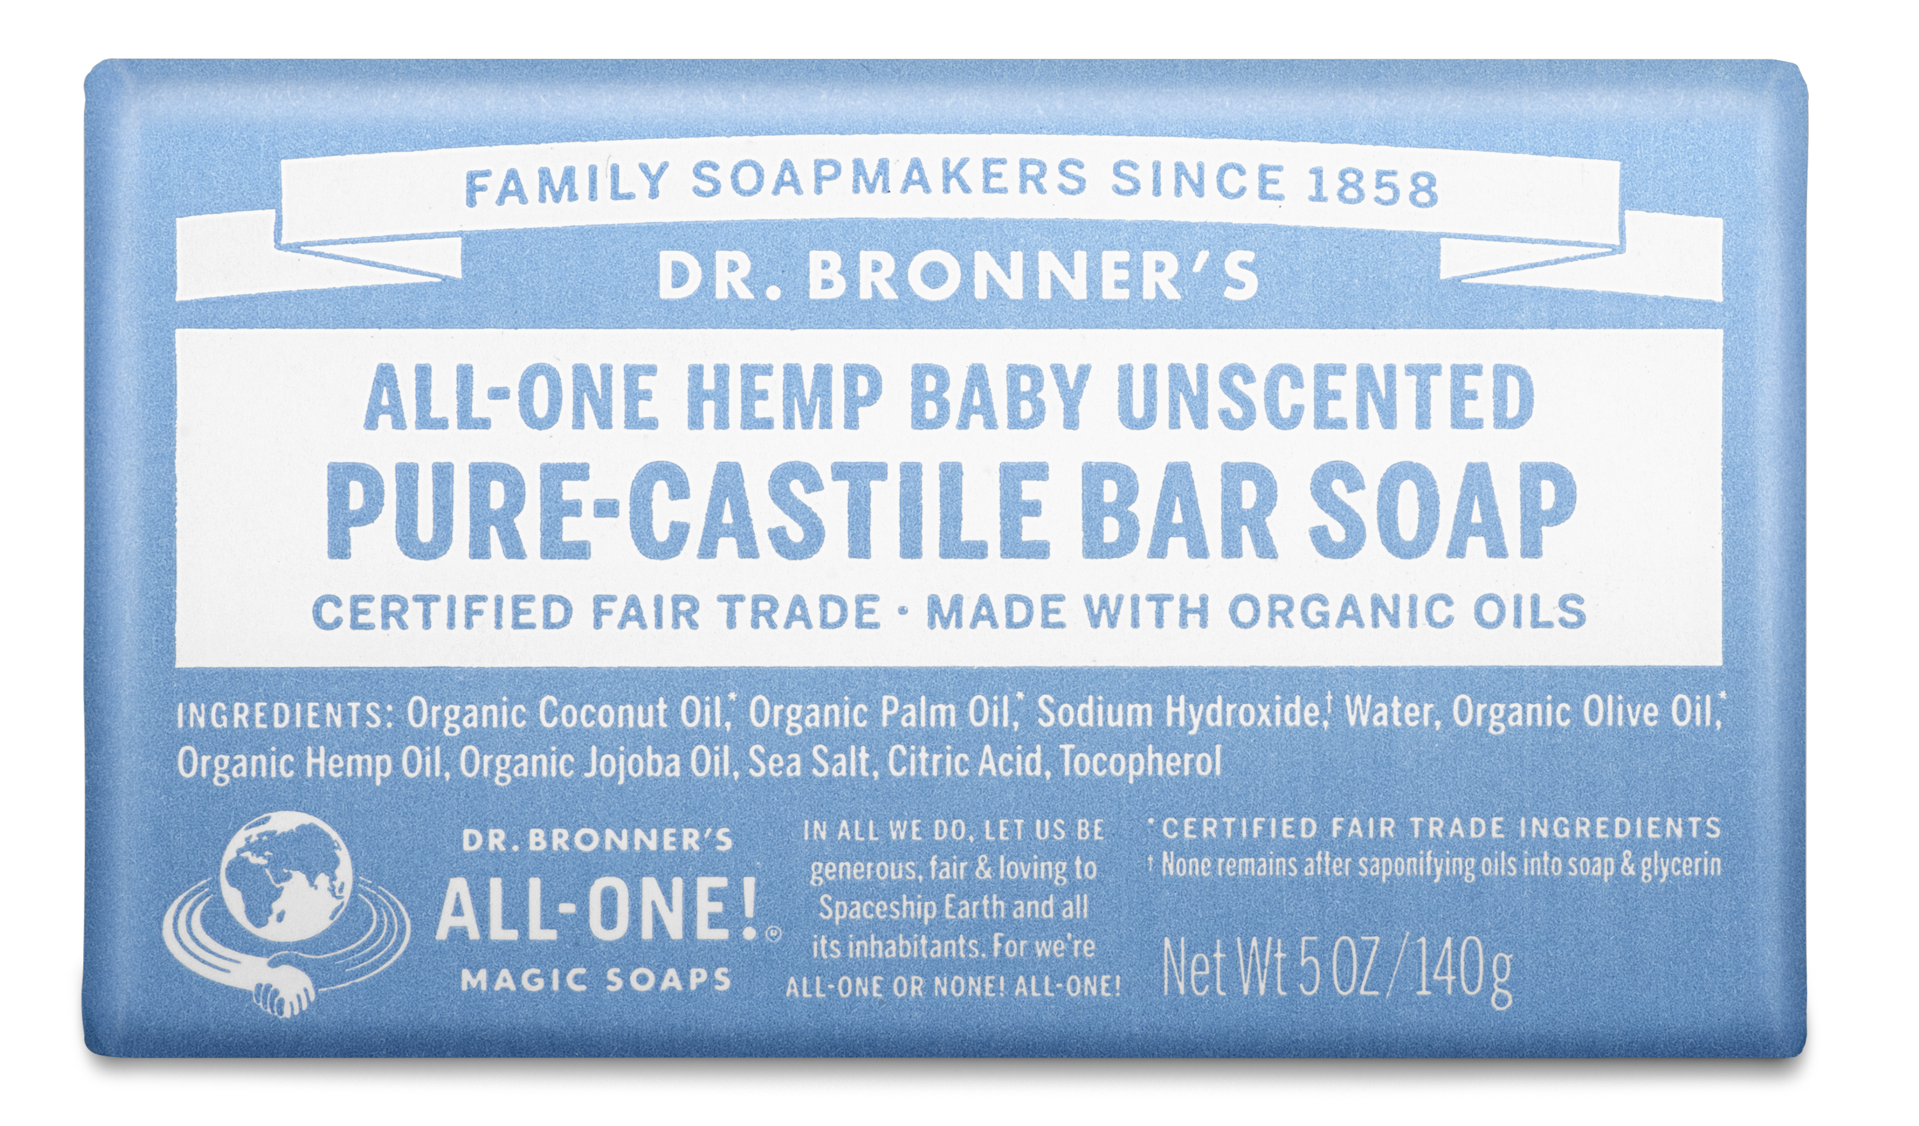
Baby unscented Pure-castile bar soap
Mild formula for sensitive skin—made with organic oils
SIZE: 5 oz.

Slide 4
Baby unscented Pure-castile bar soap
Mild formula for sensitive skin—made with organic oils
Requested by and developed for the UCLA Medical Center maternity ward
For babies and the very young
For anyone with sensitive skin
For anyone sensitive to scents
Ingredients: Organic Coconut Oil,* Organic Palm Oil,* Sodium Hydroxide,† Water, Organic Olive Oil,* Organic Hemp Seed Oil, Organic Jojoba Oil, Essential Oils,** Sea Salt, Citric Acid, Tocopherol
*CERTIFIED FAIR TRADE INGREDIENTS
†None remains after saponifying oils into soap & glycerin / **Essential oils vary by scent.
Made with U.S.-grown hemp seed oil! Bar Soaps are wrapped in 100% post-consumer recycled paper

Slide 5
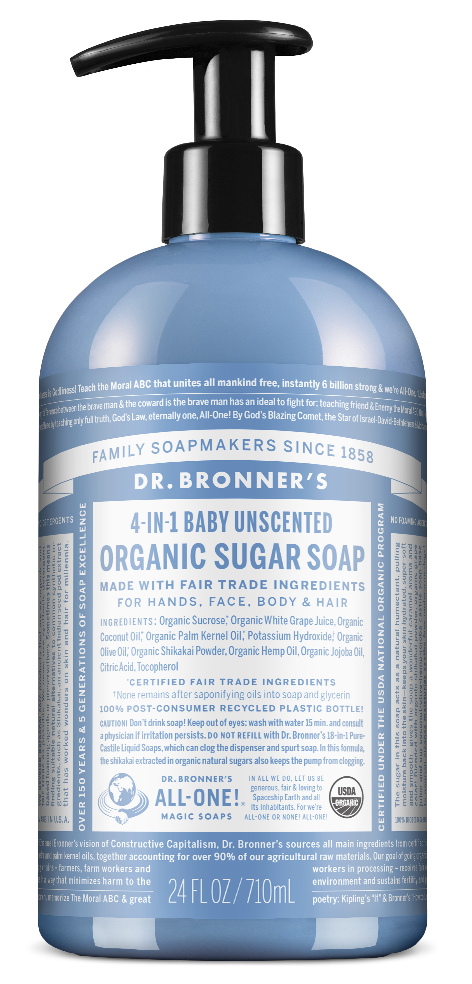
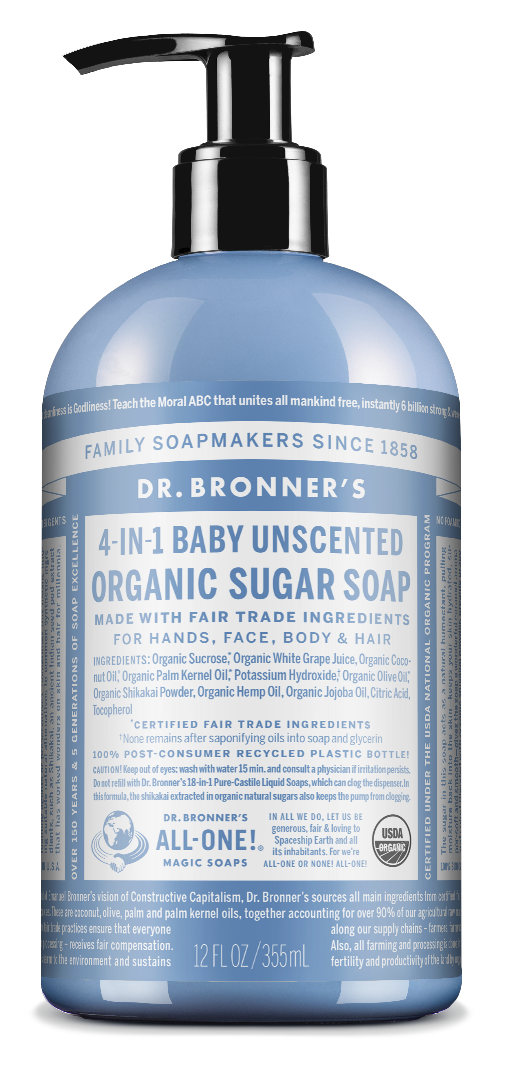
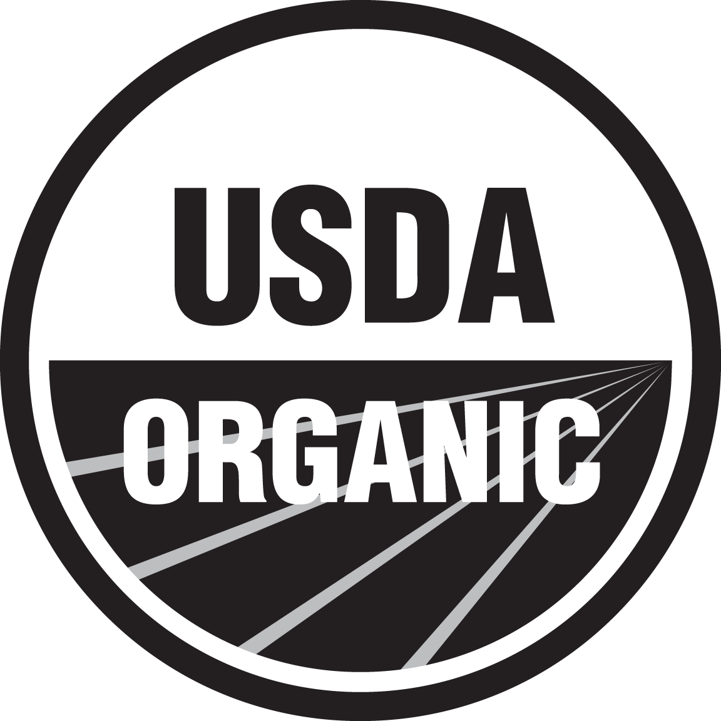
Baby unscented organic sugar soap
Mild formula for sensitive skin—made with organic oils
SIZES: 12 oz. & 24 oz.

Slide 6
Baby unscented organic sugar soap
Mild formula for sensitive skin—made with organic oils
Requested by and developed for the UCLA Medical Center maternity ward
Double the amount of olive oil for superb nourishing
For babies and the very young, though not “tear free”
For anyone who:
Has sensitive skin
Is sensitive to scents
Works around other who may be sensitive to scents For customizing with other essential oils
For washing cats or other animals sensitive to essential oils
Ingredients: Organic Sucrose,* Organic White Grape Juice, Organic Coconut Oil,* Organic Palm Kernel Oil,* Potassium Hydroxide,† Organic Olive Oil,* Organic Shikakai Powder, Organic Hemp Seed Oil, Organic Jojoba Oil, Organic Essential Oils,** Citric Acid, Tocopherol
*CERTIFIED FAIR TRADE INGREDIENTS
†None remains after saponifying oils into soap & glycerin / **Essential oils vary by scent.
Made with U.S.-grown hemp seed oil! Sugar Soaps are packaged in 100% post-consumer recycled plastic bottles.

Slide 7
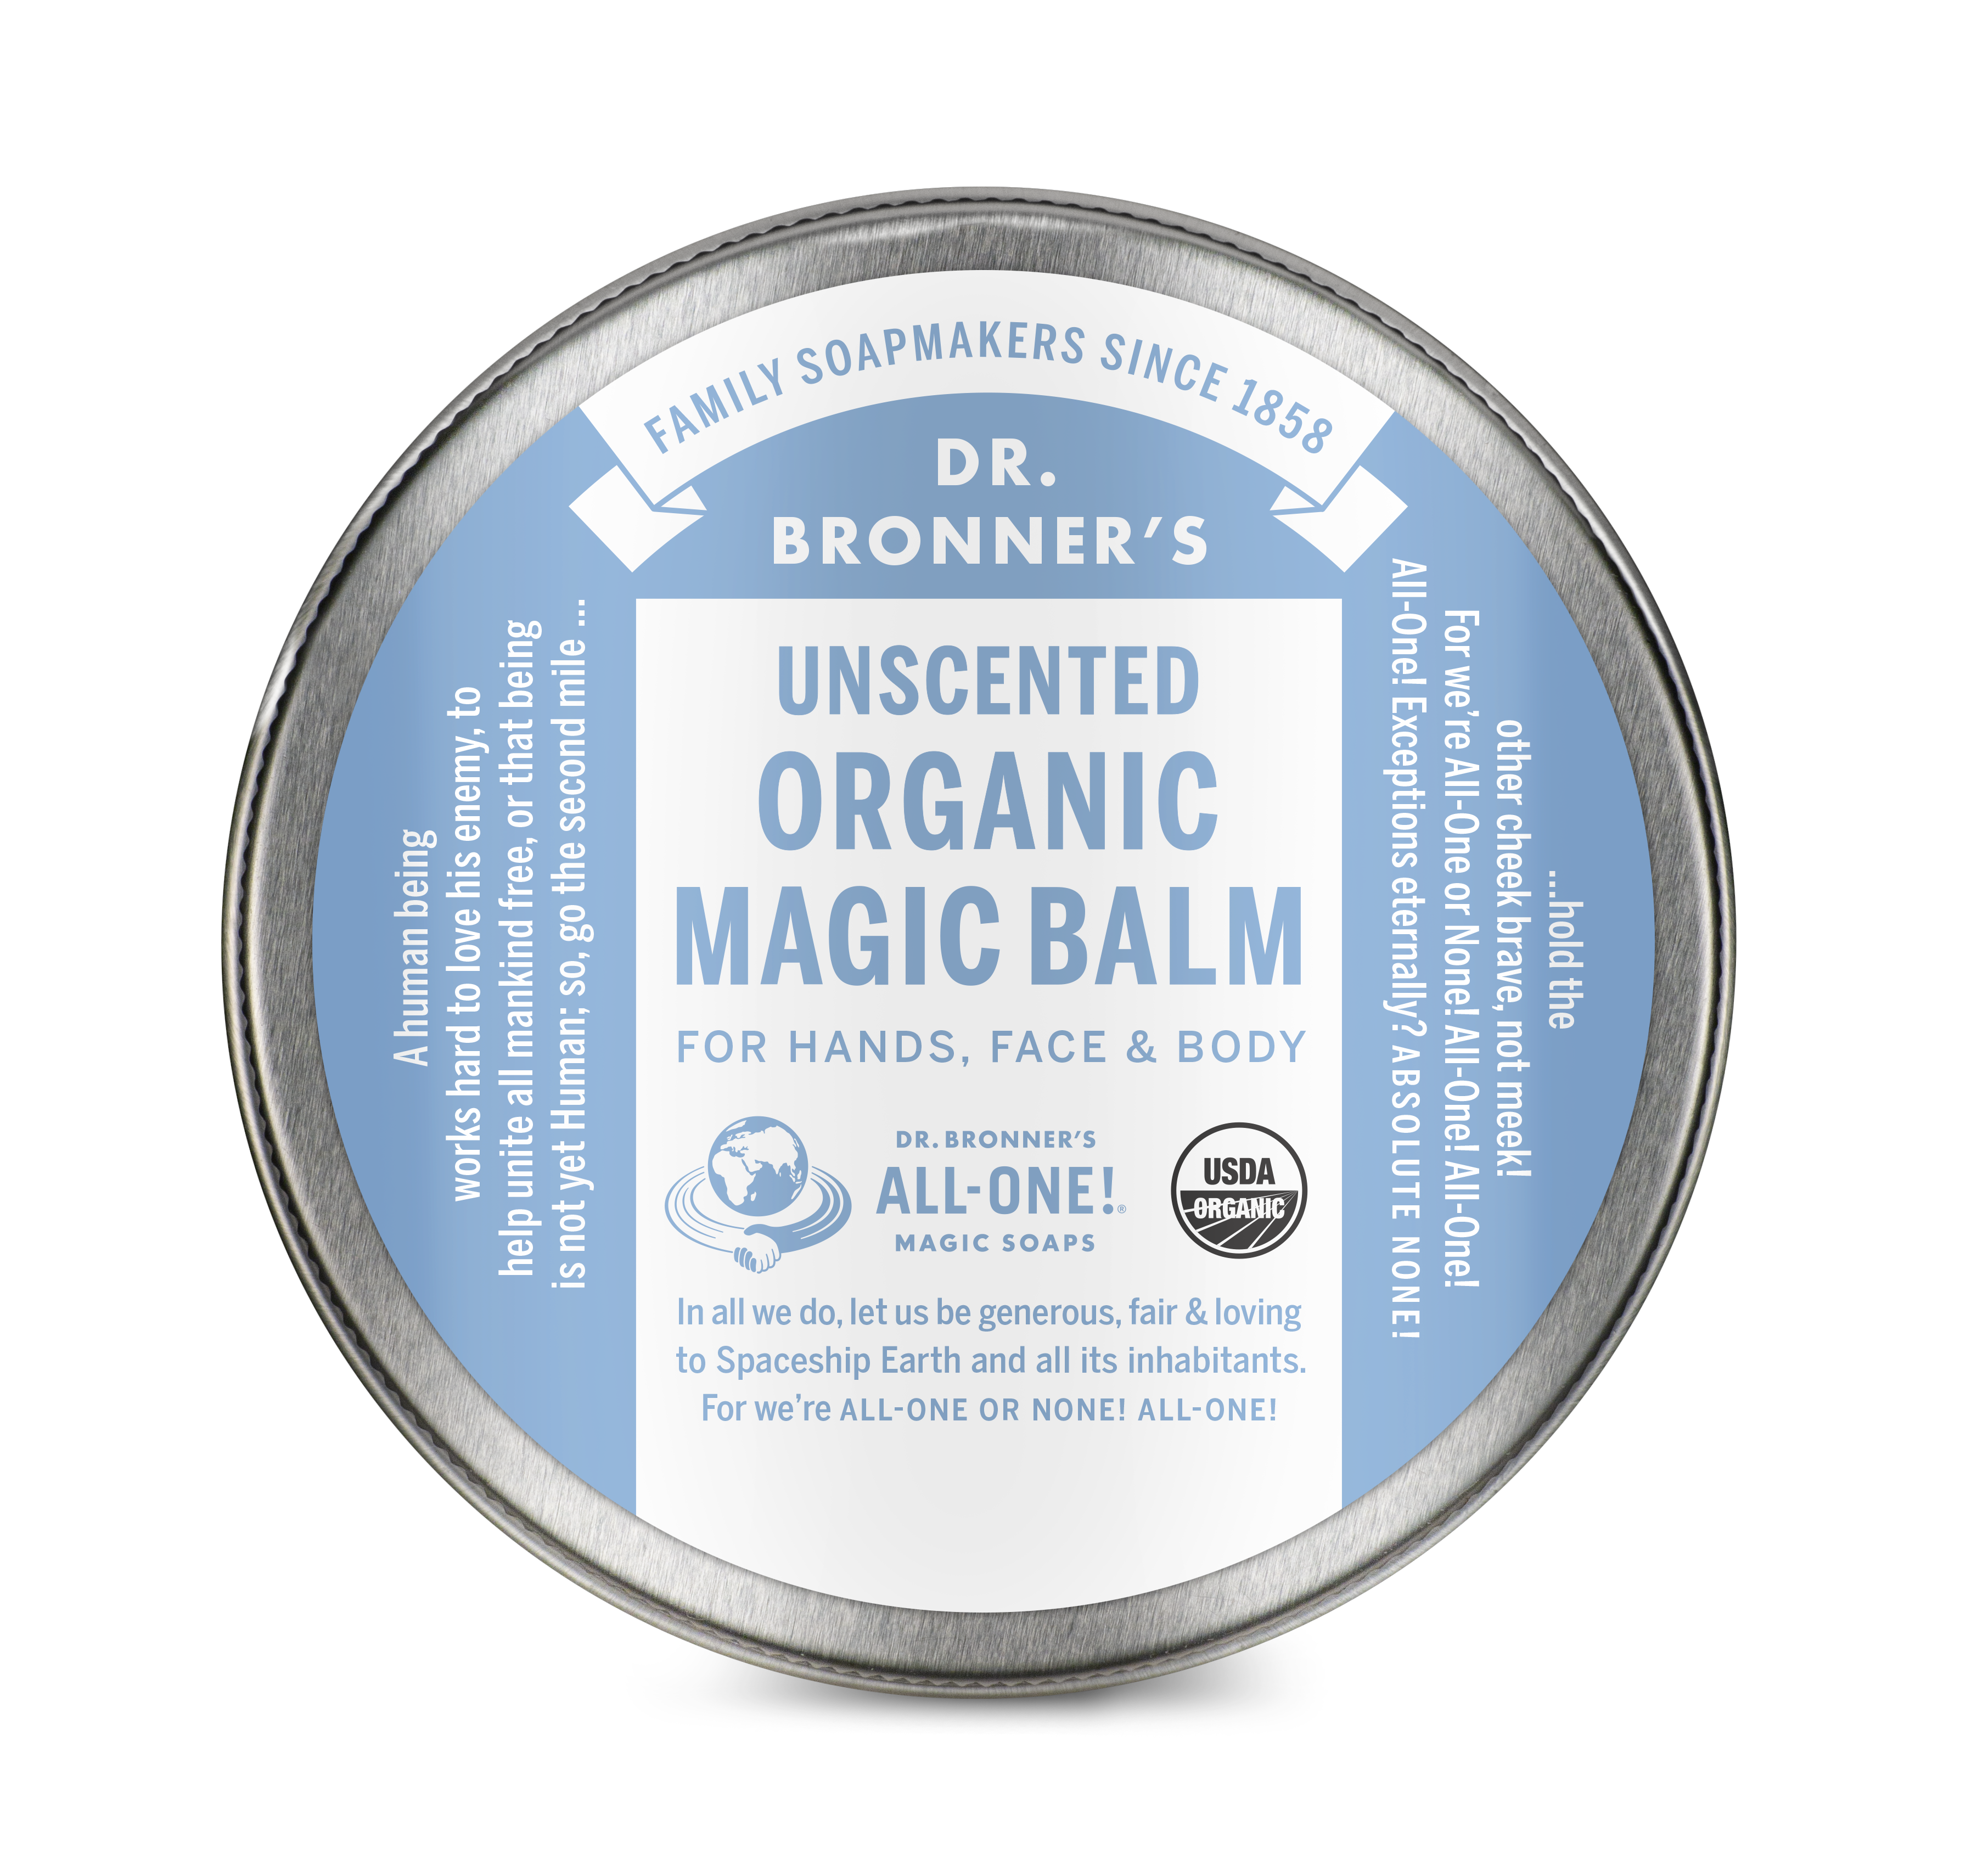
unscented organic magic balm
Mild formula for sensitive skin—made with organic oils
SIZE: 2 oz.

Slide 8
unscented organic magic balm
Mild formula for sensitive skin—made with organic oils
Requested by and developed for the UCLA Medical Center maternity ward
For babies and the very young
For anyone with sensitive skin
For anyone sensitive to scents
Ingredients: Organic Avocado Oil, Organic Beeswax, Organic Jojoba Oil, Organic Hemp Seed Oil, Organic Essential Oils, Tocopherol
*CERTIFIED FAIR TRADE INGREDIENTS
Made with U.S.-grown hemp seed oil!

Slide 9
naked organic lip balm
Mild formula for sensitive skin—made with organic oils
SIZE: 0.15 oz.

Slide 10
naked organic lip balm
Mild formula for sensitive skin—made with organic oils
For anyone with sensitive skin
For anyone sensitive to scents
Ingredients: Organic Avocado Oil, Organic Beeswax, Organic Jojoba Oil, Organic Hemp Oil, Organic Essential Oils, Tocopherol
*CERTIFIED FAIR TRADE INGREDIENTS

Slide 11
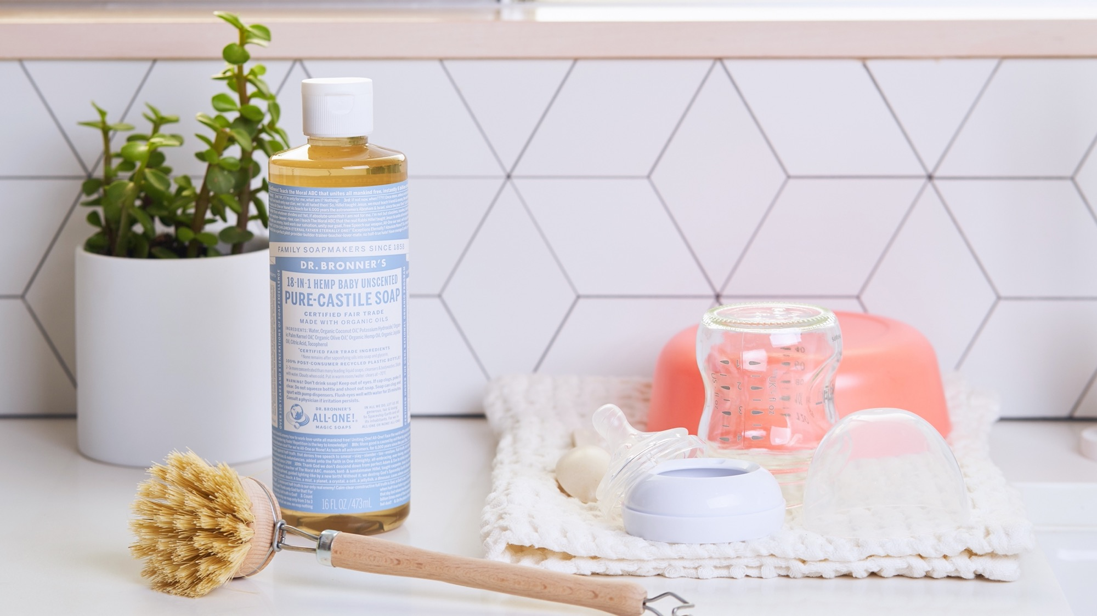
As seen in:
The Best Gifts for Pregnant Women, According to Pregnant Women

Slide 12
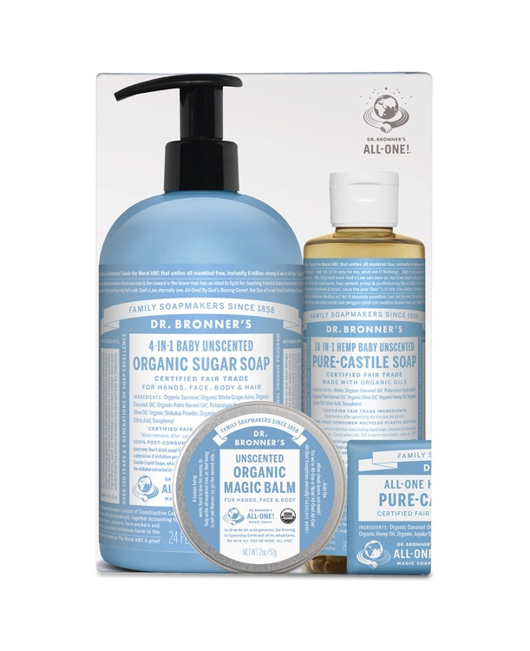
Baby Gift Set
Mild formula for sensitive skin—made with organic oils
BABY GIFT SET PRODUCTS: 24 oz. Sugar Soap, 8 oz. Liquid Soap, 2 oz. Magic Balm & 5 oz. Bar Soap

Slide 13
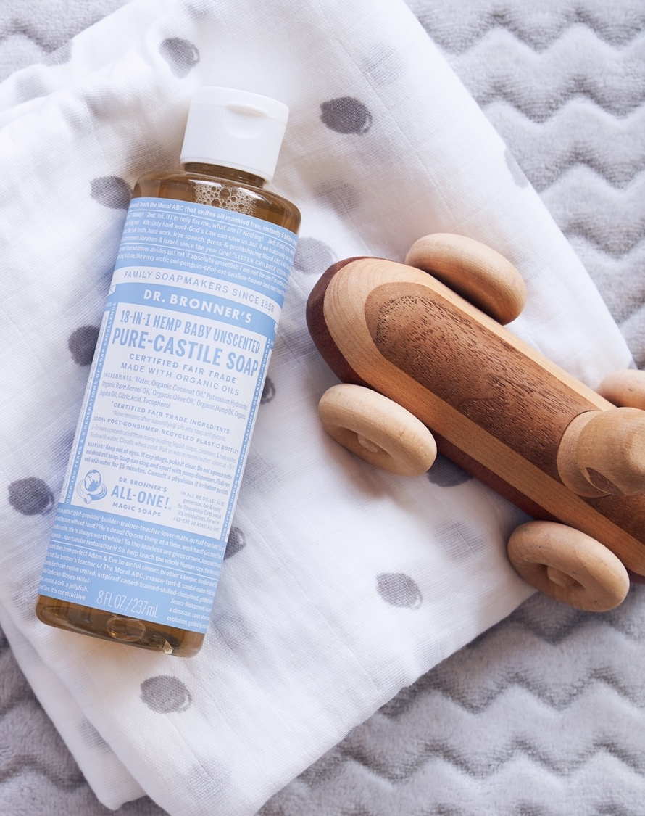
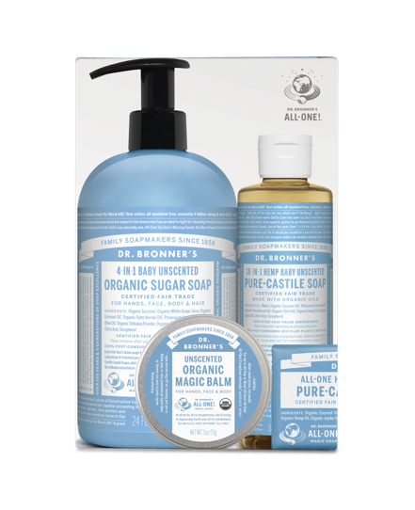
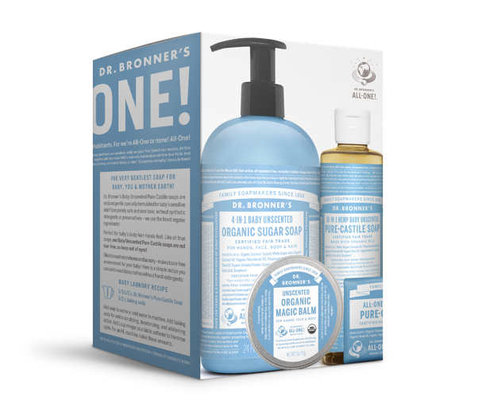
As seen in:
Totally Green Baby Shower Gift Ideas
Dr. Bronner’s Treats Baby with New Set

